Slide 1
New physics searches at the LHC: the SUSY perspective
Paris Sphicas
CERN & University of Athens
Latsis symposium 2013: Nature at the Energy Frontier
ETHZ, June 03, 2013
Introduction
  Aka how we got to here
R_{P}–conserving SUSY
Natural SUSY
R_{P}–violating SUSY
Outlook

Slide 2
Preaching to the choir: to this date, there is plenty of room for new physics
Some real and some virtual reasons to believe in new physics
Real reasons: dark matter & ν masses
Virtual reasons: naturalness

Slide 3
Preaching to the choir: to this date, there is plenty of room for new physics
Some real and some virtual reasons to believe in new physics
Real reasons: dark matter & ν masses
Virtual reasons: naturalness
Supersymmetry offers answers to both (virtual and real motivations)
[And when cornered, half of the reasons are good enough]

Slide 4
Experimentally: signatures
R_{P} conservation:
  Stable LSP, weakly interacting, “missing transv energy” (ME_{T})
  Mostly strong production – rich cascades; many jets, a few leptons
  When going after the stop: b-tagging
R_{P} violation:
  The dreaded possibility (harder, except in corners of possibility space)
  Hadronic modes: to first order, no ME_{T} (veeery hard); Leptonic modes more promising
  Strong production, but several interesting new EWK-ino production mechanisms; even more jets and leptons
Prompted by R_{P} violation, but still possible with R_{P} conservation: exotic SUSY particles
  Long-lived particles (some are even “stable”)

Slide 5
Introduction
Short historical prelude (aka how we got to here)

Slide 6
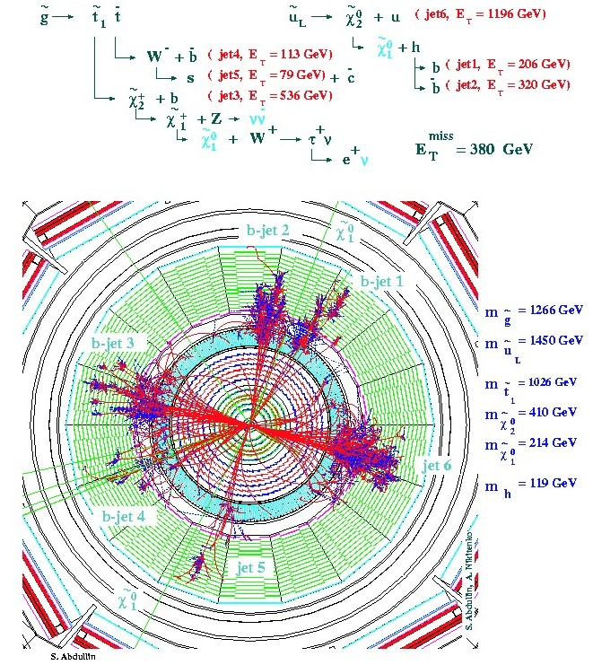
“Turn on the LHC and find Higgs & SUSY”
ATLAS and CMS were designed to do this; they were “guaranteed” to find the Higgs – period; right away
  In fact: SUSY is strongly produced, so will be observed first
    For the “impatient”: join SUSY physics group
Many hard Jets
Large missing energy
  2 LSPs
  Many neutrinos
Many leptons
In a word Spectacular!
Text & simu from 1999

Slide 7
SUSY search with ME_{T}: summary of 2010
CMS example (ATLAS similar); no signs yet. But all analysis methods in place; now need more data (2011!)
Corner around which SUSY would lie
Transp from
March 2011

Slide 8
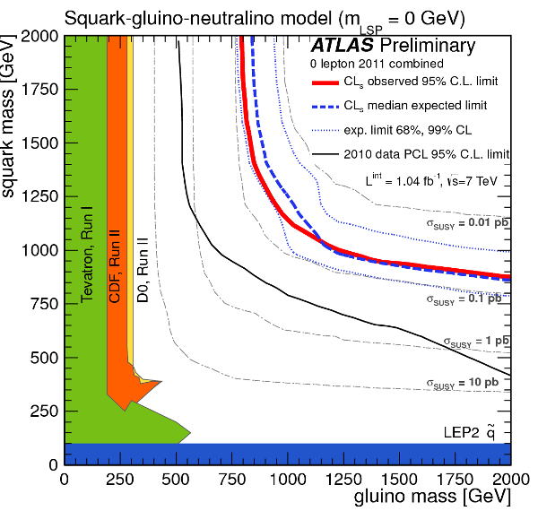
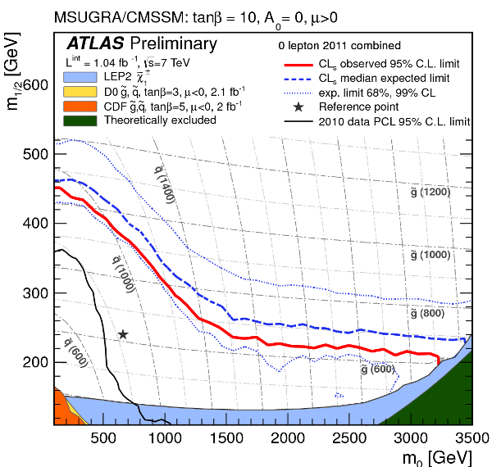
In brief: SUSY moving further out
Simplified model: two squark (q) generations, m(χ₁⁰)~0
m_{g}>800 GeV m_{q}>850 GeV
Equal mass case: m_{g}=m_{q}>1.075 TeV
MSUGRA/CMSSM:
tanβ=10, A₀=0, μ>0
Equal mass case:
m_{q}=m_{g} > 980 GeV
2010→2011
2010→2011
end 2011

Slide 9
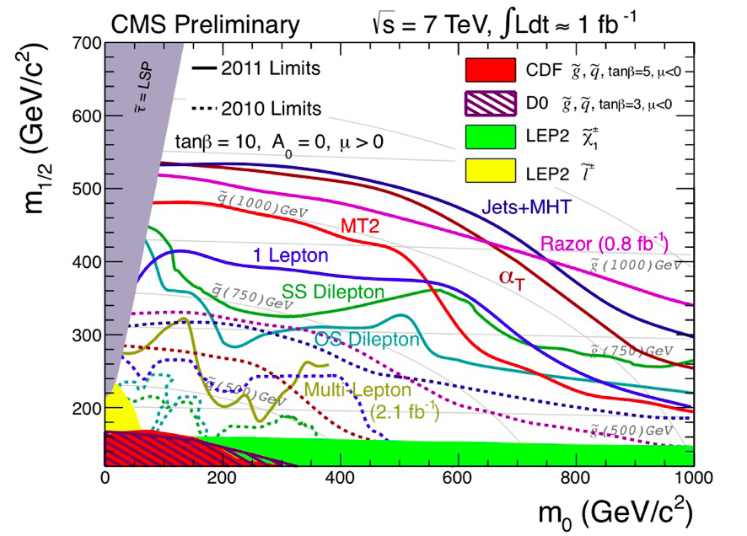
Constrained MSSM
Corner around which SUSY used to lie
end 2011

Slide 10
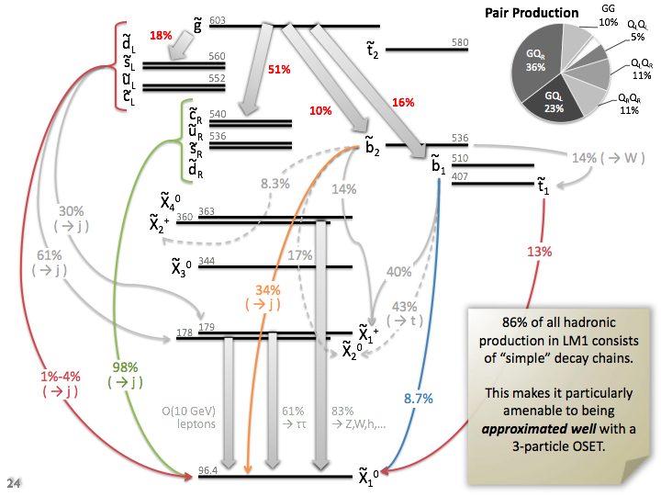
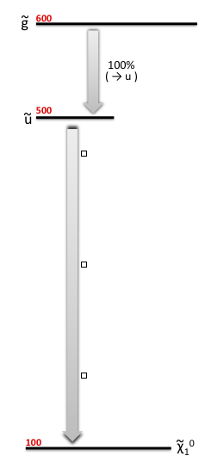
The dawn of a new era: use of Simplified Model Spectra
CMSSM
What we put in:
much simpler…
Simplified Model Spectrum (SMS)
with 3 particles, 2 decay modes

Slide 11
The dawn of a new era: use of Simplified Model Spectra
CMSSM
What we put in:
much simpler…
Use with caution!
Or, at a minimum,
conclude with caution!
Simplified Model Spectrum (SMS)
with 3 particles, 2 decay modes

Slide 12
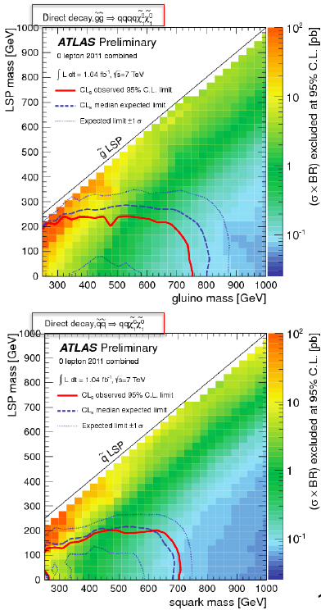
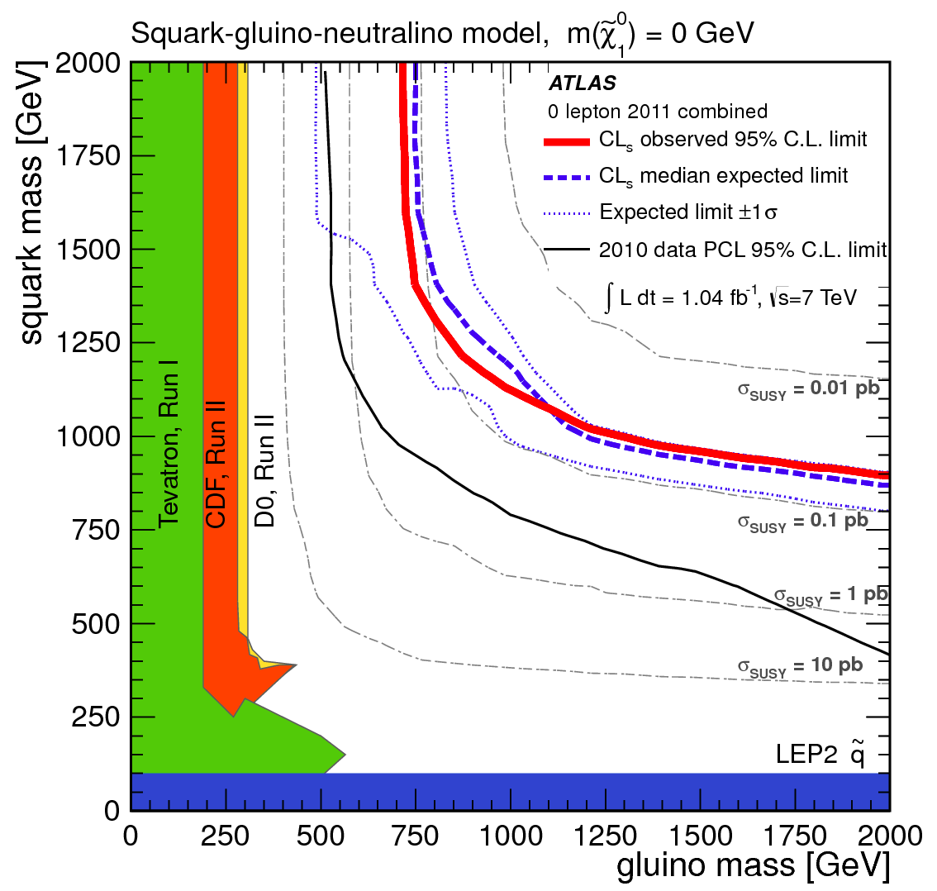
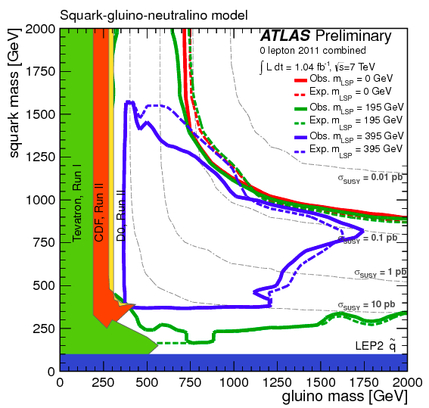
SMS: allow parameter variation
Effects can be significant;
e.g. varying M_{LSP}:
  RED: M_{LSP}=0
  Green: M_{LSP}=195 GeV
  Blue: M_{LSP}=395 GeV
Gluinos
Squarks

Slide 13
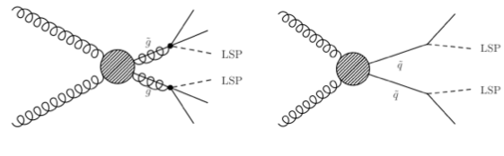
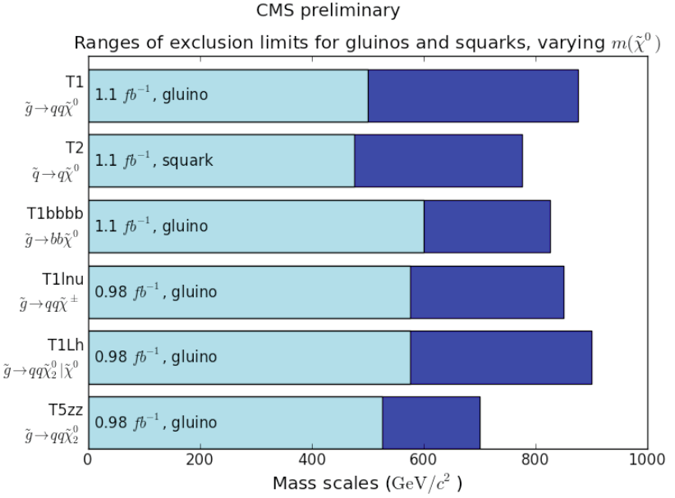
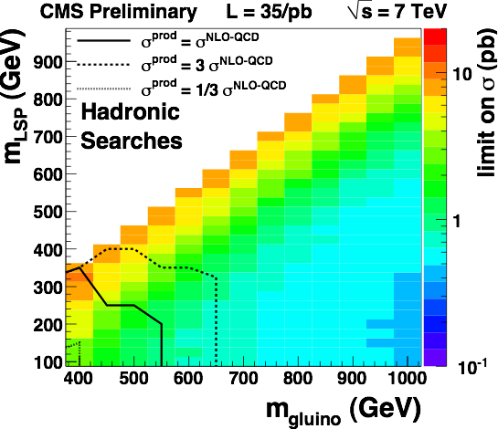
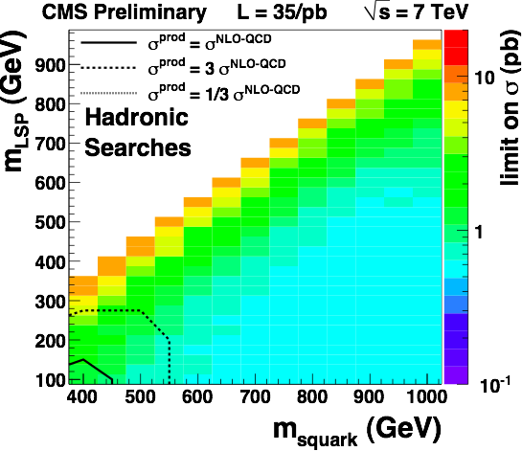
Simplified Model Spectra
Started with squark and gluino pair-production topologies
Limits are “best of N” searches (usually not a combination)
Black lines are QCD-like cross sections
Theoretical uncertainties like ISR simulation important (under study)
Theoretical uncertainties not included
Caution: usage of SMs is the sole responsibility of the user. SUSY and all its incarnations bear no obligation for any and all hasty conclusions (from SMS’s).
M(gluino)>0.4-0.5 TeV
end 2011

Slide 14
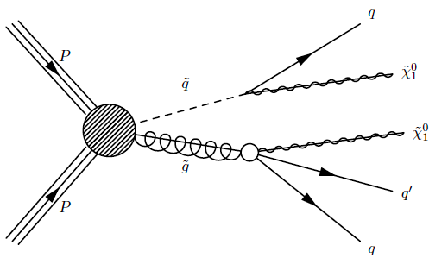
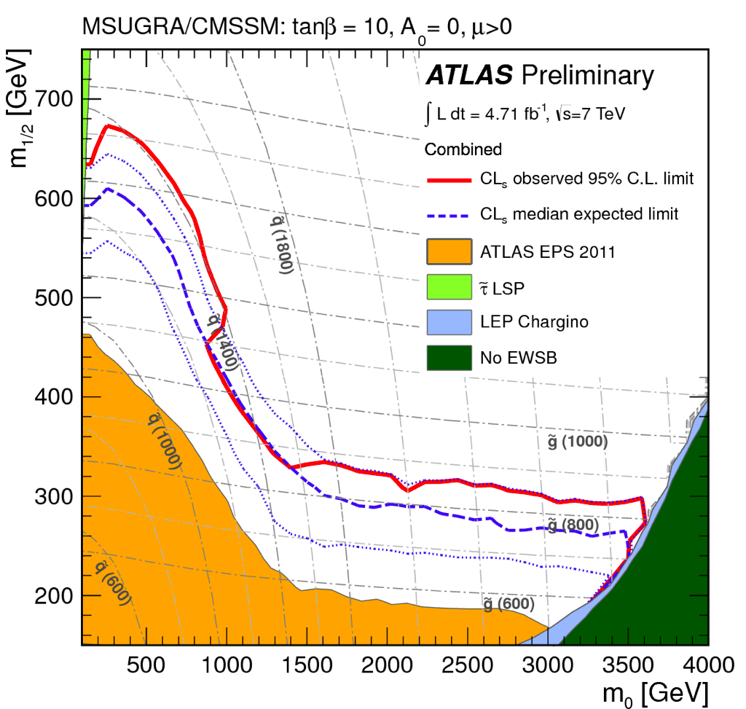
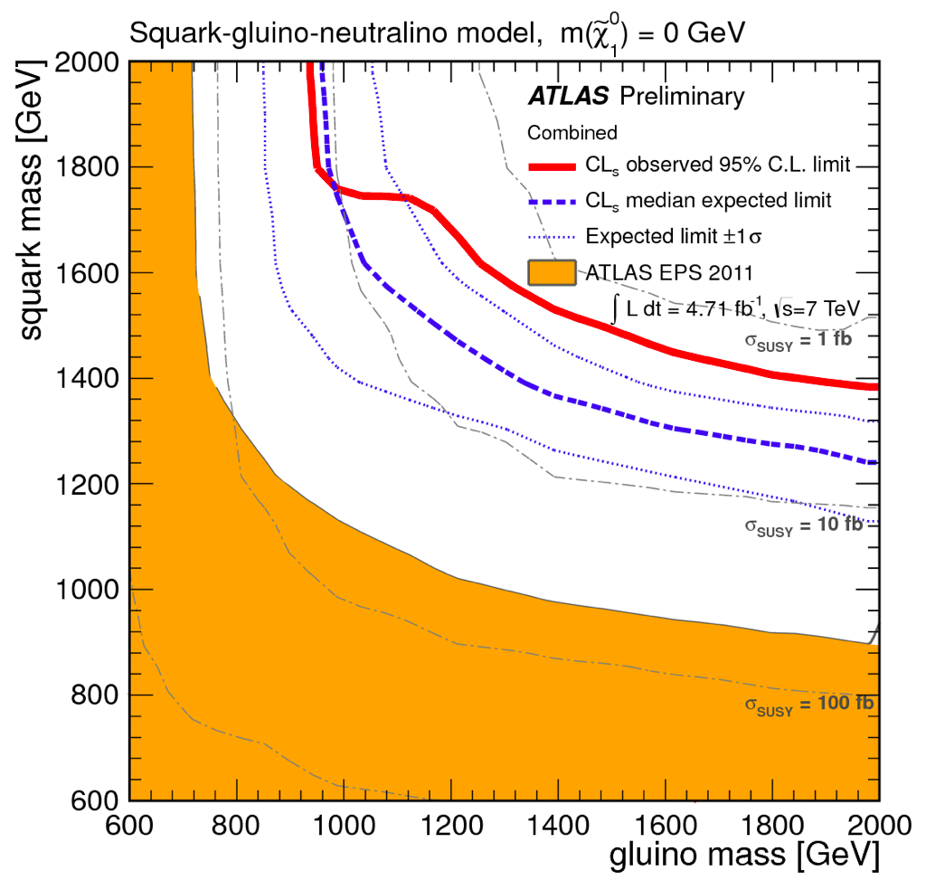
With the full 2011 data (~5 fb^{–1})
Example ATLAS SUSY search: 2-6 jets plus MET
  Veto leptons (all hadronic)
CMSSM
SMS
M_{sq} = M_{gl} ≳ 1.4 TeV
M_{sq} ≳ 1380 GeV
M_{gl} ≳ 940 GeV

Slide 15
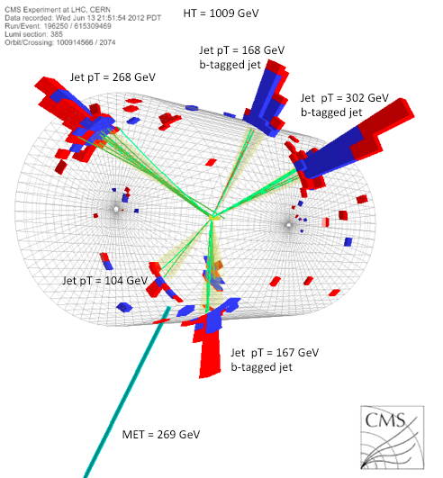
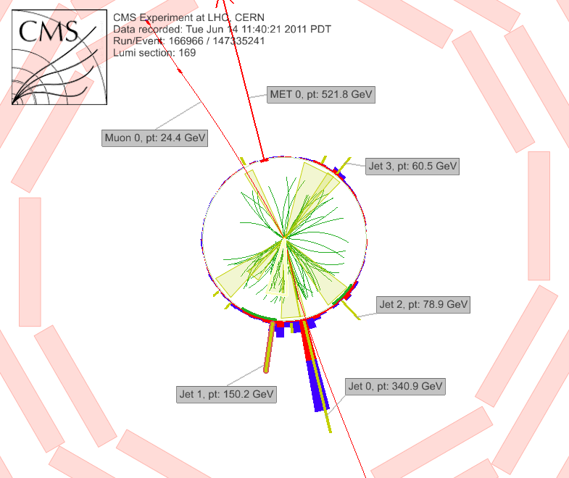
What we’ve been looking for

Slide 16
What we have found: QCD, W/Z+jets, t-tbar

Slide 17
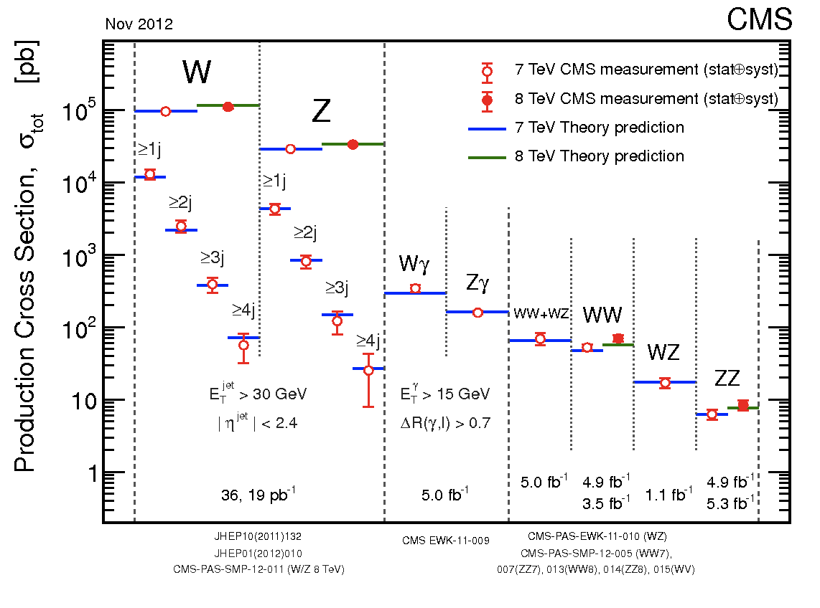
Prerequisites: understand W/Z+jets; ttbar

Slide 18
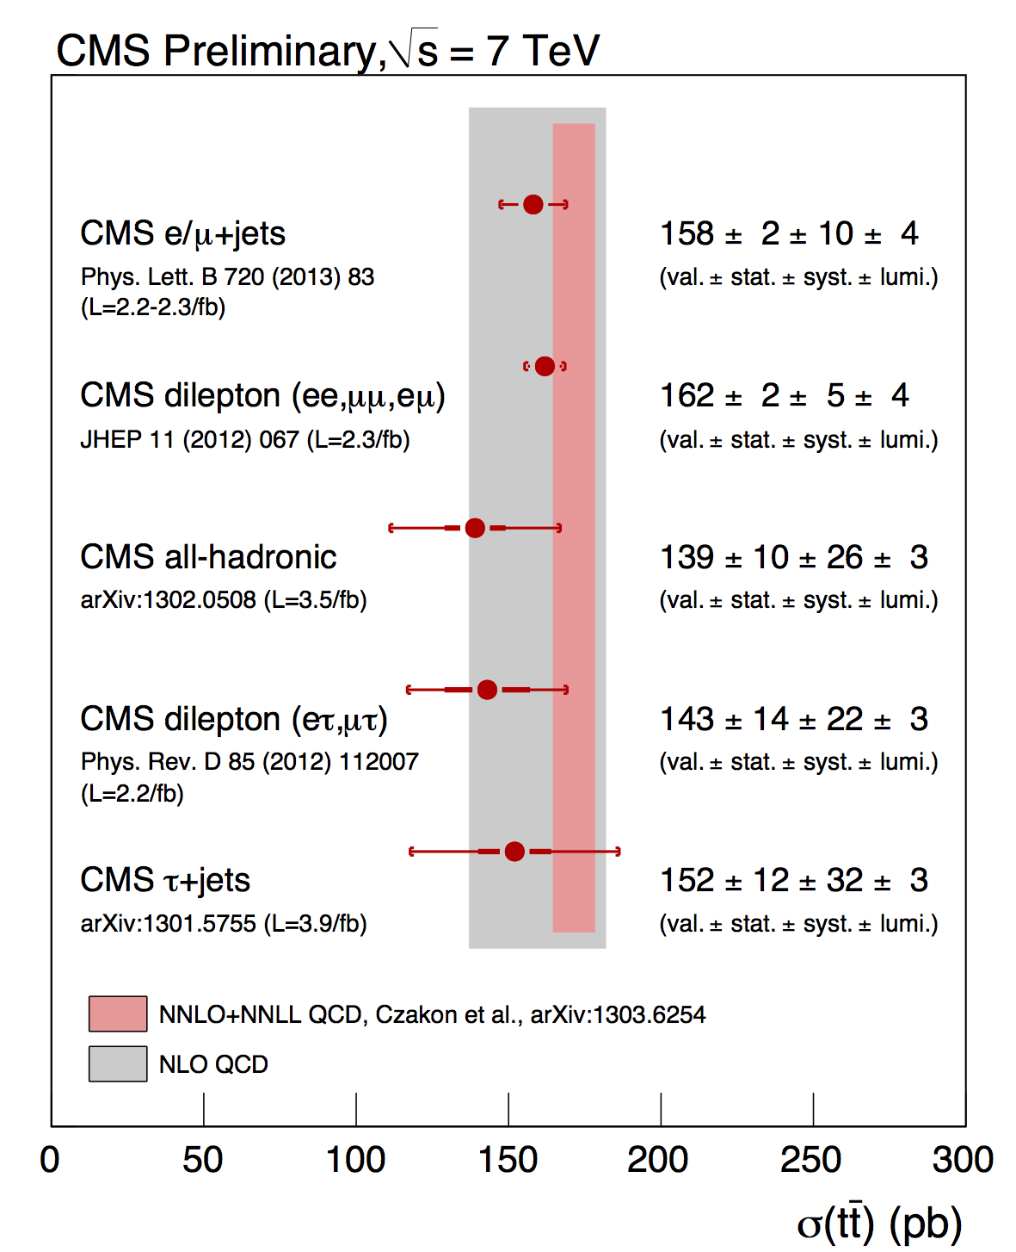
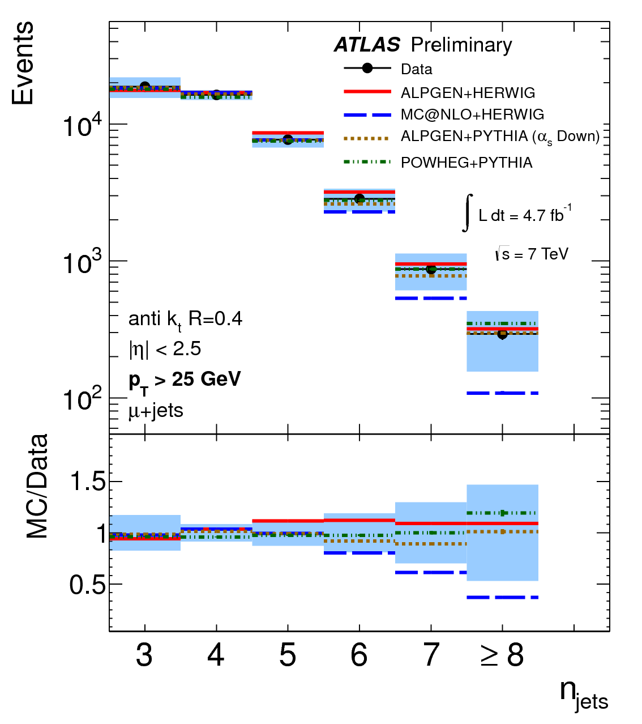
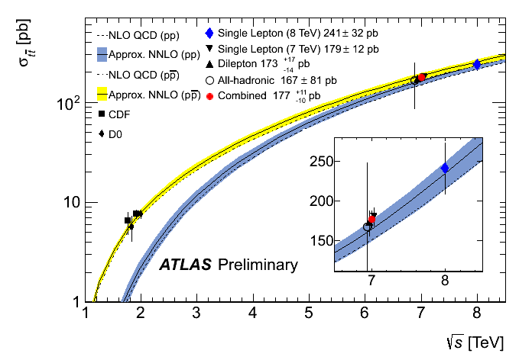
Mostly understood: currently studying associated jet production (also with b-bbar)

Slide 19
R_{P}–conserving SUSY
2nd-gen results at 7 TeV; some 8 TeV results
Light quark spartners

Slide 20
Considerable ingenuity in developing new methods
0-lepton searches
  New topological variables
    α_{T} (the “QCD killer”)
    Razor (hunt for a mass bump)
    M_{T2}, etc – extensions of W decays to massless neutrinos
  Understand full hadronic component (H_{T}, ME_{T} distribution)
    Cut on highest mass scales (e.g. M_{eff})
Leptonic (on, two, multiple) searches
  Looking at tails of distributions.
  Topological variables help less, because missing neutrinos in addition to χ₀.

Slide 21
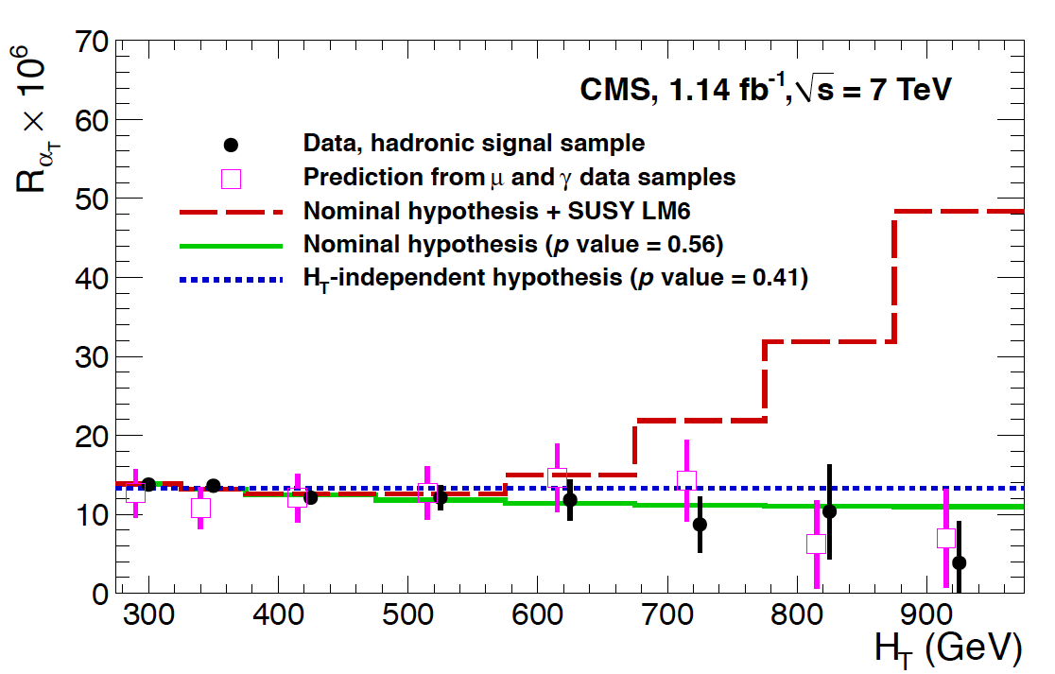
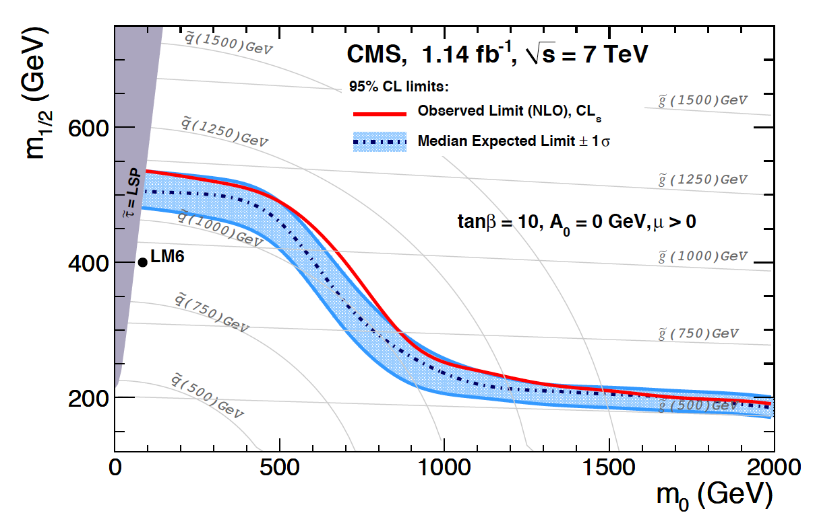
“Alpha_T” (α_{T})
0l (all-hadronic)
Well-measured QCD: α_{T} = 0.5
Jet mismeasurements: α_{T}<0.5
For higher jet mutiplicities: merge jets: form two “superjets”
2 jets
Evolution of R(α_{T}) with H_{T}
1st-gen results

Slide 22

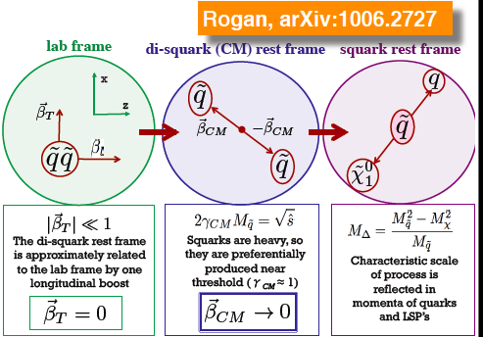


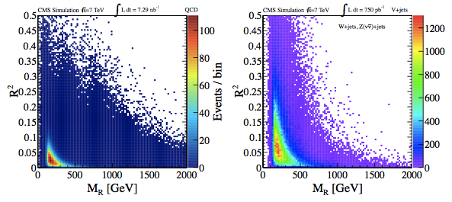
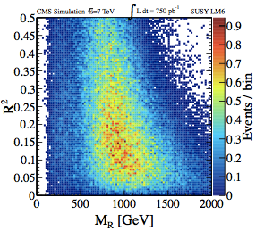
The “Razor” (I)
Two equal-mass sparticles at ~rest
For γ_{CM}→1; M_{R}→M_{Δ}
M_{T}^{R} has endpoint: M_{Δ}
Signal: ~ ½; Bkg: falling (~exp)
Bkg
vs
Sig

Slide 23
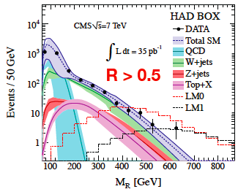
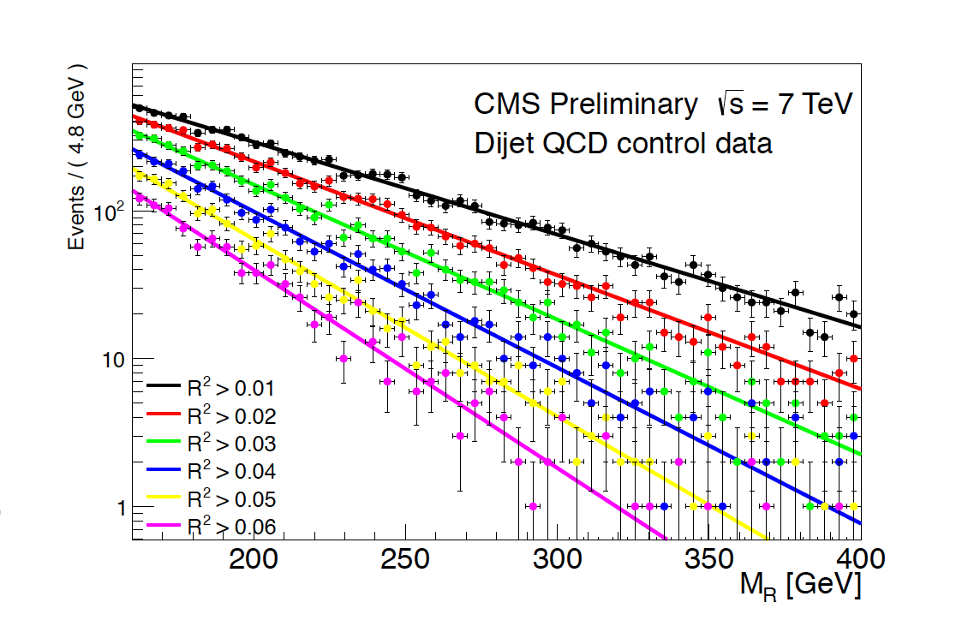
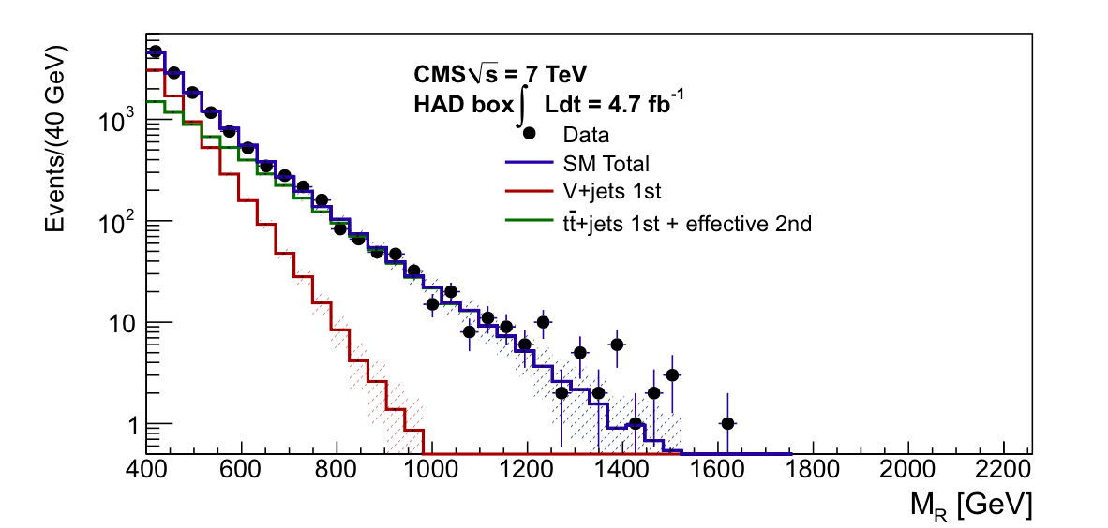
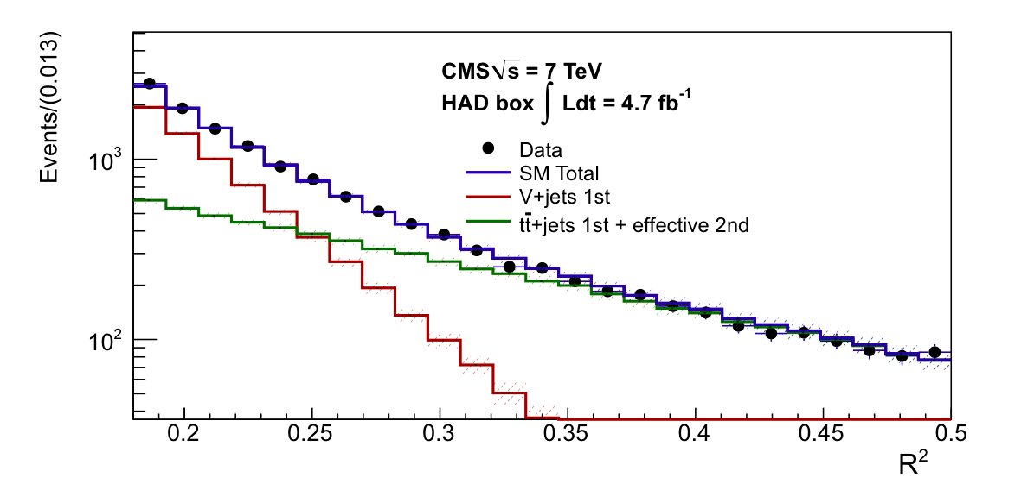
Searching with the Razor (II)
First Razor
result
Advantages:
  turns SUSY search to a bump hunt
  All lepton multiplicities (including 0)
Fit 2D (R²,M_{R}) spectrum: QCD+other
  double exp for QCD bkg
  W+jets/ttbar bkg also falling
  ~exponentially

Slide 24
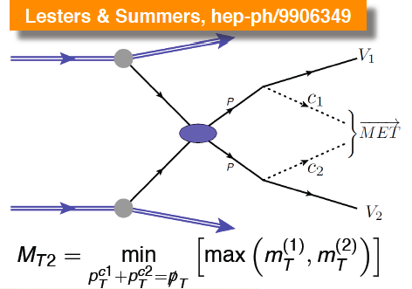
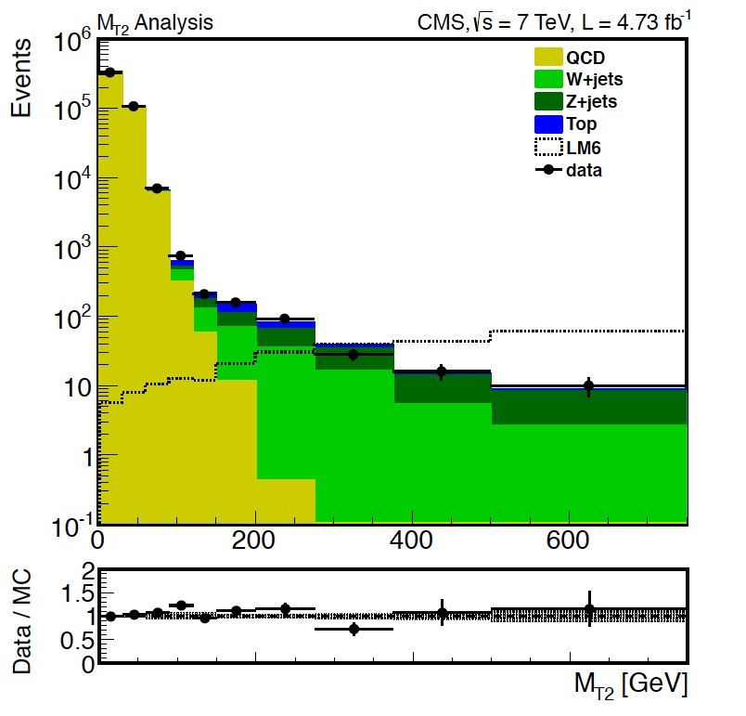
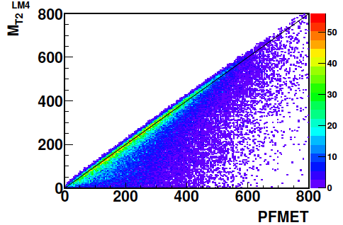
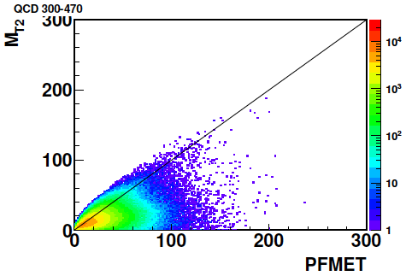
Stransverse mass (M_{T2})
Generalize transv. mass to two invisible particles (M_{miss})
  Simplest case: no extra jets; M_{miss}=0
  Always with pseudojet formation
  For signal: M_{T2}~ME_{T}
  For bkg:
    Well-measured dijets: M_{T2}~0
    Mis-measured evs: M_{T2}< ME_{T}

Slide 25
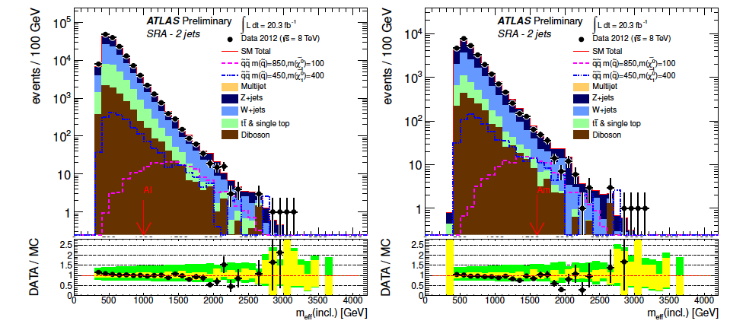
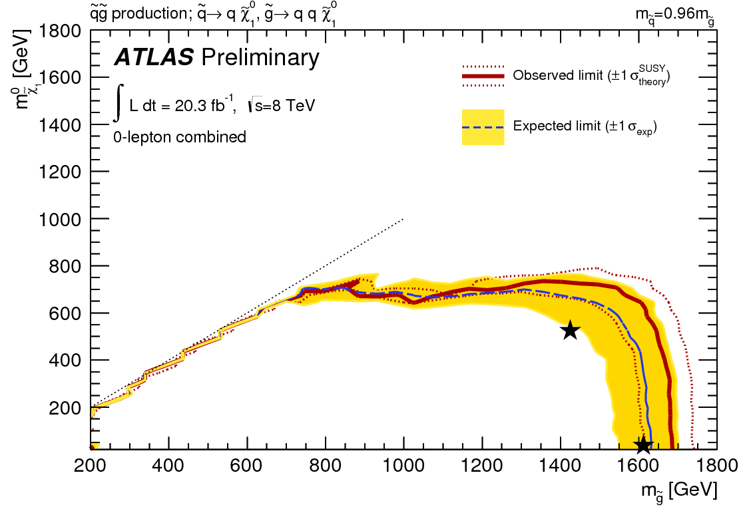
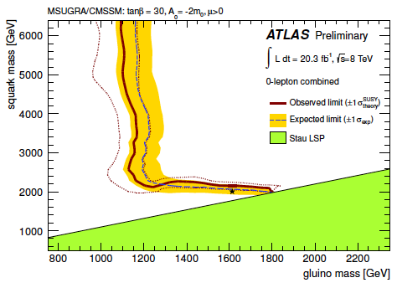
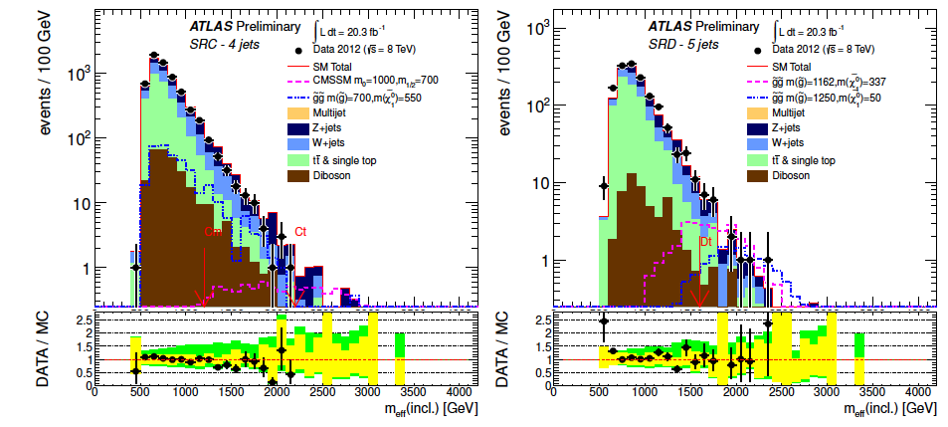
And the full inclusive jets+MET spectrum
Effective mass:
Analyze different jet multiplicities
2 jets
4 jets

Slide 26
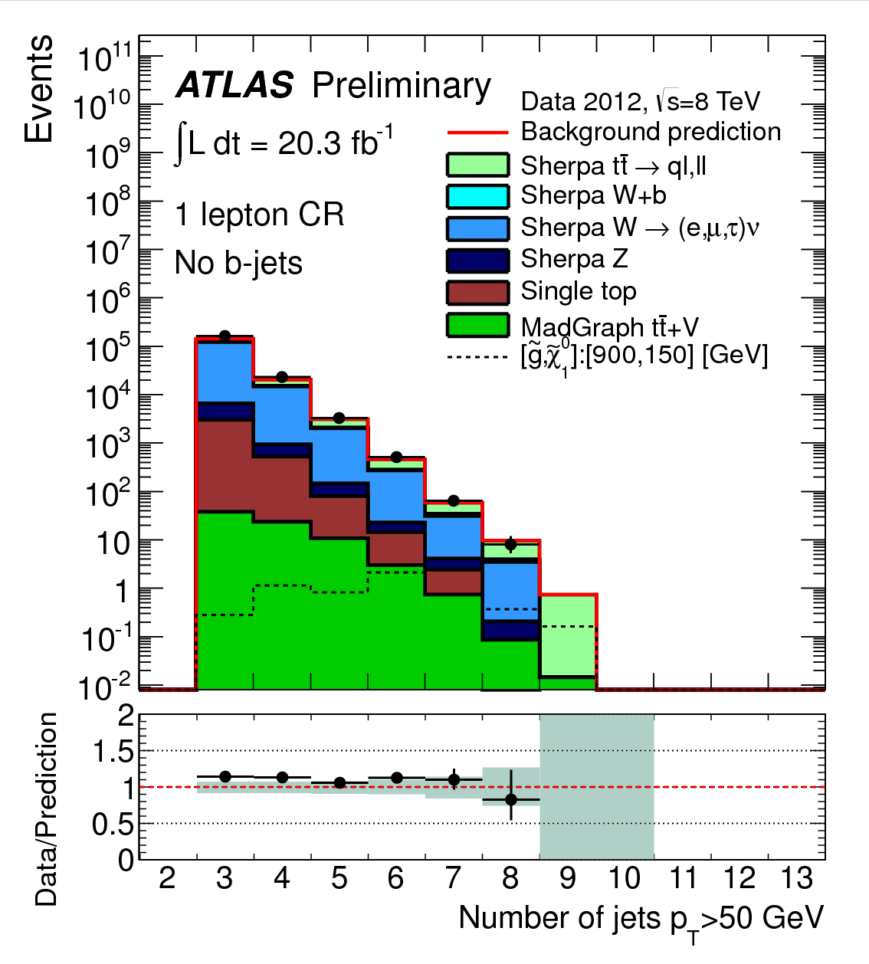
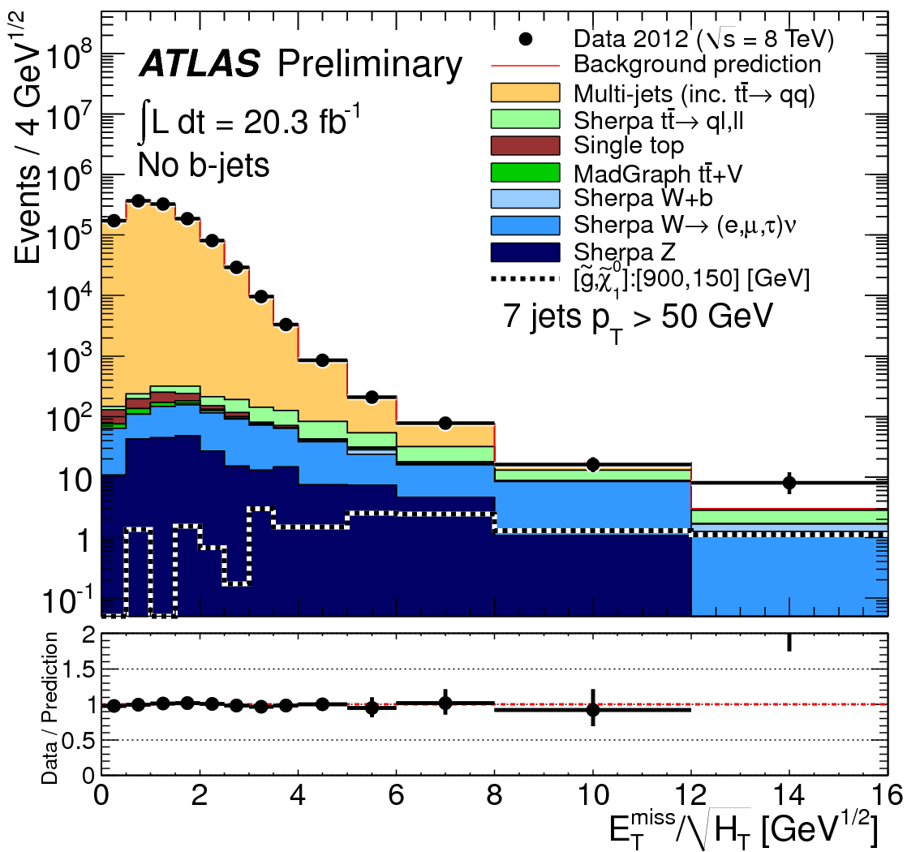
Searching with up to 10 (!) jets
More in the “natural SUSY” section later

Slide 27
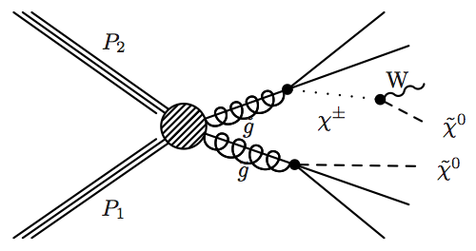
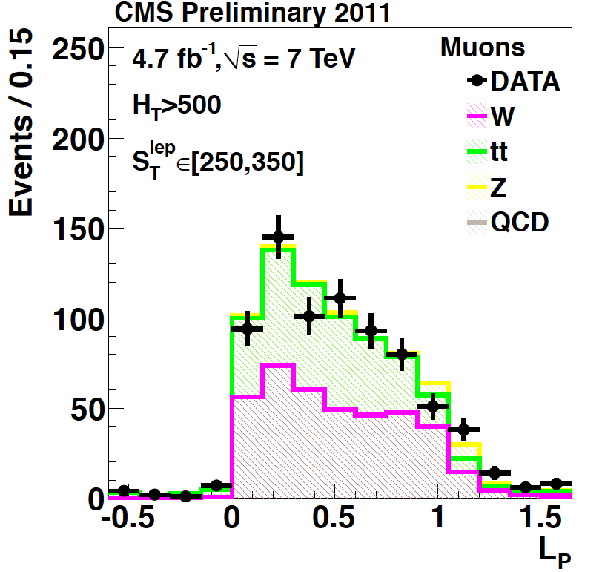
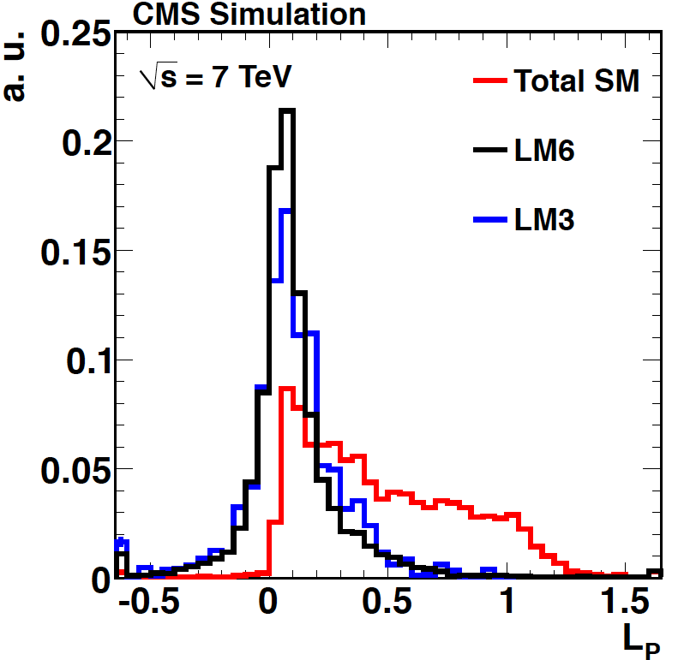
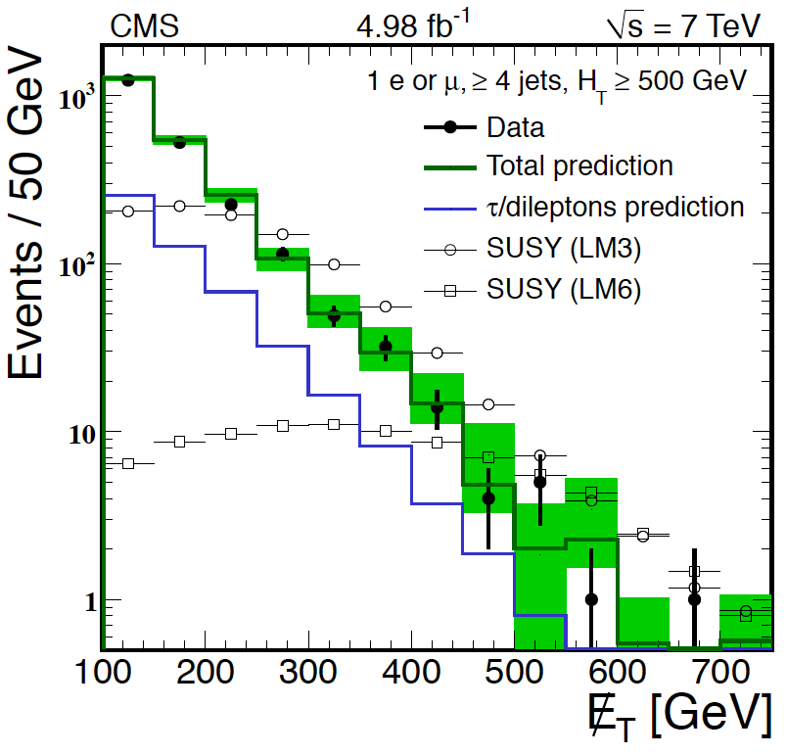
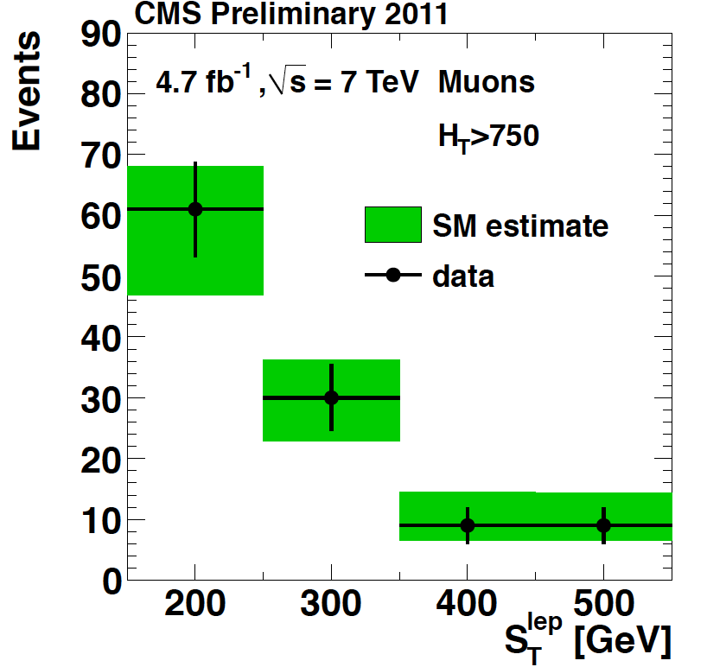

Single-lepton searches
Data-driven approaches to get SM background
Lepton Spectrum:
Lepton → ME_{T}

Slide 28
Single-lepton searches: inclusive
Data-driven approaches to get SM background
Lepton Spectrum:
Lepton → ME_{T}

Slide 29
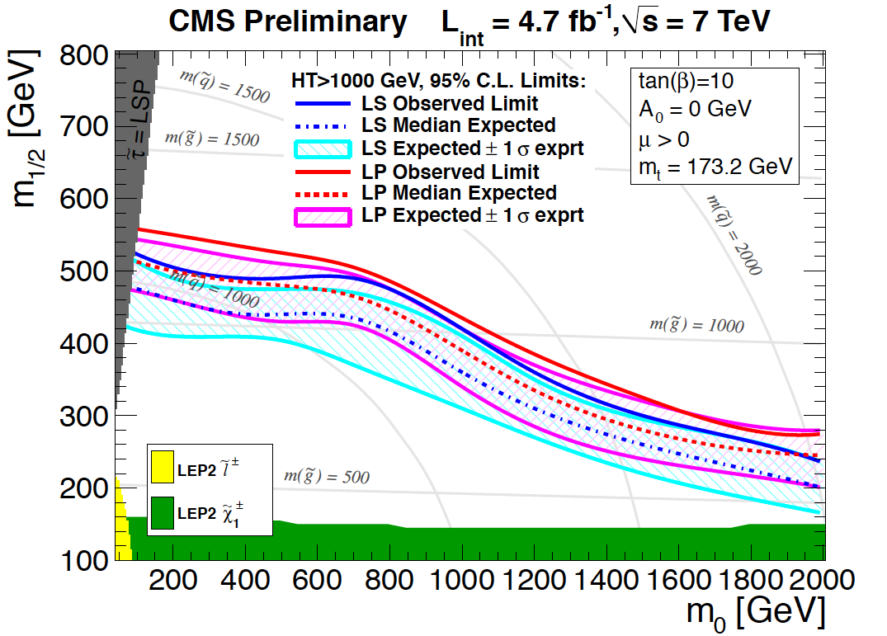
Single-lepton searches: inclusive
Data-driven approaches to get SM background
Lepton Spectrum:
Lepton → ME_{T}

Slide 30
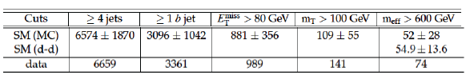
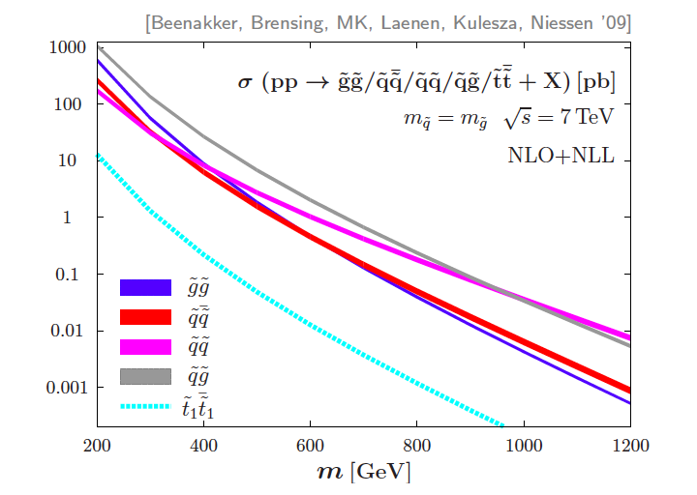
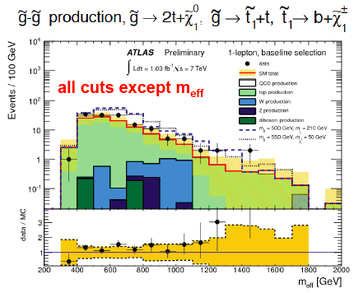

First stop searches (ATLAS)
SUSY will be unnatural if m_{stop}>1 TeV: this is a real challenge for the LHC experiments!
σ(stop):
down by x8

Slide 31
First stop searches (ATLAS)
SUSY will be unnatural if m_{stop}>1 TeV: this is a real challenge for the LHC experiments!

Slide 32




Dileptons
Without Z

Slide 33




Dileptons: with a Z :
SM: Z+jets (with “bad” ME_{T}) + tt dileptons (large ME_{T})
  Bkg: +/– symmetric; Signal: positive tail
          For t-tbar: use eμ
Alternate method: MET templates from data (γ+jets & multijet events)

Slide 34


ATLAS SUSY searches (highlights)

Slide 35
Stepping back: a theory that has consistently missed its rendez-vous with experiment*…
And that leaves some issues unsolved…
Scalar(s) Under Stress? Yes!
*In the past 30 years

Slide 36
Do [should] we still believe in SUSY
1. SUSY no-lose theorem: so many new params (N_{MSSM} = N_{SM} + 105) that it can never be declared dead (even the CMSSM); unless naturalness arguments used
2. Can it be that nature has missed opportunity to solve three major pending issues (M_{H}; Dark Matter; couplings) in one swoop?
  Three goods for the price of two [one new principle (B→F; F→B) and one unknown symmetry-breaking mechanism]
3. Alternative theories solve only one or two of these issues – so it allows us [SUSY-ers] to consider less “powerful” versions of SUSY
As long as it solves the naturalness issue (which conveniently implies weak-scale SUSY)
Today’s motto: it’s there, but it has escaped. How?

Slide 37

SUSY: what we do not know
The facts: despite conventional wisdom, SUSY is quite predictive: it specifies spins & couplings of superpartners
  At least as predictive as the SM (if CKM not measured)
Agnostic approach: consider all possible mass hierarchies: there are 9! = 362880 of them
  ME_{T}: 4x8! (161,280) cases, LSP=weakly-interacting, neutral particle; phenomenology depends crucially on mass hierarchy
  CHAMPs: 8! (40,320) cases, LSP=e_{R} (charged, color-neutral); signature: CHAMP (independently of hierarchy)
  R-hadrons: 4x8! (161,280) cases, LSP=colored object; again, independent of hierarchy
arXiv:1008.2483: “How to look for SUSY under the lamp-post at the LHC”; P.Konar, K.Matchev, M.Park, G.Sarangi

Slide 38


Natural relationship between Higgs & SUSY
“We will always have the stop” (top squark)
Previous limits not applicable, due to (expected) different decays of the stop
Previous limits not applicable when ME_{T} is small (Compressed spectra; or even zero? R_{P} violation?!?)
Other signatures that would have (easily!) escaped?

Slide 39
R_{P}–conserving SUSY
“Natural SUSY”
(third-gen squarks; also gaugino searches)

Slide 40
Cross sections determine “strategy”
Direct
Strong production
Gluino –induced

Slide 41


Cross sections determine “strategy”
EWK production

Slide 42








Direct stop search
Top squark decays: in large region, ~ “top+ME_{T}”

Slide 43



Numerous analyses
e.g. ATLAS MET searches
  N_{lep}=0; 2 b-jets; N_{jet}=0 & 4
  N_{lep}=1; 1 b-jet; N_{jet}=3
  N_{lep}=2
  Z (+ lepton) + 1 b-jet + N_{jet}=2–4
  + heavy stop2 search
“Tag” two top quarks (top: 3-jet combinations closest in η-φ, with 80<M_{3J}<270);
look for excess in ME_{T}

Slide 44







Stop search – continued
  N_{lep}=1; 1 b-jet; N_{jet}=3
1 top tag, look at large MET
BDT

Slide 45

Summary: limits on direct stop production

Slide 46




Gluino-induced stop production (I)
Spectacular signatures with high jet and b-tag multiplicities

Slide 47





Gluino-induced stop production (II)
With four top quarks: large lepton multiplicities (+SS)
Same-Sign

Slide 48


Gluino-induced stop: summary

Slide 49




EWKinos (I)
Two leptons, OS + MET
M_{T2}
M_{CT,P}

Slide 50




EWKinos (II)
Limits

Slide 51





EWKinos
Large set of searches
  2 leptons + MET
  2 taus + MET (C1C1 pair production with staus)
  3 leptons + MET (for sleptons)
  4 leptons + MET (N2+N3); also RPV

Slide 52
A word on models
It would be useful to have a
“NatMSSM”
Even if this sounds a bit naïve,
the point is that with the (SUSY) SMS
and an accumulating set of limits we have an overall “interpretation issue”
This goes beyond limits; prepare for the day we will have multiple 2-3σ excesses; correlation of different channels

Slide 53
R_{P} violating SUSY
Mainly leptonic channels

Slide 54




RPV with hadrons only
Very, very hard… gluino → 3 jets
  Combinatorics! Take all triplets,
  QCD: M_{3j} ~ ΣP_{T}(jets); SUSY: M_{3j} ~ M_{g}
  Apply M_{3j} < ΣP_{T}(jets) – 160 GeV
Assumes
Br 100%

Slide 55







Easier channel: RPV with leptons

Slide 56







RPV: 4 leptons

Slide 57

Natural SUSY with RPV: stop
Leptonic RPV
λ₁₂₂ (e,μ) λ₂₃₃ (μ,τ)
Semi-lep
λ’₂₃₃ (μ,b,t)

Slide 58

Summary of RPV (with leptons) (e.g. CMS)

Slide 59
Exotic SUSY
Long-lifetime & “strange” signatures
(RPV, GMSB, Split-SUSY, hidden valleys…)

Slide 60
Heavy Stable Charged Particles
They appear in numerous SM extensions:
  SUSY (split SUSY: gluinos much lighter than squarks → long lifetime; GMSB models: stau NLSP, decaying via gravitational coupling only; light stop with only a limited number of decay modes)
  Other: hidden valleys; GUTs; …
Two types of signatures:
  MIP: HSCP passes through tracker & muon chambers
  Strongly interacting: R-hadrons traversing material can flip Q or become neutral (for example in gluino hadronization). Majority would not reach muon chambers
Analyses
  dE/dx: Massive, charged particles traversing detector: highly ionizing tracks in tracker and possibly muon systems
  (Out-of-time) Jet: particles stopping in the detector and decaying – possibly out-of-time with the collisions
Complementary signatures: jet analysis sensitive to slow particles; dE/dx search needs higher β (min-P_{T} requirement)

Slide 61

Heavily ionizing tracks
Mass estimate from approximate Bethe-Bloch:
  K and C determined from proton data
    Mass resolution: 12% at 300 GeV
Cut on I_{AS} (MIP compatibility) & p_{T} (I_{AS}, p_{T}: uncorrelated)
  Bkg
K=2.58 MeV c²/cm
C=2.56 MeV/cm
staus

Slide 62


Multiply-charged particles

Slide 63






Stopped gluinos (I)
Slow (β < 0.4) long-lived gluinos hadronize into and then stop in the dense material of the CMS detector
  Their number builds up with luminosity:
They then decay μs, s or day(s) later. Their decay:
Spectacular jets in the absence of beam

Slide 64





Stopped gluinos (II)
Search carried out for different lifetimes (Δt=1.26 τ_{g})
Also look at time structure (τ<100μs)
Fix (efficient trig/jet)
Counting experiment:
Given τ hypothesis: calculate PDF for signal evt time, using lumi profile; bkg: flat
τ=1μs

Slide 65






Intermediate lifetimes
cτ~O(cm)
cτ~O(10 cm)
Displaced vertex
“Disappearing” track
Dedicated tracking

Slide 66





Off-pointing photons
e.g. GMSB; NLSP: gravitino
  long-lived χ₁⁰:
  Production:
  Degree of “off-pointing”:

Slide 67
Searches not covered
GMSB signatures, and photons
Disappearing tracks
A very large number of other analyses on the topics mentioned

Slide 68

A dizzying exclusion map
Spring 2013

Slide 69
Outlook
(LHC at 13-14 TeV & at very high luminosity)
&
Summary

Slide 70

An amazing three years

Slide 71

Going beyond design conditions
CMS event with 78 reconstructed vertices and 2 muons…

Slide 72

LHC running at higher energy
Enhances physics reach in two ways:
  Higher cross sections for new physics over full mass range
SUSY
squarks/Gluino
~1.5 TeV
or
Z’
~3.0 TeV
SUSY
3rd Gen
~500 GeV
Higgs
~ 100 GeV

Slide 73
Summary
With ~40pb⁻¹ (2010)
  Observed all particles of the standard model. Solid basis for understanding the “background” to searches at higher mass and transverse energy scales; early W+jets, t-tbar; learned how to cope with QCD
  First SUSY searches– significant coverage beyond Tevatron
With 1fb^{–1} (2011) at 7 TeV
  Excluded “expected SUSY-with-ME_{T} at ~1 TeV”
  With 5fb^{–1} (2011) at 7 TeV: “standard” SUSY signatures came short for squarks/gluinos with M<1.5 TeV; but searches extended
Factor four more data at 8 TeV
  With the Higgs there, naturalness ever more pressing. Stop/sbottom searches: no sign so far. Adding RPV channels; not exhaustive yet [will it ever be?]
  Exotica signatures being explored. But huge signature space.
There are still very significant regions of parameter space left. The 13/14 TeV run promises to be very (as in very) exciting.
Stay tuned.

Slide 74



Extending to the stop: the early days

