Slide 1
Neutrino Physics:
Status & Prospects
A. Yu. Smirnov
International Centre for Theoretical Physics, Trieste, Italy
Latsis Symposium 2013 ,
``Nature at the Energy Frontiers’’
ETH Zurich, June 3 – 6, 2013

Slide 2
High energy frontiers
High energy neutrino
Neutrino mass scale
TeV scale physics
interactions
Smallness is related to existence of new physics
at high energy scales
TeV scale mechanisms of
neutrino mass generation ?
Atmospheric neutrinos
in Ice Cube E = 4 10²TeV
(V_{EW} ) ²
m_{ν}
M_{new} ~
Cosmic neutrinos ( ?) with
~ 10¹⁰ - 10¹⁶ GeV
Neutrinos and LHC
GUT scale
E ~ 10³ TeV
Leptogenesis
s = (1 TeV )²
Studying neutrino mass and mixing
probe of new physics at these scales

Slide 3
Status
All well established/
confirmed results
are described by
Anomalies
Three neutrinos
with mass and mixing
Reactor, Galllium
Connected ?
interactions:
LSND, MiniBooNE
Highlights
standard model
Discovery of
the 1-3 mixing
Additional radiation in
the Universe
- Mass hierarchy
- CP violation
absolute scale
nature (Majorana?)
Discovery of
cosmic neutrinos
of high energies ?
New solar neutrino anomaly
1 eV sterile neutrino:
not a small perturbation
of the 3ν picture
Theory beyond
Weinberg operator?

Slide 4
Content:
1. Masses & mixing
2. Neutrinos & LHC
3. Sterile neutrinos
4. Prospects

Slide 5
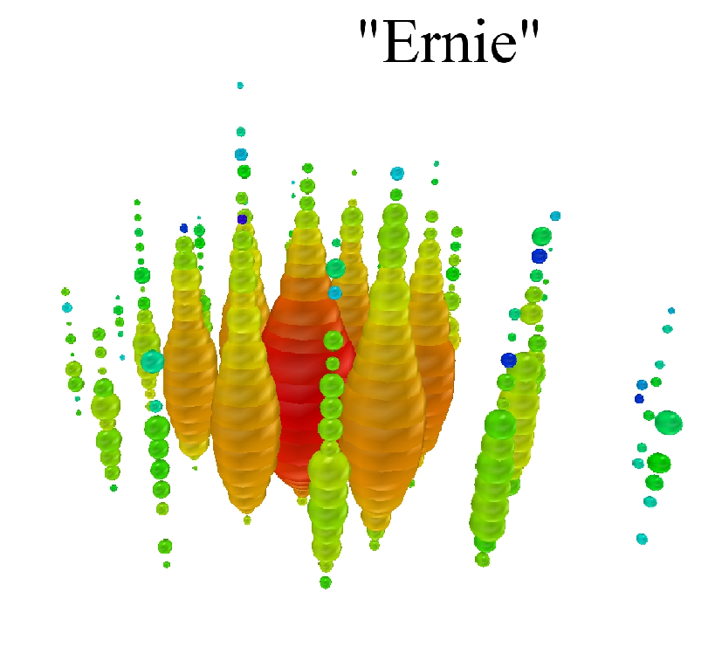
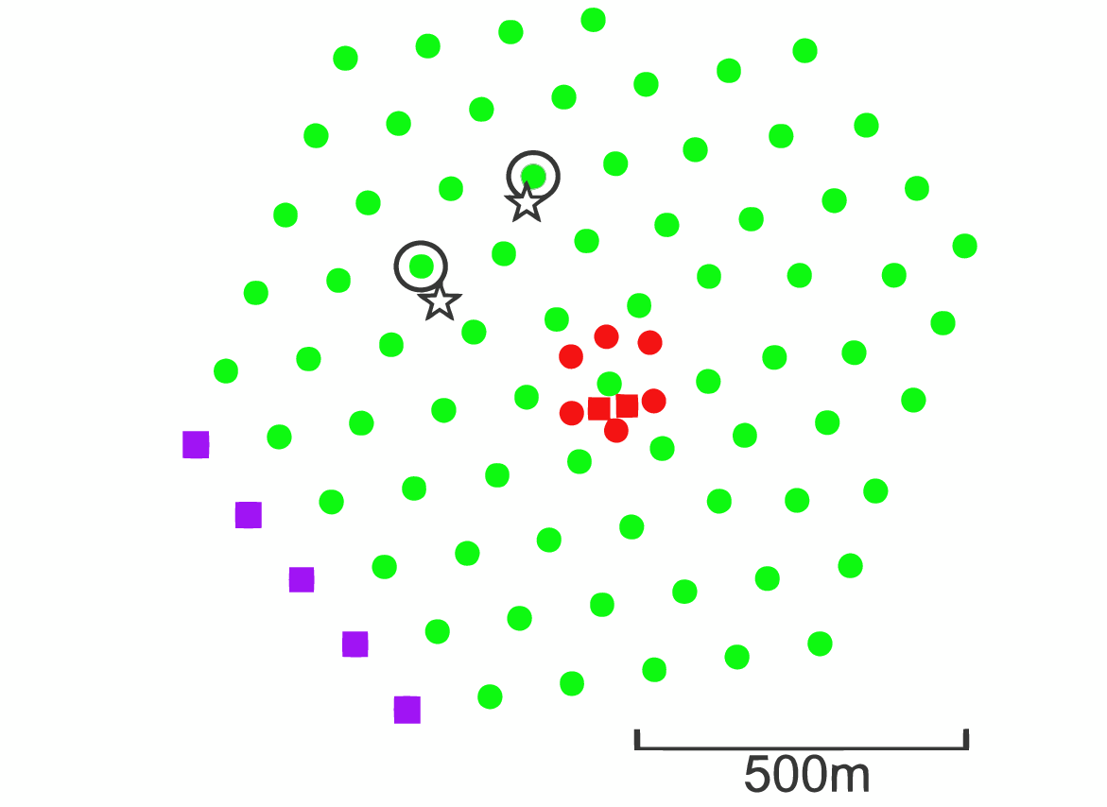
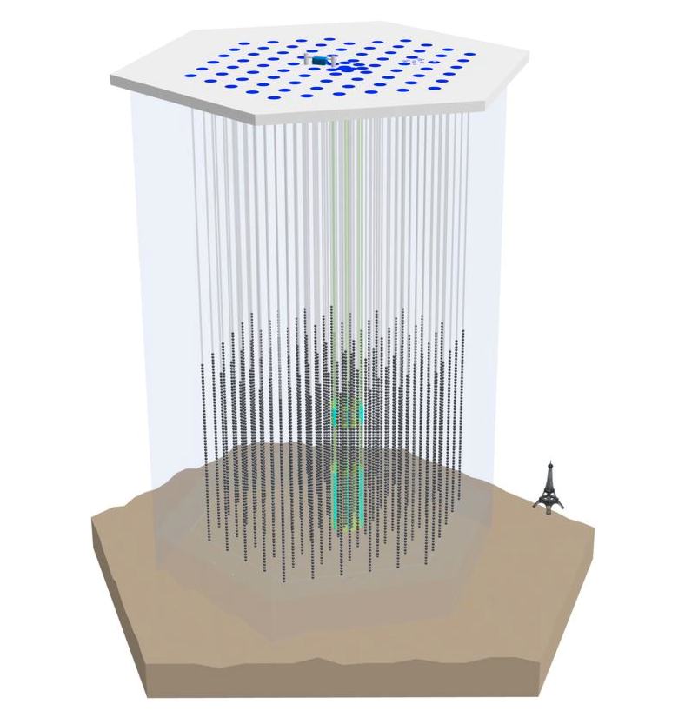
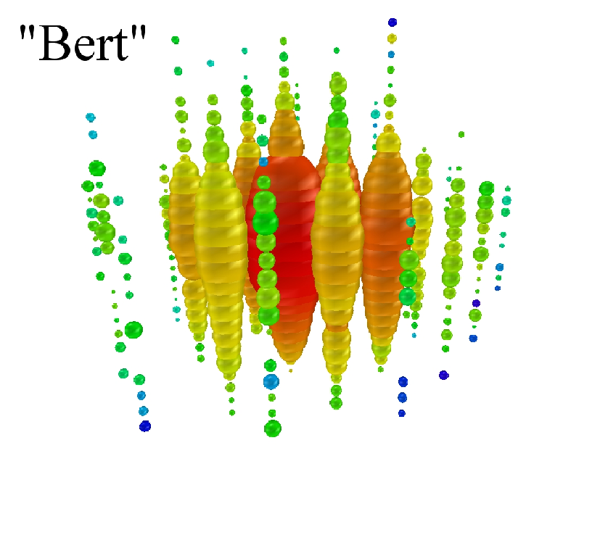
PeV neutrinos in IceCube
M.G Aarsten, et al.
arXiv:1304.5356 [astro-ph.HE]
January 2012
Centers of two cascades
E = 1.04 +/- 0.16 PeV
August 2012
Atmospheric neutrino background:
0.082 +/- 0.004 (stat) +0.041/–0.057(syst.)
p-value 2.9 10⁻² (2.8σ)
``Hint’’ of cosmic
neutrinos or
New physics with atmospheric neutrinos
Excess at lower energies 0.02 – 0.3 PeV
28 events (7 with muons) are observed ~ ~ 11 expected
E = 1.14 +/- 0.17 PeV

Slide 6
1. Masses & Mixing

Slide 7
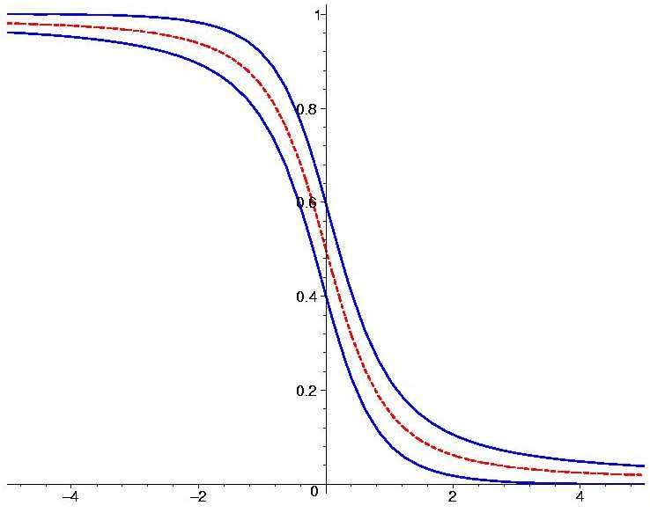
Solar
neutrinos
KamLAND
MSW-effect
Atmospheric
2
neutrinos
Δ
m
Double Chooz
θ
Daya Bay
MINOS
RENO
Oscillations
K2K
Antares
Can be resonantly
enhanced in matter
T2K
DeepCore
Parametric efects

Slide 8
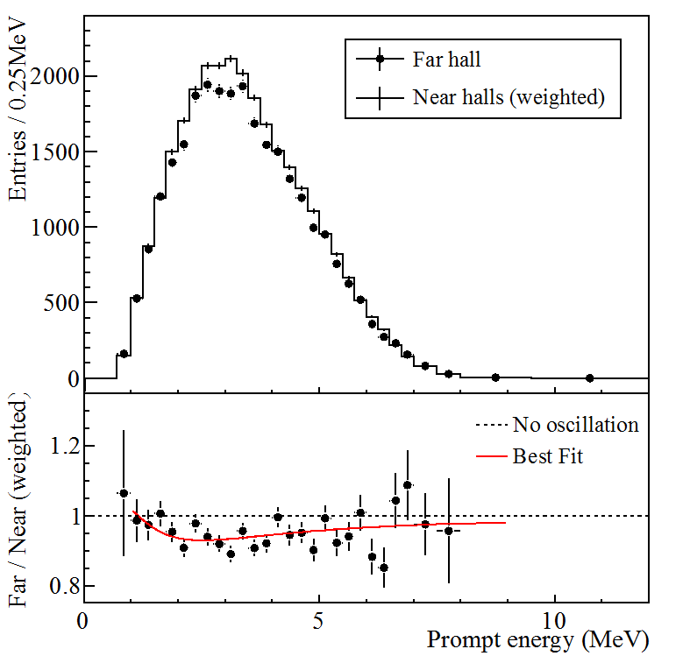
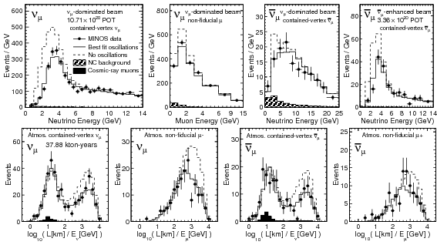
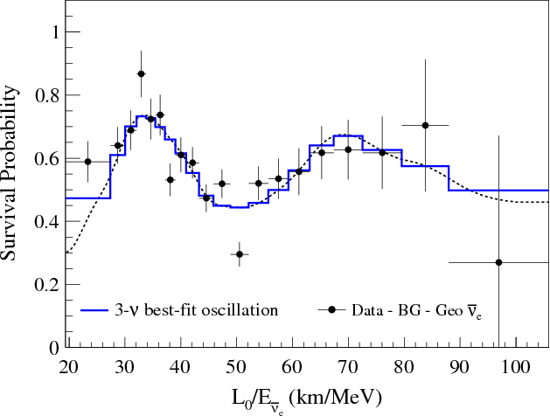
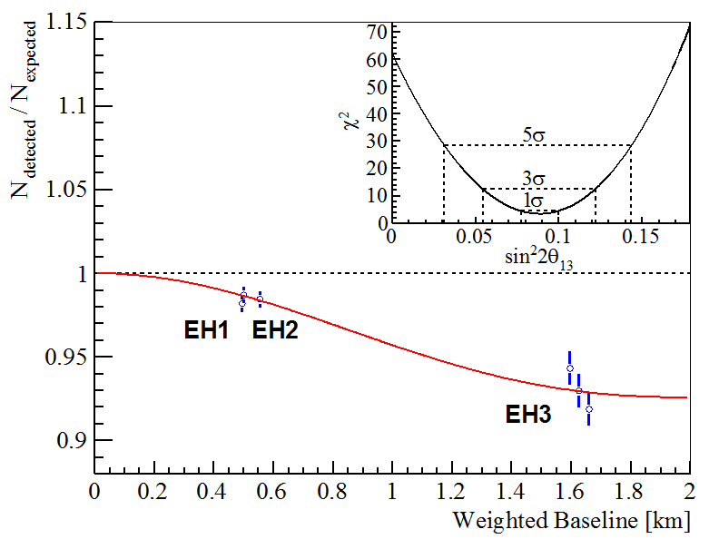
Oscillations
15 years after discovery: routinely detect oscillation effects
Daya Bay
MINOS
KAMLAND
In wide energy range: from 0.3 MeV to 30 GeV
confirming standard oscillation picture with
standard dispersion relations

Slide 9
Results: mixing & masses
ν_{e}
ν_{μ}
ν_{τ}
1-3 mixing
ν₃
ν₂
Δm²₂₁
?
ν₁
MASS
MASS
Δm²₃₂
Δm²₂₃
ν₂
ν₁
Δm²₂₁
ν₃
Normal mass hierarchy
Inverted mass hierarchy
(cyclic permutation)
Two large mixings
Symmetry: TBM?
For antineutrinos spectra are different (distribution of the ν_{μ} and ν_{τ} - flavors in ν₁ and ν₂) due to possible CP-violation
Δm²₃₂ = 2.4 x 10⁻³ eV²
Δm²₂₁ = 7.5 x 10⁻⁵ eV²

Slide 10
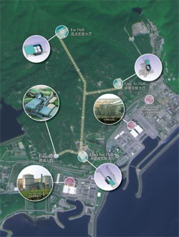
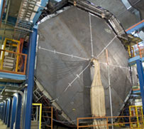
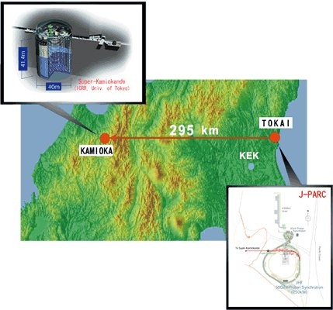
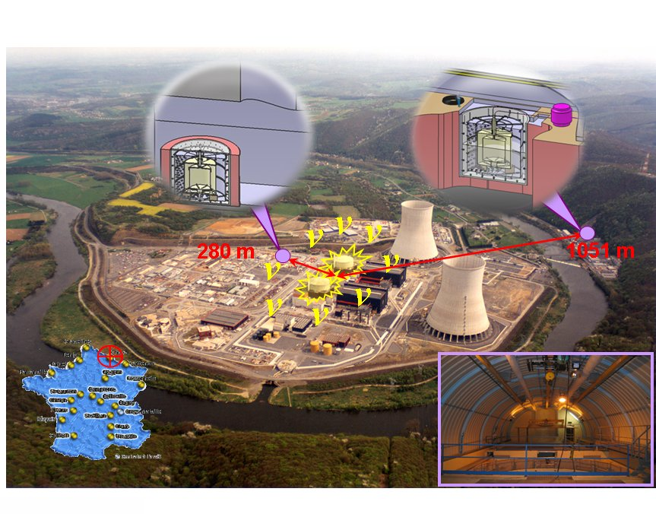
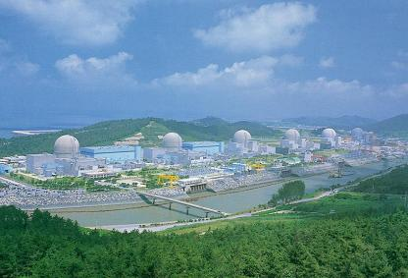
1-3 mixing
MINOS
Daya Bay
T2K
RENO
Double-CHOOZ

Slide 11
QLC
μ−τ breaking
Gonzalez-Garcia et al, 1σ
mass ratio
Fogli et al, 1σ
Daya Bay, 1σ
RENO, 1σ
Double Chooz, 1σ
T2K 90%
0.0 0.010 0.020 0.030 0.040
sin² θ₁₃
Measurements of 1-3 mixing

Slide 12

Gonzalez-Garcia et al, 1σ
QLC
Fogli et al, 1σ
MINOS, 1σ
SK (NH), 90%
SK (IH), 90%
0.30 0.35 0.40 0.45 0.50 0.55 0.60 0.65 0.70
sin² θ₂₃
Measurements of 2-3 mixing

Slide 13
Huge impact of small angle
theoretical
dominant factor
for SN neutrinos
implications
U
symmetry
e3
door to determination of
atmospheric
CP-violation
neutrinos
mass hierarchy

Slide 14
At the cross-roads
The same 1-3 mixing with completely different implications
``Naturalness’’
Absence of
Fine tunning of mass matrix
θ₁₃ = 2^{1/2}(π/4 - θ₂₃)
ν_{μ} − ν_{τ} –
symmetry
violation
~ ½cos² 2θ₂₃
Δm₂₁²
Δm₃₂²
O(1)
~ ¼ sin²θ₁₂sin²θ₂₃
sin²θ₁₃
Analogy with quark mixing relation
~ ½sin²θ_{C}
θ₁₃ + θ₁₂ = θ₂₃
Quark- Lepton
Complementarity
GUT, family
symmetry
> 0.025
Self-complementarity
Mixing
anarchy
1/3 – |U_{e2}|² ~ sin²θ₁₃

Slide 15
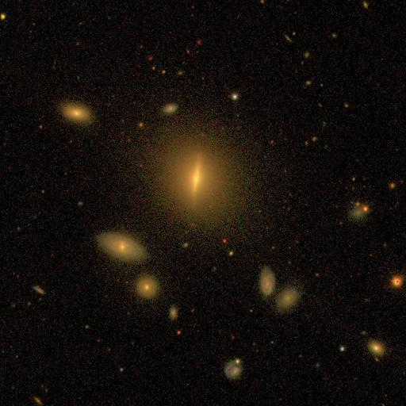
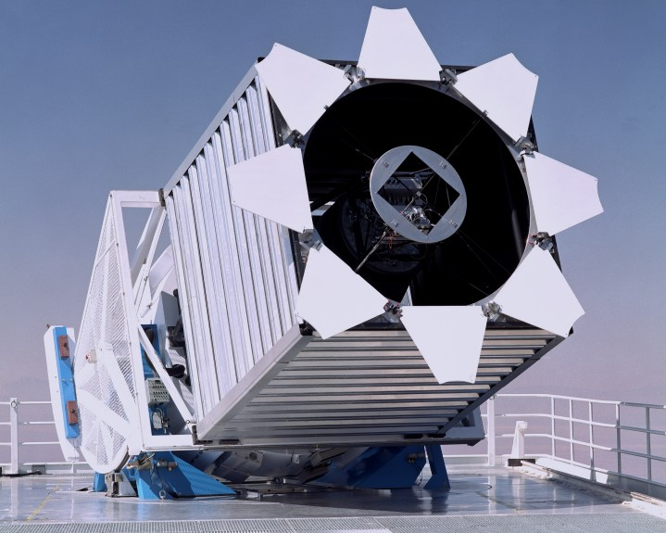
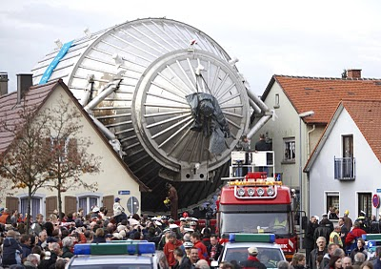
Masses
Large scale structure
of the Universe
Oscillations
m > Δm₃₁² > 0.045 eV
m₂
m₃
Δm₂₁²
Δm₃₂²
The weakest
hierarchy
NH
>
~ 0.18
SDSS
Δm₂₁
m₁
Δm₂₁²
2 Δm₃₂²
Strong
degeneracy
→ symmetry
IH
~ = 1.6 10⁻²
Cosmology (Planck BAO)
Σ m < 0.23 eV (68 % CL)
KATRIN
Direct kinematic measurements (future)
m_{e}^{eff} < 2.2 → 0.2 eV (90% CL)

Slide 16
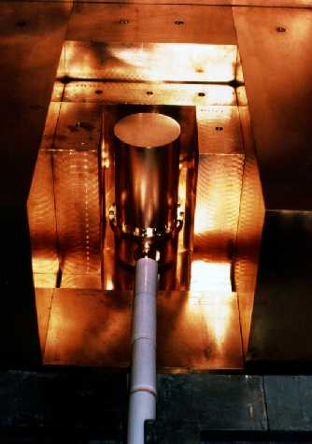
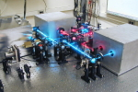
Double beta decay
m_{ee} = U_{e1}² m₁ + U_{e2}² m₂ e^{ια} + U_{e3}² m₃ e^{ιβ}
p
⁷⁶Ge → ⁷⁶Se + e + e
Q_{ee} = 2039 keV
n
Heidelberg-Moscow
W
e
5 detectors, 71.7 kg yr
ν
x
m_{ee}
m_{ee} = (0.29 – 0.35) eV
e
W
n
p
m_{ee} = Σ_{k} U_{ek}² m_{k} e^{iφ(κ)}
EXO-200
¹³⁶Xe
Xe- Observatory
m_{ee} < (0.14 – 0.38) eV

Slide 17
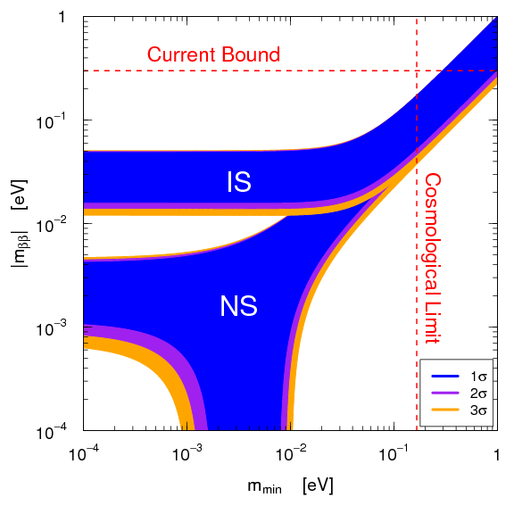
Sensitivity to the Majorana mass
S M Bilenky C Giunti
arXiv:1203.5250 [hep-ph]
Upper bounds, boxes –
uncertainties of NME
NEMO
Cuoricino
Heidelberg-
Moscow
GERDA I
KamLAND-Zen
EXO-200
GERDA II
GERDA II
CUORE
H-M: m_{ee} = (0.29 – 0.35) eV
EXO-200: m_{ee} < (0.14 – 0.38) eV
EXO and Kamland-Zen
Almost exclude H-M
(interpretation in terms of light Majorana neutrinos
m₁

Slide 18
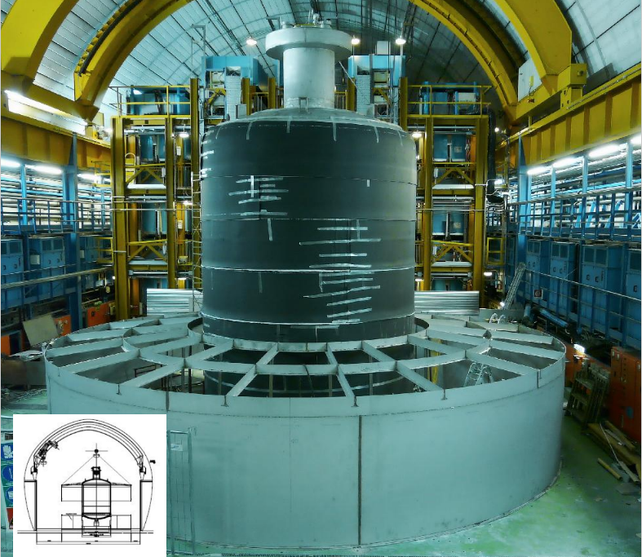
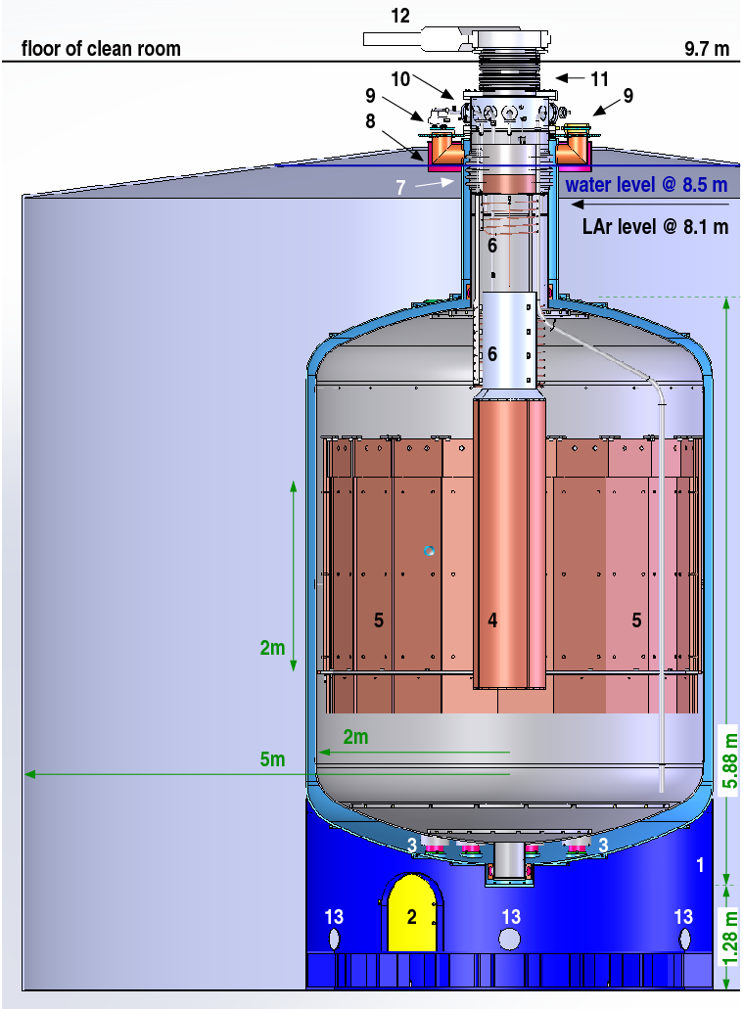
GERDA
GERmanium Detector Array
Phase I in absense of signal
for 20 kg year:
T_{1/2} > 1.9 10²⁵ yr (90% CL)
Heidelberg- Moscow:
T_{1/2} = 1.19 10²⁵ yr
3σ range:
(0.69 – 4.19) 10²⁵ yr
Blind analysis, the box should be opened now
Can confirm but not exclude completely
Phase II: 37.5 kg y: 0.09 – 0.29 eV
Phase III: 1 ton 0.01 eV

Slide 19
Theory:
Phenomenology: to a large extend elaborated
In spite of 1-3 mixing
determination…
new physics
Still at the cross-roads
mass scale
~ 10⁻⁹ – 10¹⁹ GeV
from eV to Planck
mixing
from symmetry
and hierarchy
anarchy
to
→ far from real understanding this new physics?
Some interesting developments along different lines
From minimalistic scenario of nuMSM to sophisticated structures at several new scales
Discovery of new physics BSM in some other sectors would have …..

Slide 20
Tri-bimaximal mixing
L. Wolfenstein
In the first
approximation
0.15
P. F. Harrison
D. H. Perkins
W. G. Scott
2/3 1/3 0
- 1/6 1/3 - 1/2
- 1/6 1/3 1/2
U_{tbm} =
0.62
0.78
ν₃ is bi-maximally mixed
ν₂ is tri-maximally mixed
U_{tbm} = U₂₃(π/4) U₁₂
- maximal 2-3 mixing
- zero 1-3 mixing
- no CP-violation
- sin²θ₁₂ = 1/3
Uncertainty related
to sign of 2-3 mixing:
θ₂₃ = π/4 ◊ − π/4
Symmetry from mixing matrix

Slide 21
S_{ν}
Framework
Mixing appears as a result of different ways of the flavor symmetry
breaking in the neutrino and charged lepton (Yukawa) sectors.
This leads to different residual symmetries
S₄
T’
G_{f}
A₄
T₇
Flavons
Z_{m}
G_{l}
G_{ν}
Z₂ x Z₂
Residual symmetries
of the mass matrices
M_{l}
M_{ν}
?
1_{ν}
Generic symetries
which do not depend
on values of masses to get TBM
Symmetry transformatios
in mass bases
T
S_{ν}
S_{ν} M_{ν} S_{ν} ^{T} = M_{ν}
In this framework bounds on mixing can be
obtained without explicit model-building
In flavor basis S_{iU}

Slide 22
Symmetry group relation
Transformations should be taken in the basis where CC are diagonal
(S_{iU} T) ^{p} = I
(S_{iU} T) ^{p} = (W_{iU}) ^{p} = I
D. Hernandez, A.S.
1204.0445
In flavor basis
Explicitly
( U_{PMNS} S_{i} U_{PMNS}⁺ T ) ^{p} = I
The main relation: connects the mixing matrix and
generating elements of the group in the mass basis
Equivalent to
Tr ( U_{PMNS} S_{i} U_{PMNS} ⁺ T ) = a
Tr (W_{iU}) = a
a = Σ_{j} λ_{j}
λ_{j} - three eigenvalues of W_{iU}
λ_{j}^{p} = 1
j = 1,2,3

Slide 23
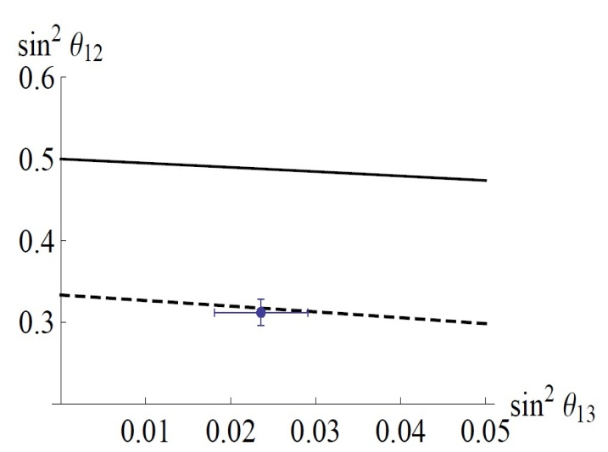
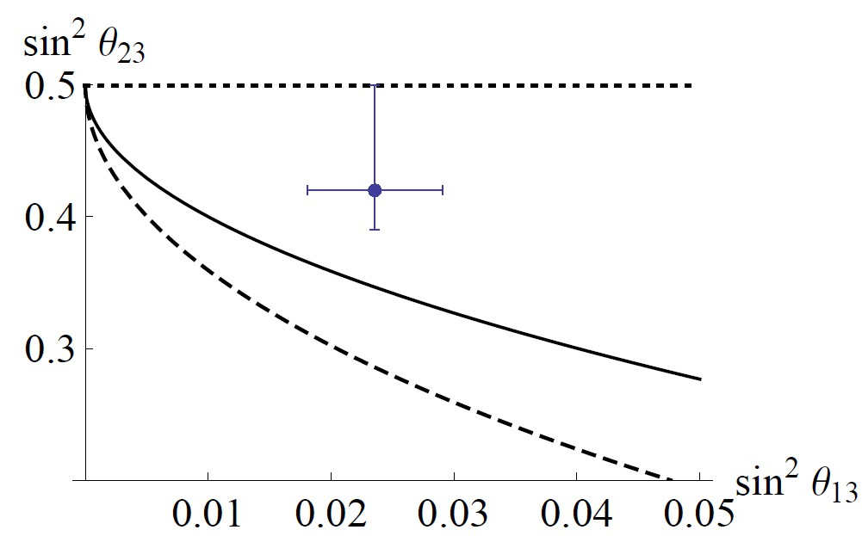
Special case
D. Hernandez, A.S.
k_{α} = 0
a = 0
For column of the mixing matrix:
|U_{βi}|² = |U_{γi}|²
S₄
|U_{αi}|² =
1 – a
4 sin² (πk/m)
k, m, p integers which
determine symmetry group
δ = 103⁰
Also S. F. Ge, D. A. Dicus,
W. W. Repko, PRL 108 (2012) 041801
D. Hernandez, A Y S.
1304.7738 [hep-ph]
If symmetry transformations S_{ν} depend on specific mass spectrum,
Relations include also masses and Majorana CP phases
sin² 2θ₂₃ = sin δ = cos κ = m₂ /m₁ = 1

Slide 24
Behind neutrino mass
Old does not mean wrong
SO(10) GUT + …
RH-neutrino
16
u_{r} , u_{b} , u_{j} , ν
d_{r} , d_{b} , d_{j} , e
u_{r}^{c}, u_{b}^{c}, u_{j}^{c}, ν^{c}
d_{r}^{c}, d_{b}^{c}, d_{j}^{c}, e^{c}
High scale mass seesaw
S
Possibly some Hidden sector at GUT - Planck scales
S
S
S
S
S
S
S
S
S
Explains smallness of neutrino mass
and difference of q- and l- mixings
S
S
S
S
S
S
S
S
- Enhance mixing
Produce zero order structure
- Randomness (if needed)
S
S
S
S
S
S
S
S
S
S
S
Flavor symmetries at very high scales, above GUT?
Hidden sector

Slide 25
2. Neutrinos & LHC

Slide 26
Neutrinos & LHC
Tests of the low
(TeV) -scale mechanisms of neutrino mass
generation
Tests of BSM framework which can lead to the neutrino mass generation
Low scale Seesaw
Of different types
at LHC
Radiative mechanisms
Tests of the physics
framework
SUSY, extraD …
Search for
mediators of seesaw, accompanying particles
R-parity violation
No good motivations
RH neutrinos at LHC

Slide 27
Low scale LR symmetry
Senjanovic
Keung
q
q
W_{R}
N
W_{R}*
x
ββ0ν
q
l
l
q
Type-Ii
l l j j
bi-leptons with the same-sign
No missing energy
Peaks at
s (jj l) = m_{N}²
s (jj ll) = m_{W}²
Also opposite sign leptons

Slide 28
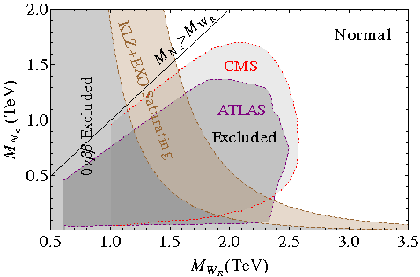
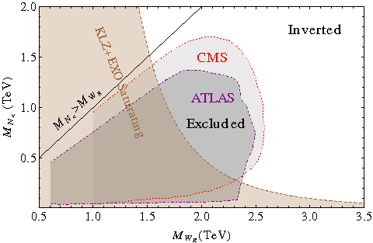
nn
Low scale L – R symmetry
P.S Bhupal Dev, et al,
1305.0056 [hep-ph]

Slide 29
3. Sterile neutrinos

Slide 30
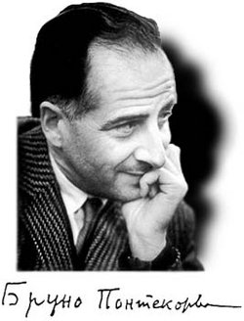
Sterile neutrino
ν_{s}
RH-components
of neutrinos
Light
No weak interactions:
- singlets of the SM
symmetry group
Mix with active neutrinos
may have Majorana masses
maximal mixing?
Dear Dr. Alexei Yu. Smirnov,
Please pay attention to our upcoming
Special Issue on "Research in Sterility"
which will be published in the
"Advances in Sexual Medicine" ,
an open access journal.
Sov. Phys. JETP 26 984 (1968)
Pisa, 1913
We cordially invite you to submit your paper …

Slide 31
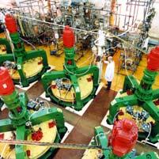
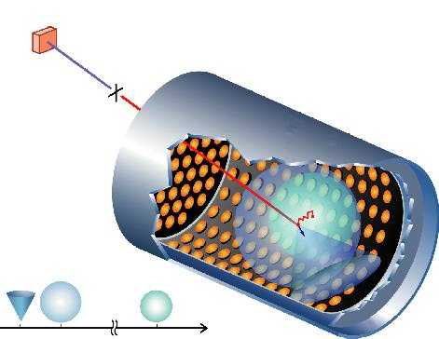
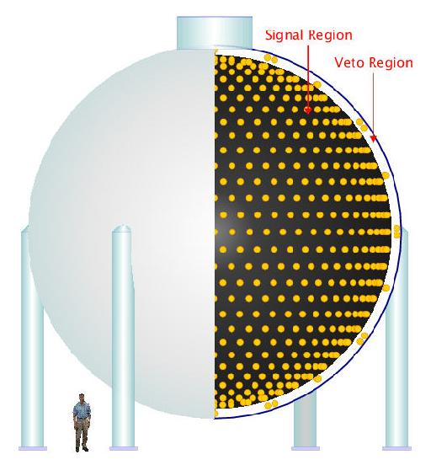
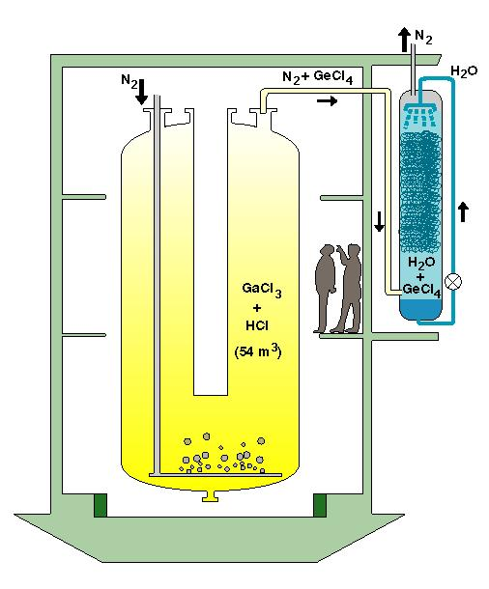
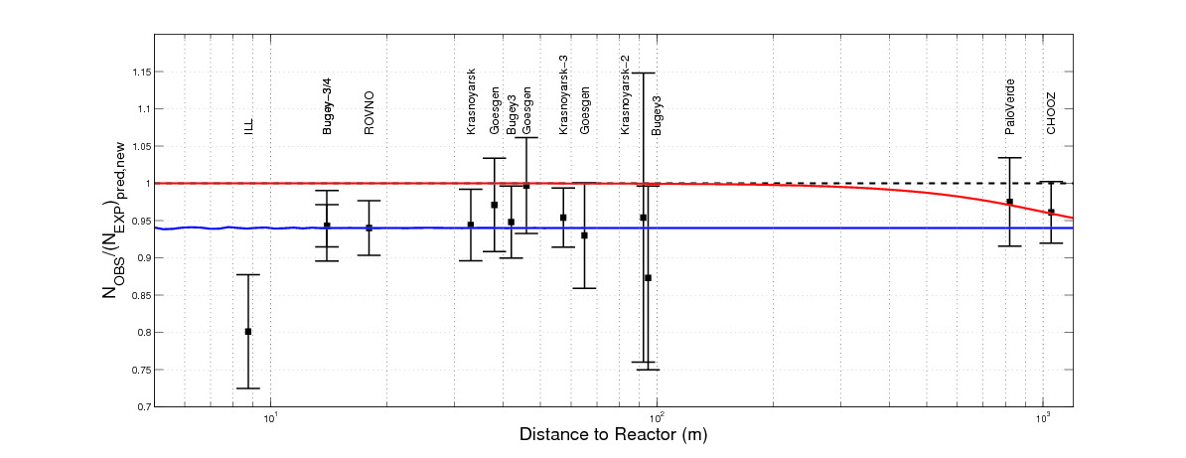
Evidences?
Δm₄₁² = 1 - 2 eV²
SAGE
LSND
MiniBooNE
G.Mention et al,
arXiv: 1101.2755
P Huber
Gallex,GNO

Slide 32
(3 + 1) scheme
ν_{e}
ν_{s}
ν_{μ}
ν_{τ}
LSND/MiniBooNE: vacuum oscillations
ν₄
P ~ 4|U_{e4} |²|U_{μ4} |²
restricted by short baseline exp.
BUGEY, CHOOZ, CDHS, NOMAD
mass
Δm²₄₁
For reactor and source experiments
ν₃
Δm²₃₁
ν₂
P ~ 4|U_{e4}|² (1 - |U_{e4}|²)
ν₁
Δm²₂₁
With new reactor data:
- additional radiation in the universe
- bound from LSS?
Δm₄₁² = 1.78 eV²
( 0.89 eV²)
U_{e4} = 0.15
U_{μ4} = 0.23

Slide 33
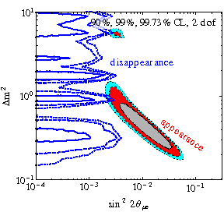
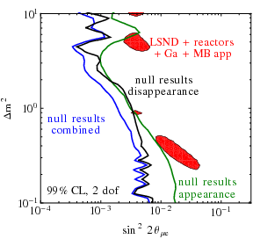
Desirable and allowed
Controversial
situation
J. Kopp , P. A. N. Machado, M. Maltoni, T. Schwetz, 1303.3011 [hep-ph]
Tension between disappearance data
and νμ → νe LSND-MiniBooNE signals
All positive evidences vs null results
0PERA
cosmology
OPERA, Collaboration 1303.3953 [hep-ex]

Slide 34
Extra radiation in the Universe
After Planck
Effective number of neutrino species
+ 0.54
- 0.51
N_{eff} = 3.30 (95 % CL)
Planck +WP+highL+BAO
N_{eff} = 3.30 +/- 0.27 (68% CL)
+ 0.50
- 0.48
N_{eff} = 3.62 (95 % CL)
Planck +WP+highL + H₀
BBN
+ 0.80
- 0.70
Y. I. Izotov and T X Thuan
Astrophys J 710 (2010) L67
N_{eff} = 3.68 (68 % CL)
Inconclusive

Slide 35
Searching for sterile neutrinos
NUCIFER
Very short baseline reactor experiment
SCRAAM
⁵¹Cr
G Bellini et al 1304.7721
SOX
Source experiments
Tens kilocurie source 50 kCi
¹⁴⁴Ce - ¹⁴⁴Pr (3 MeV) or
¹⁰⁶Ru - ¹⁰⁶ Rh (3.54 MeV)
BOREXINO,
KamLAND,
SNO+
Accelerator SBL experiments
MicroBooNE (LArTPC),
M. Cribier et al, 1107.2335 [hep-ex]]
OscSNS BooNE
MiniBooNE + SciBooNE
NESSiE
arXiv: 1304.7127 [physics.ins-det]
Neutrino Experiment with Spectrometers in Europe,
Charged Current (CC) muon neutrino and antineutrino interactions.
two magnetic spectrometers located in two sites:"Near"
and "Far" from the proton target of the CERN-SPS beam.
complemented by an ICARUS-like LAr target
For (NC) and electron neutrino CC interactions reconstruction.

Slide 36
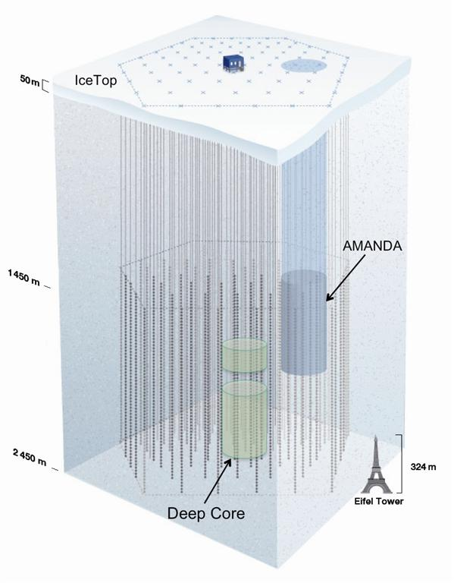
Looking for sterile in ice
IceCube
H Nunokawa O L G Peres
R Zukanovich-Funchal
Phys. Lett B562 (2003) 279
ν_{μ} - ν_{s} oscillations with Δm² ~ 1 eV²
are enhanced in matter of the Earth in energy range 0.5 – few TeV
This distorts the energy spectrum
and zenith angle distribution of the
atmospheric muon neutrinos
S Choubey JHEP 0712 (2007) 014
S Razzaque and AYS ,
1104.1390, [hep-ph]

Slide 37
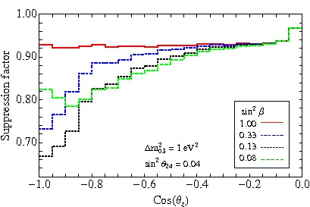
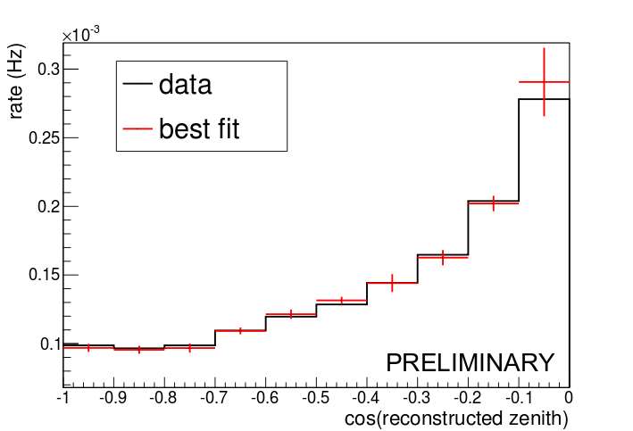
Zenith angle distributions
CC interactions, muon tracks
Possible distortion of the zenith angle
distribution due to sterile neutrinos
A. Gross, 1301.4339 [hep-ex]
< 3% stat. error
IC79
no sterile
Varying |U_{τ0}|²
Less than 5% puls

Slide 38
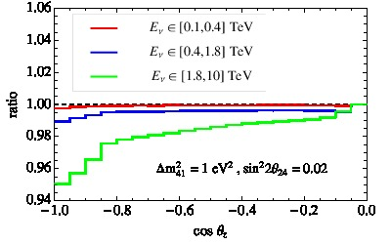
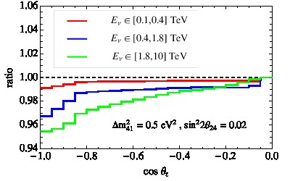
IC sensitivity to sterile
A Esmaili, AYS

Slide 39
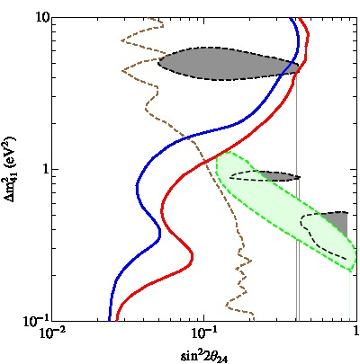
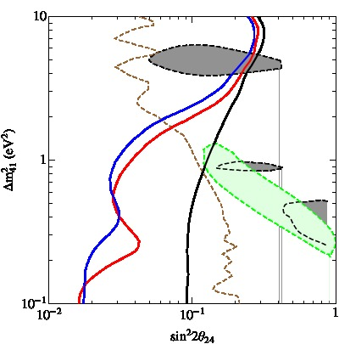
IC sensitivity to sterile
With 5% uncorrelated systematics

Slide 40
Another possibility
ν_{s}
ν_{e}
ν_{μ}
ν_{τ}
Very light sterile neutrino
ν₃
m₀ ~ 0.003 eV
DE scale?
M²
M_{Planck}
M ~ 2 - 3 TeV
Δm²₃₁
mass
ν₂
Motivated by
Δm²₂₁
- solar neutrino data
ν₀
ν₁
Δm²_{dip}
additional radiation
in the Universe if mixed in ν₃
no problem with LSS
(bound on neutrino mass)
sin² 2α ~ 10⁻³
sin² 2β ~ 10⁻¹
can be tested in atmospheric
neutrinos with DC IceCube

Slide 41
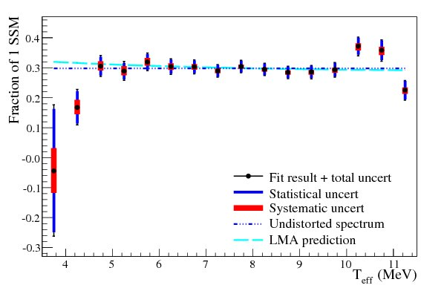
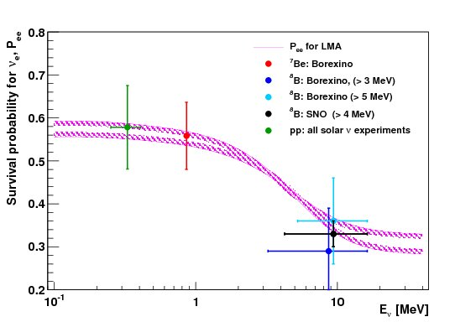
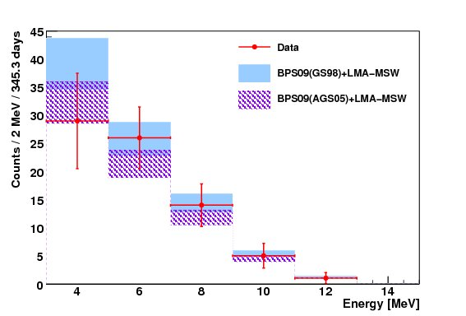
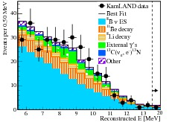
Up-turn?
SNO: LETA
pp ⁷Be CNO ⁸B
pep
.
BOREXINO
SNO
ν_{e} - survival probability from solar
neutrino data vs LMA-MSW solution
KamLAND
HOMESTAKE
low rate
SNO+

Slide 42
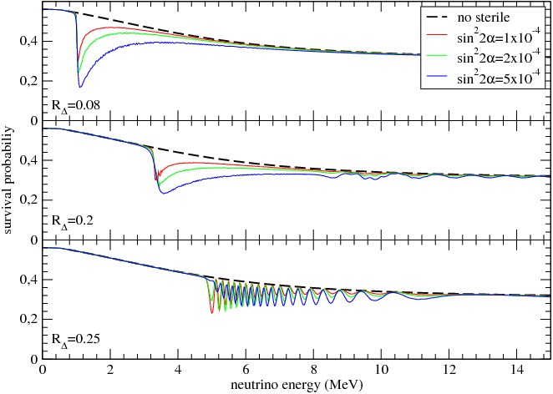
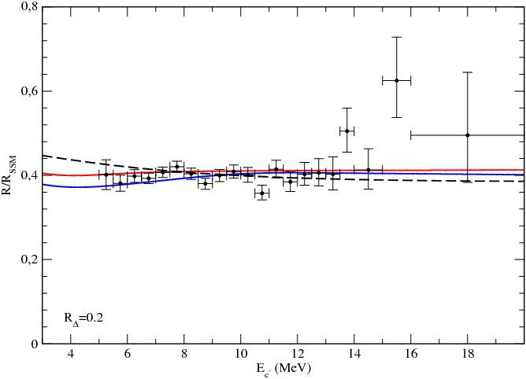
Survival probability
P. de Holanda, AYS
m₀ ~ 0.003 eV
m₀ =
M²
M_{Planck}
M ~ 2 - 3 TeV

Slide 43
ν
MSM
M. Shaposhnikov et al
Everything below EW scale
→ small Yukawa couplings
L
R
- generate light
mass of neutrinos
generate via oscillations
lepton asymmetry
in the Universe
can beproduced in
B-decays (BR ~ 10⁻¹⁰ )
BAU
Few 100 MeV
split ~ few kev
WDM
3- 10 kev
- warm dark
matter
- radiative decays →
X-rays
Normal
Mass
hierarchy
EW seesaw
Phenomenology of
sterile neutrinos

Slide 44
4. Prospects

Slide 45
Goals
Astrophysics
Detection of high energy cosmic neutrinos
Reconstruction of the mass and mixing spectrum
Detection of Galactic SN
neutrinos
Neutrino mass hierarchy
Checks of existence
of sterile neutrinos
CP-violation
relic SN neutrinos
deviation of 2-3 mixing from maximal
Solar neutrinos: DN - asymmetry, CNO, spectral upturn
Study of geo-neutrinos
Absolute mass scale
Majorana
nature
Searches for
ββ_{0ν}- decay
Neutrinos and cosmology:
connections of neutrinos to the dark Universe
Majorana
phases

Slide 46
Race for hierarchy
Matter effect
Cosmology
Precise
on 1-3 mixing
measurements
Σm
of Δm²
at reactors
Double beta
Atmospheric
m_{ee}
Supernova
decay
neutrinos
LBL
neutrinos
experiments
Earth matter effect
Energy spectrs
PINGU
INO
NOvA
NH ←→ IH
Sterile neutrinos
may help?
Neutrino beam
Fermilab-PINGU(W. Winter)
nu ←→ antinu

Slide 47
Supernova
Time rise of the anti-ν_{e} burst initial phase → IH
neutrinos
P. Serpico et al
Strong suppression of
the ν_{e} peak → NH
1-3mixing &
ν_{e} → ν₃
hierarchy
Permutation of the electron and
non-electron neutrino spectra
Dighe, A. S.
C. Lunardini
Earth matter effects
Shock wave
effect
in the antineutrino
channel only → NH
Neutrino collective
effects
in the neutrino
channel only → IH
in neutrino
channels → NH
in antineutrino
→ IH
more in IH case,
spectral splits
at high energies
→ IH
If the earth matter effect is
observed for antineutrinos
NH is established!
G. Fuller, et al
R. Tomas et al
G Fuller et al
B Dasgupta et al

Slide 48
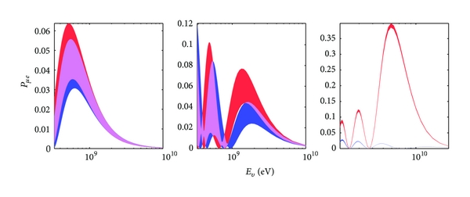
Hierarchy and CP
M. Blennow and A Y Smirnov Advances in High Energy Physics Volume 2013 (2013), Article ID 972485
The neutrino oscillation probability at baselines of 295 (left), 810 (middle), and 7500 km (right) as a function of the neutrino energy. The red (blue) band corresponds to the normal (inverted) mass hierarchy and the band width is obtained by varying the value of . The probabilities for look similar with the hierarchies interchanged. Note the different scales of the axes.

Slide 49
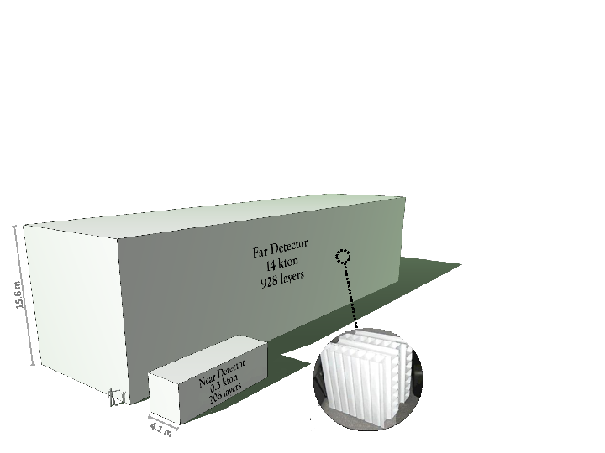
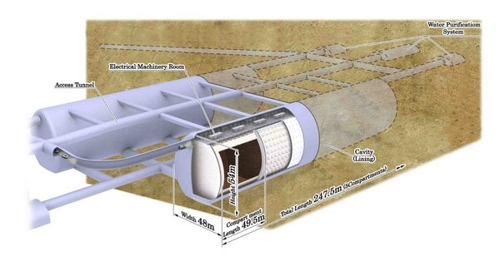

Segmented scimtillator detector 14 kT
NuMI beamoff-axis (14 mrad)
baseline 810 km
NOvA
CP/MH/osc. parameters
MH: 2 - 3 σ in half δ space
WC, V = 0.99 Mt
Fid. V = 0.56 Mt
99,000, 20 inch PMTs
20% photocoverage
JPARC beam, off-axis
Baseline 295 km
HyperKamiokande
CP/MH/astro
ICAL Iron calorimeter
scintillator
INO
MH/astro

Slide 50



Next?
MEMPHYS: CERN - Fréjus tunnel. Two WC tanks 65 m (d) x 103 m (h)
LBNO
The LENA (Low-Energy Neutrino Astronomy)
50 kt of liquid scintillator (LSc)
tank 32 m x 100 m height.
LBNE

Slide 51

Atmospheric neutrinos
Oscillation physics with Huge atmospheric neutrino detectors
ANTARES
Oscillations 2.7σ
DeepCore
Oscillations at high energies 10 – 100 GeV in agreement with
low energy data
Ice Cube
no oscillation effect
at E > 100 GeV

Slide 52




Neutrino oscillations in IceCube
M G Aarten et al [IceCube Collaboration]
arXiv: 1305.3909

Slide 53


PINGU
Precision
IceCube
Next
Generation
Upgrade
Ice Cube
ANTARES
ORCA
Oscillation
Research with
Cosmics with the
Abyss

Slide 54
PINGU Geometry
Denser array
PINGU v6
DC: h = 350 m d =250
20 new strings (~60 DOMs each)
in 30 MTon DeepCore volume
6 m vertical
26m
Few GeV threshold in inner
10 Mton volume
75m
Energy resolution ~ 3 GeV
125m
Existing IceCube strings
Existing DeepCore strings
New PINGU strings

Slide 55


Nu-mu - events
E. Akhmedov, S. Razzaque, A. Y. S.
arXiv: 1205.7071
cascade
10⁵ events/year
ν_{μ} + n → μ + h
muon track
E_{μ} θ_{μ} E_{h}
E_{ν} = E_{μ} + E_{h}
S_{tot} ~ s n^{1/2}
E_{h} E_{μ} θ_{μ} → θ_{ν}

Slide 56


Smeared asymmetries
Smearing with Gaussian reconstruction functions characterized by (half) widths
σ_{Ε} = A E _{ν}
σ_{θ} = B (m_{p} / E _{ν})^{1/2}
σ_{θ} ~ 1/E^{0.5}
σ_{θ} ~ 0.5/E^{0.5}
σ_{Ε} = 0.2E

Slide 57

Total significance
S ^{tot} = [Σ _{ij} S_{ij}² ]^{1/2}
3, 14º
Improvements of
reconstruction of the neutrino angle leads to substantial increase of significance
without degeneracy of parameters
E , GeV 10 – 20 20 – 50
σ_{Ε} , GeV 2.3 7.8
σ_{θ} 8.3º 4.3º
Tyce De Young,
March 2013

Slide 58






Measuring inelasticity y
Mathieu Ribordy, A. Y .S., 1303.0758 [hep-ph]
with experimental smearing
σ_{E} = (0.7 E_{ν})^{1/2}
ψ₀ = 20º
bad nu – nubar separation
Increases significance
by 30 – 70 %
bad angular resolution
y-integrated

Slide 59



Other physics
dms_23
Non-standard
interactions
Sterile nu
theta_23
sin² θ_{32, fit} = 0.50
sin² θ_{32, true} = 0.42

Slide 60


CP asymmetry
Difficult with PINGU but can be done with next update
With E ~ 0.1 GeV
Shape does not change
the amplitude changes
Large significance at low energies

Slide 61
Conclusion

Slide 62
The last mixing angle the 1-3 mixing is measured. Strong impact on phenomenology , theory and future experimental programs.
Race for thre neutrino mass hierarchy and CP has started
Critical check of the 0νββ - decay observation claim
Theory: still at the cross-roads. The same 1-3 mixing from different relations with different implications. TBM, Flavor symmetries…?
Sterile neutrinos: challenge for everything. Ice Cube can help
IceCube: hint for detection of cosmic neutrinos of high energies or new physics in neutrino interactions?
New important developments (new phase) in the field can be related to Multi-megaton mass scale under ice,underwater detectors with low (~1 GeV) energy threshold (PINGU, ORCA)
Studies of atmospheric neutrinos may allow to establish mass hierarchy , measure oscillation parameters, perform searches for
sterile neutrinos, non-standard interactions .
The fastest, cheapest, reliable way?

Slide 63
Backup slides

Slide 64
Neutrinos & Dark Sector
of the Universe
indirect
connection
Mechanism of
neutrino mass
generation
Z₂
Light active
neutrinos
HDM
new particles
Direct
connection
right handed
neutrinos
Mixing pattern
New
neutrino
states
play the role of DM
Flavor symmetries
Neutrinos and gravitino as DM
ensure stability
of DM particles
Warm DM
W. Buchmueller
Dark
Energy
Everything from one

Slide 65
Tri-bimaximal mixing
L. Wolfenstein
Dominant approach
0.15
P. F. Harrison
D. H. Perkins
W. G. Scott
2/3 1/3 0
- 1/6 1/3 - 1/2
- 1/6 1/3 1/2
U_{tbm} =
0.62
0.78
ν₃ is bi-maximally mixed
- maximal 2-3 mixing
- zero 1-3 mixing
- no CP-violation
ν₂ is tri-maximally mixed
U_{tbm} = U₂₃(π/4) U₁₂
- sin²θ₁₂ = 1/3
Form invariance
Symmetry from mixing matrix

Slide 66
Relations between matrix elements
D. Hernandez, A.S.
to be submitted
Tr (W_{iU}) = Tr ( U_{PMNS} S_{i} U_{PMNS} ⁺ T )
iφ_{α}
Σ_{α} (2|U_{αj}|² – 1) e = a
bounds on moduli of matrix elements
elements of a given column j determined by index of S
two relations corresponding to real and imaginary of a
the column j is completely determined
a_{R} cos (φ_{e} /2) + cos (3φ_{e} /2) – a_{I} sin (φ_{e} /2)
|U_{ej}|² =
φ_{αβ} = φ_{α} - φ_{β}
4 sin (φ_{eμ} /2) sin (φ_{τe} /2)
a_{R} cos (φ_{μ} /2) + cos (3φ_{μ} /2) – a_{I} sin ( φ_{μ} /2)
|U_{μj}|² =
4 sin (φ_{eμ} /2) sin (φ_{μτ} /2)

Slide 67
For finite groups
Interesting possibilities
2/3
1/6
1/6
1/3
1/3
1/3
1/4
1/2
1/4
For i =1
Trimaximal 1
For i = 2
Trimaximal 2
Another class of possibilities: with (m – p) permutation
T (S_{iU} T) = W_{iU}

Slide 68
Flavor alignment
Values of elements gradually decrease from m_{ττ} to m_{ee}
corrections wash out sharp
difference of elements of the
dominant μτ-block and
the subdominant e-line
This can originate from power dependence of elements
on large expansion parameter λ ~ 0.7 – 0.8 .
Another complementarity: λ = 1 - θ_{C}
Froggatt-Nielsen?

Slide 69

Hint of cosmic neutrinos
Also excess of events at lower energies:
27 events are observed
12 are expected
Number of photo-electons
Atm. Neutrino Background:
0.082 +/- 0.004 (stat) + 0.041 / – 0.057(syst.)

Slide 70
Double Seesaw
Three additional singlets S which couple with RH neutrinos
0 m_{D}^{T} 0
m_{D} 0 M_{D}^{T}
0 M_{D} μ
ν
ν^{c}
S
Beyond SM:
many heavy singlets
…string theory
R.N. Mohapatra
J. Valle
m_{n} = m_{D}^{T} M_{D}^{-1T} μ M_{D}⁻¹ m_{D}
μ - scale of B-L violation
violation of universality,
unitarity
μ = 0
massless neutrinos
μ << M_{D}
allows to lower the scales
of the neutrino mass generation
Inverse seesaw
explains intermediate scale
for the RH neutrinos
μ >> M_{D}
Cascade seesaw
μ ~ M_{Pl}, M ~ M_{GU}
M ~ M_{GU}²/M_{Pl} ~ 10⁻¹⁴ GeV

Slide 71
Mass scales
ν_{s}
40 - 70 MeV
- LSND, MiniBooNE
1 MeV
1 - 10 keV
Warm Dark matter
Pulsar kick
1 keV
- LSND, MiniBooNE
Reactor anomaly
Ga-calibration experiments
- Extra radiation
1 eV
0.5 - 2 eV
(2 – 4) 10⁻³ eV
- Solar neutrinos
- Extra radiation
in the Universe
10⁻³ eV
rich phenomenology

Slide 72


Solar neutrinos: two features
SuperKamiokande
M. Smy
No distortion of the energy spectrum
at low energies : the upturn is disfavored at (1.1 – 1.9) σ level
Increasing tension between Δm²₂₁ measured by KamLAND and in solar neutrinos 1.3σ level
This is how new physics may show up

Slide 73
Mass hierarchy (ordering)
ν_{e}
ν_{μ}
ν_{τ}
Normal hierarchy
Inverted hierarchy
Cosmology
ω₃₂
ν₃
ββ-decay
ν₂
ν₁
ω₃₂
ω_{ij} = Δm²_{ij} /2E
MASS
ω₃₁
Mass states can
be marked by
ν_{e} - admixtures
ν₂
ν₁
ν₃
ω₃₁
ω₃₁ > ω₃₂
ω₃₁ < ω₃₂
Oscillations
Fourier
analysis
S. Petcov M. Piai
D₃₁ ~ 2D₃₂
ω
Matter effect
makes the e-flavor heavier
changes two spectra differently

Slide 74


Reactor anomaly
J. Kopp , P. A. N. Machado,
M. Maltoni,
T. Schwetz,
1303.3011 [hep-ph]

