Slide 1
Latsis Symposium 2013
LHC Detectors:
Challenges
Achievements
Future
Nature at the Energy Frontier
Zürich, 3. June 2013
Roland Horisberger
Paul Scherrer Institute

Slide 2
Find unknown toy particle X⁰
my Little Hadron Collider
toy experiment
We will just produce in violent pp collision the new, unknown toy particle X⁰ here !
Detector
accelerated proton
accelerated proton
leaving remnant “proton”
leaving remnant “proton”
Detector
Particle X⁰ may be produced by:
p + p → π⁺ + π⁻ + X⁰ + π⁺ + π⁻ + . . . . .
Detector → measure points of all pion trajectories
→ calculate for all tracks
angles, momenta & charge
π⁺ + π⁻

Slide 3
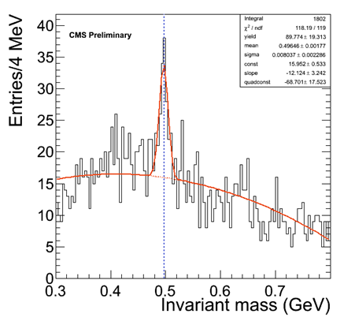
Reconstructing the Puzzle
Measure for all particle: p_{i}, m_{i}, θ_{i} → 4-vector
For many events try all 2 pion combinations and calculate their invariant mass m_{X} by
→ correct combination of X⁰ will stick out statistically
from all incorrect combinations !
K⁰_{s} → π⁺ + π⁻
CMS Experiment at LHC
Sunday, 6. Dec. 2009, 11:30
(from first 5h of colliding beam at 2x450GeV, run 123’596)
Principle of heavy particles reconstruction
Beauty-, Top- or SUSY and Higgs-Particles
is quite similar.
K.Stenson,B.Drell, K.Ulmer (Univ. Colorado)
Particle Data Group Value
K⁰ mass: 0.49765 GeV/c²
H → γγ measure E_{1,2} & θ_{1,2} of photons
Electromagnetic Calorimeter (ECAL)

Slide 4
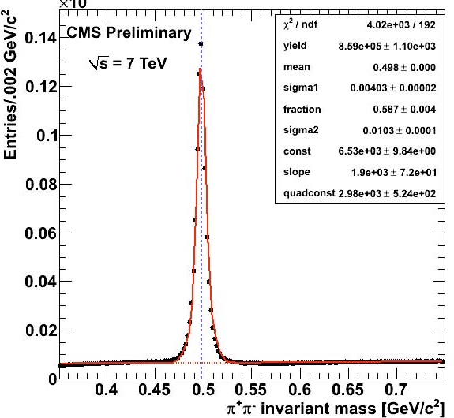
The Trouble with Experiments
Detector
K⁰
x
Detector
Real detectors have:
finite mass → particle interactions (mult. scat., γ-conversion, nucl. int.)
multiple event Pile-Up → track reconstruction: efficiency / fakes
finite resolution → merging detector hits
finite data rates → limited data samples, limit in statistics of rare physics
What can you do?
more layers → robustify track & event reconstruction
precise hits, 3D-pixel-points → separate hits, distinguish multiple PU vertices, sec. vtx
less mass → less particle interaction but in conflict to above
local data buffering, triggers & high speed links → heavy use of FE μ-electronics

Slide 5
A young postdoc’s perception in late 80’s
Proton collider experiments had gained valuable experience in detection and isolation of rare, high Q²-physics in large data volume of hadronic collisions. But other physics capabilities (e.g. beauty-physics) seemed marginal.
→ high rate, messy environment, difficult event reconstruction, rad. damage
LEP experiments with new state of the art high tech detectors (e.g. silicon strips) under construction but not operated yet!
→ low rate, clean simpler event reconstruction, no rad. damage
CERN study group for high energy colliders options:
- linear e⁺e⁻ collider 1 TeV → machine very difficult, experiments easy
- pp colliders 16 TeV → machine “easy”, experiments challenging
Emerging LHC scenario (Aachen, 1990) with lower collision energy than SSC implied even more challenging detector parameters. Particle detection rate, DAQ data rates, radiation damage and background rejection capability were orders of magnitude beyond what ever had been done before.
→ LHC detectors looked like very, very challenging project. (at least to me)

Slide 6
Timeline of Large Hadron Collider & Experiments
1980’s: Study groups compare e⁺e⁻, pp scenarios for machines, experiments & physics
1990 ECFA Aachen meeting: Physics, detector, machine, → CERN R&D projects
1992 Letter of Intend of experiments
1994 Technical Proposal of experiments
1996 - Technical Design Reports of Experiments (e.g. CMS Tracking Strips/Pixels 1998)
2000 Memorandum of Understanding
2000-04 Underground & experimental cavern work
2002-08 Construction of experiments
LHC start-up & incident / repair of damaged LHC sector 3-4
Experiments: calibrations, commissioning, cosmic muons data taking
LHC p-p-collisions & machine commissioning at 0.9 TeV & 2.76 TeV
2010 running at ~0.035 evts/fb at 7 TeV & Pb-Pb collisions
2011 running at ~ 5 evts/fb at 7 TeV & Pb-Pb collisions
2012 running at ~ 20 evts/fb at 8 TeV → Higgs boson discovered m_{H}~125 GeV
2013 p-Pb collisions and start of a two years Long Shutdown LS1
→ 20 years from specific ideas to large experiments and physics success

Slide 7
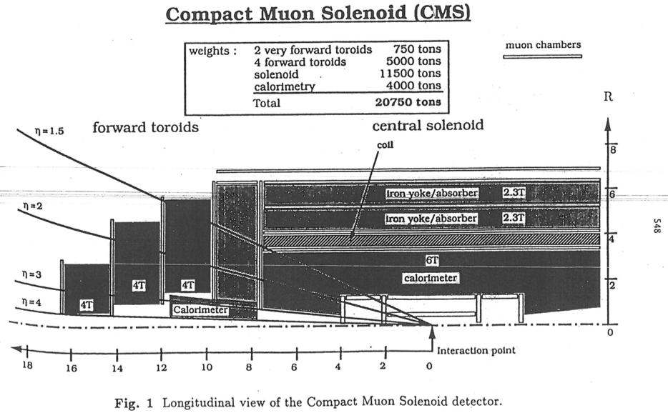
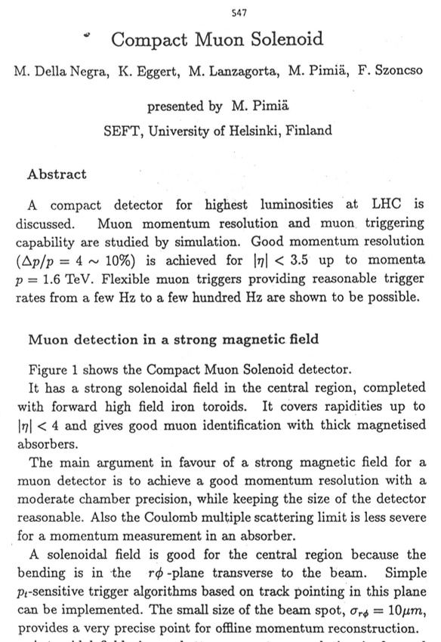
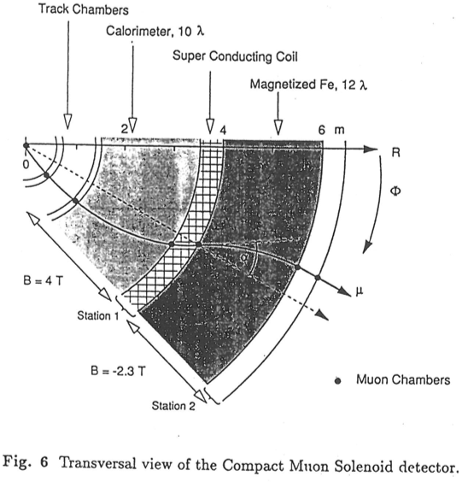
An Idea starts Everything
ECFA Aachen Workshop, 4. Oct 1990

Slide 8
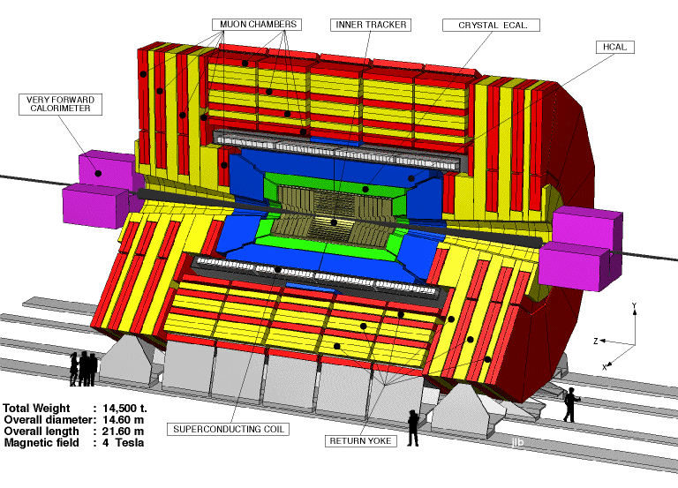
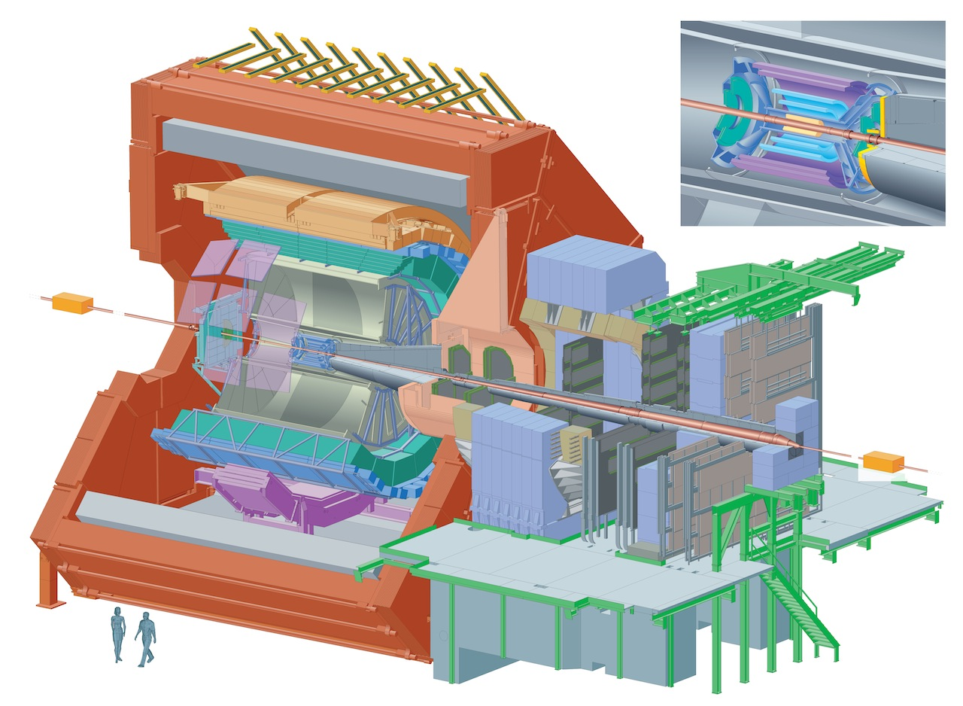
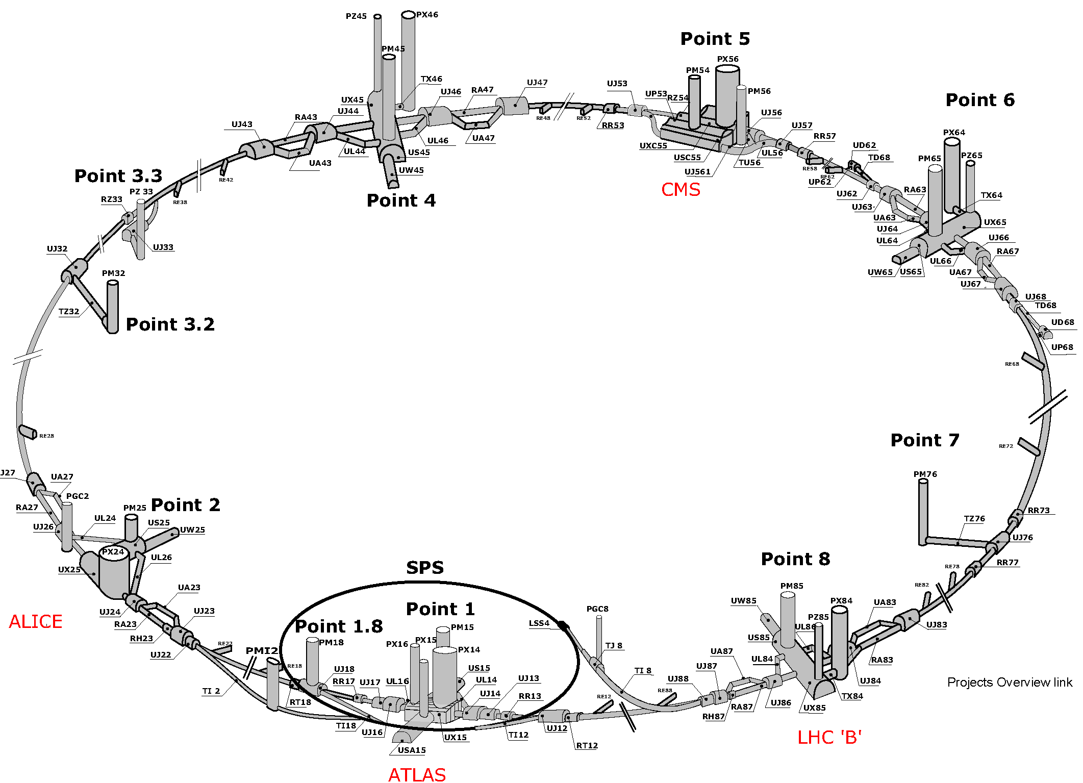
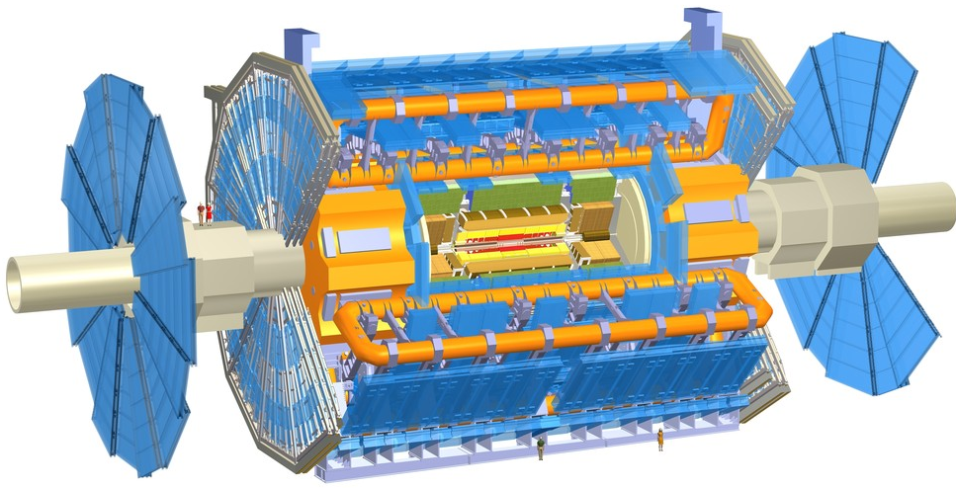
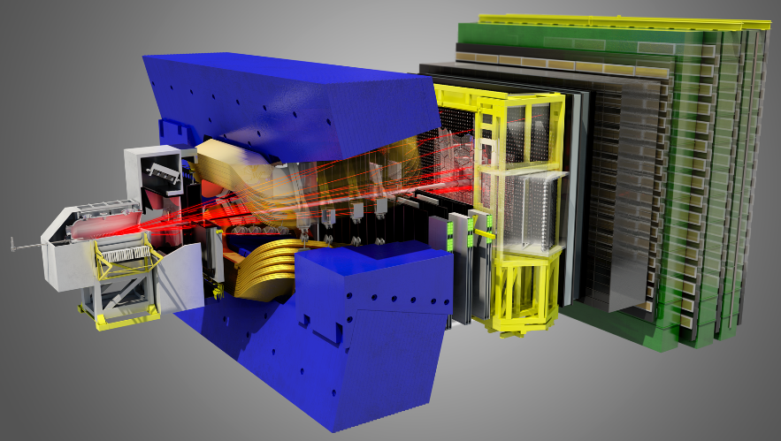
LHC Experiments
CMS
weight 12’000 tons
height 18m
length 22m
~3000 scientists
ALICE
weight 10’000 tons
height 16m
length 25m
~1200 scientists
weight 7’000 tons
height 22m
length 45m
~3000 scientists
weight 5’600 tons
height 10m
length 21m
~620 scientists
ATLAS
LHCb

Slide 9
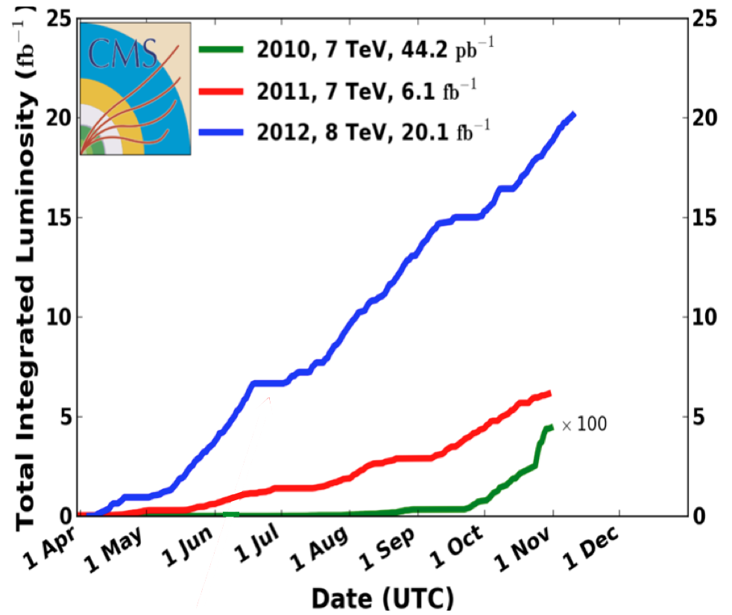
Detector performance of LHC experiments
Enormous growth (~10⁵) of LHC luminosity since startup
Experiments constantly adapting
- algorithms
- FPGA firmware
- DAQ software
Problems showed up with rates !
Low lumi periods allowed debugging
Overall things have worked as planned !
→ great success !
High channel segmentation of experiments has paid off (so far)
- operational channels (typ > 98% or better) & well calibrated
Flexibility in detector specific, low level digital data manipulation by FPGA’s has been crucial to this success story. → lesson for HL-LHC and other ambitions projects

Slide 10
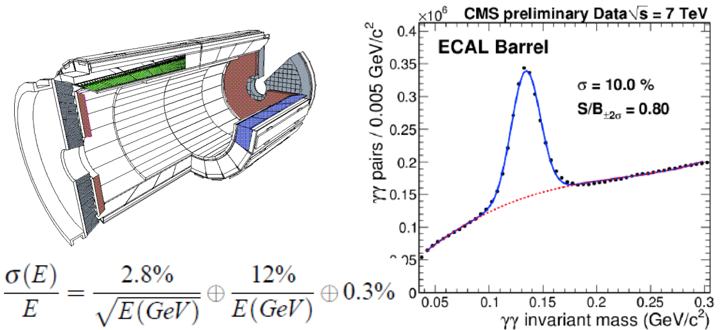
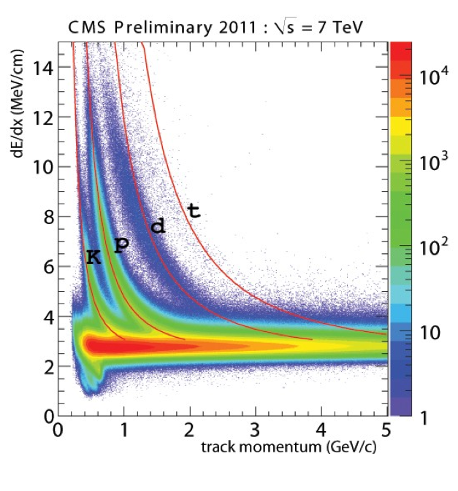
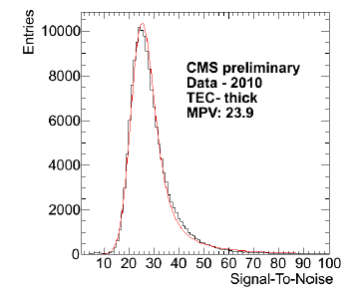
CMS
CMS ECAL
all sub-detectors in good shape
well calibrated & aligned
Trigger & DAQ runs ~100KHz
Data taking efficiency ~93%
jet energy resolution improved by particle-flow using tracker info
Silicon Strips ~200m² !
alive channels : 98%
analog pulse height readout
Pixels pixel size = 100μ x150μ
- alive pixel channels : 97%
- Pixel threshold = 2500 e
- in-time threshold ~3200 e
- analog pulse height readout
measured position resolution:
rϕ = 12.7μ +/- 2.3μ
z = 28.2μ +/- 1.9μ
measured impact parameter (10GeV)
δ (rϕ) = 25μ
δ (z) = 45μ
deconvolution mode (25ns)

Slide 11
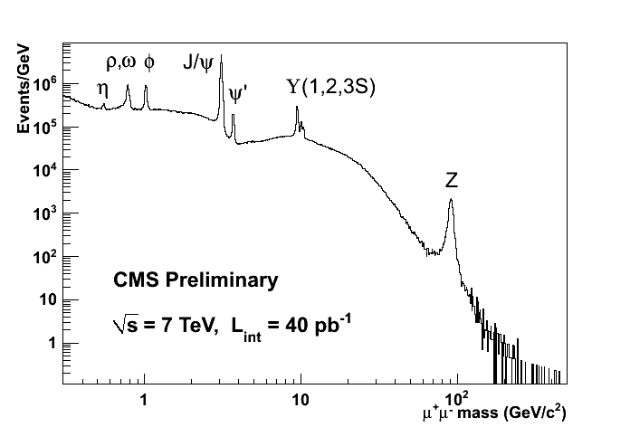
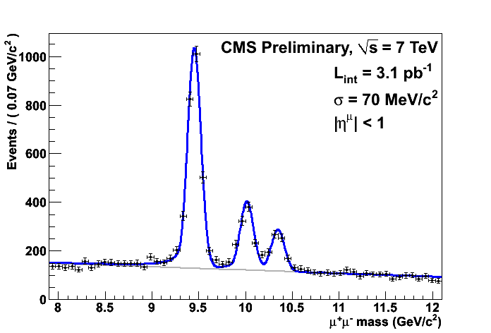
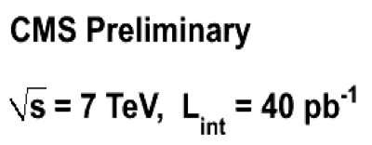
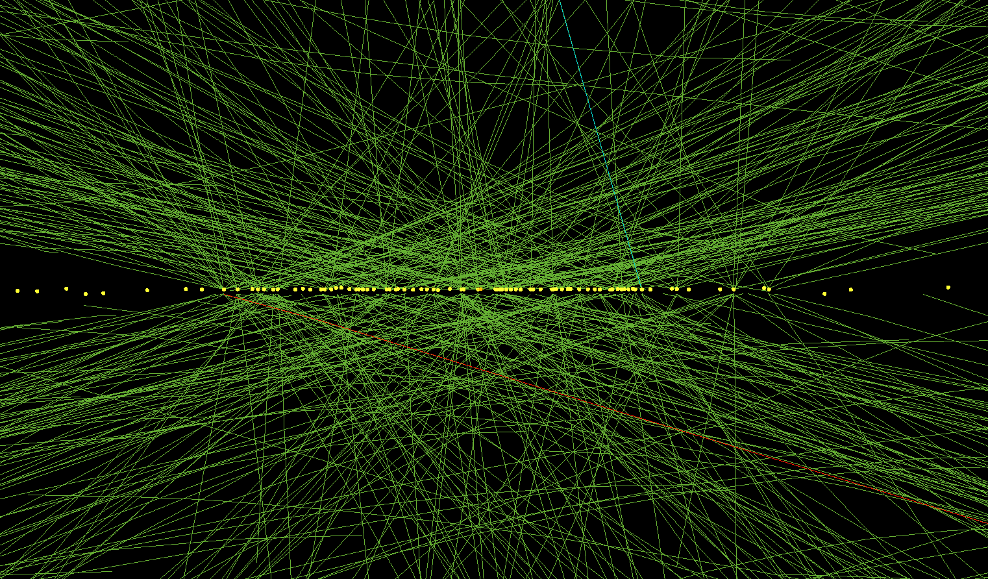
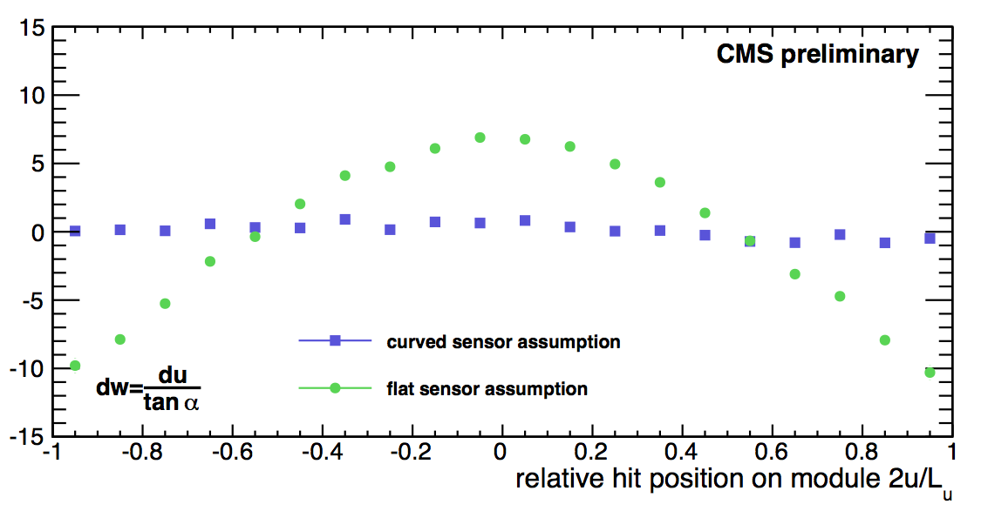
CMS highlights
μ-chambers with silicon/pixel tracker and 3.8T B-field allows excellent muon p_{T}- resolution
Pixel Detector with excellent z-resolution and 2-track separation allow superbe reconstruction of multiple pp-interactions (pile up events)
primary vertex reconstruction of high pile up event
Tracker Alignment with Data (Milepede/HIP)
Residual Si-strip module
residual [μm]
r-z-view of 78 vertices

Slide 12
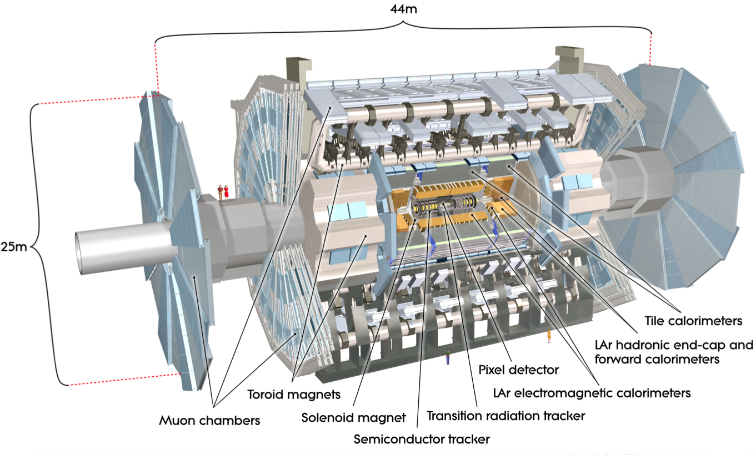
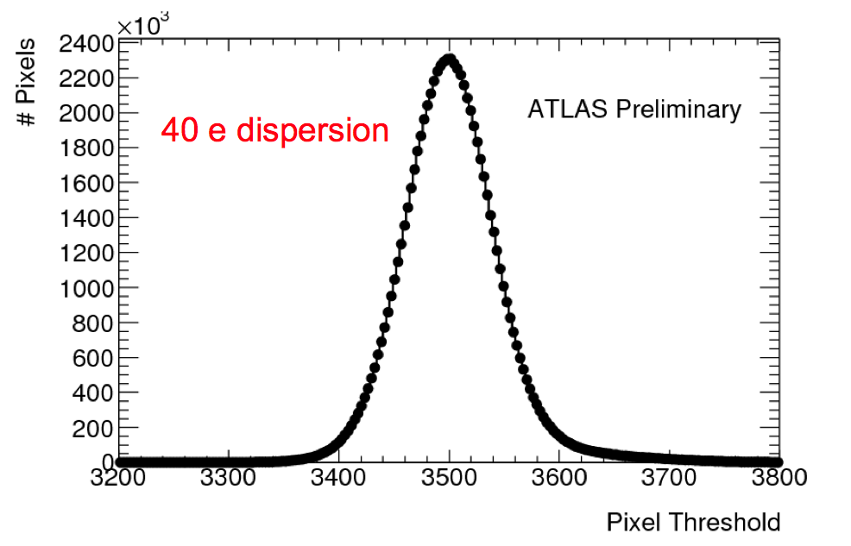
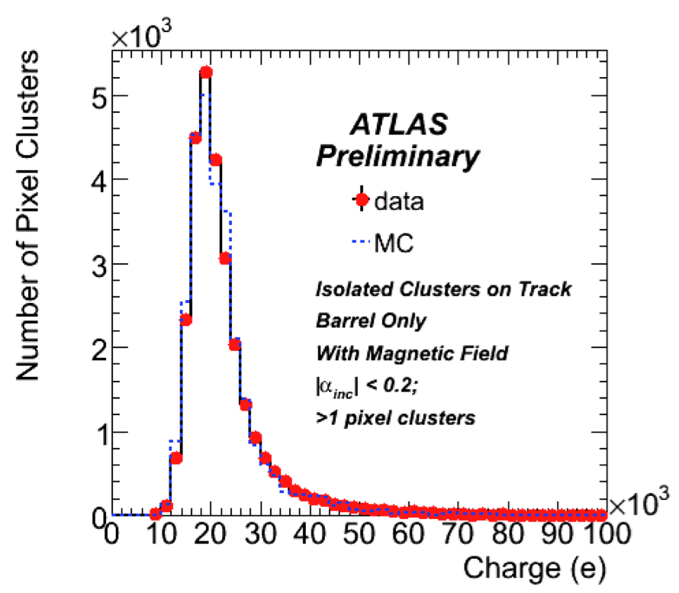
ATLAS
works very well
run efficiency 95.8% !
highly segmented Liquid Argon (LAr) calorimeter performs excellent in H→ γγ
Inner Tracker(|η|<2.5,B=2T):
Si pixels/strips, TRD
σ/p_{T}~ 0.04%pT(GeV)⊕1.5%
ECAL(|η|<5):
Pb-LAr Accordeon
σ/E ~ 10%/√E ⊕0.7%
HCAL(|η|<5):
Fe/scintillator tiles (cen)
Cu/W-LAr (fwd)
σ/E ~ 50%/√E ⊕3%
Muon spectr. (|η|<2.7):
< 10% up to E_{μ}~ 1 TeV
Pixels pixel size = 50μ 400μ
Pulse
alive pixel channels : 95% (80Mpixel, largest at LHC)
pixel threshold (in-time) = 3800e
meas. resolution: rϕ = 19μ z =115μ
Well adjusted pixel thresholds
Pulse-height by ToT

Slide 13
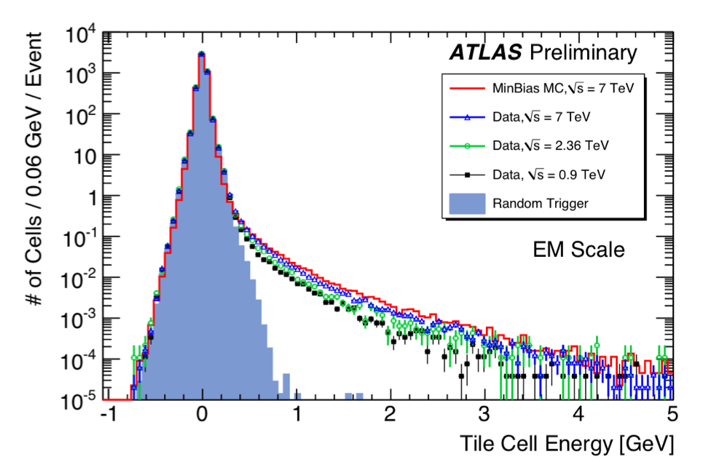
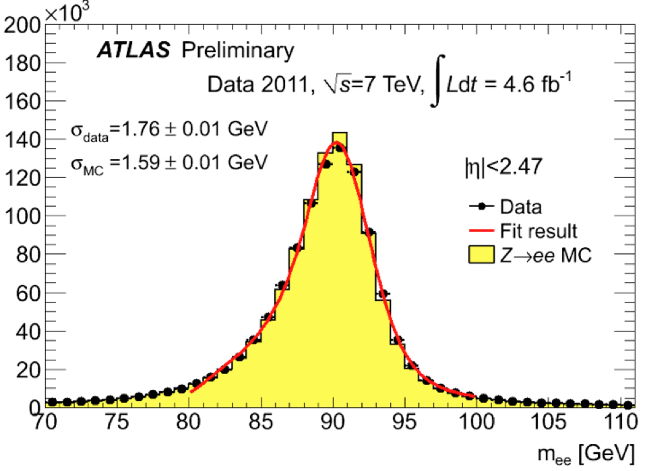
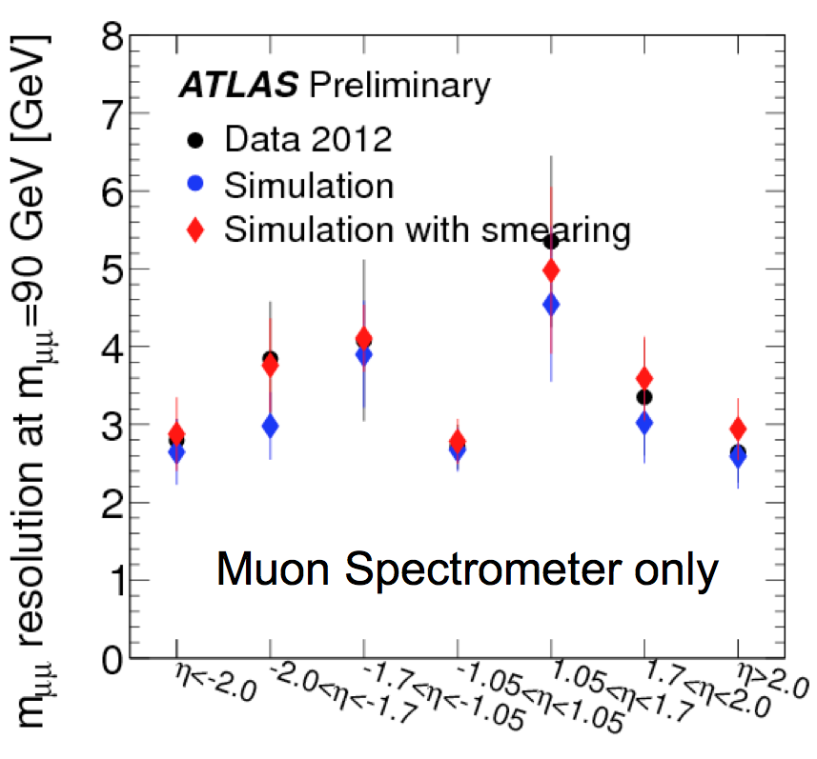
General Comment: remarkable agreement between Data & MC
Pb/scint. tile hadron calorimeter
Z→ e⁺e⁻ electromagn. calorimeter
Performance muon spectrometer:
μ reconstruction efficiency ~ 97%,
– constant for p_{T} > 6GeV and |η|<2.7
– not affected by pile-up
mounting of muon chambers ~ mm
- after alignment position known ~40μ

Slide 14
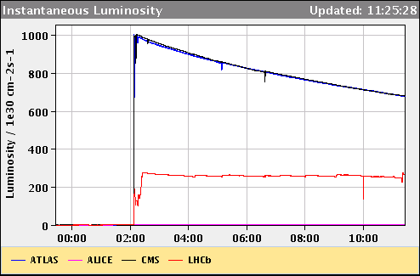
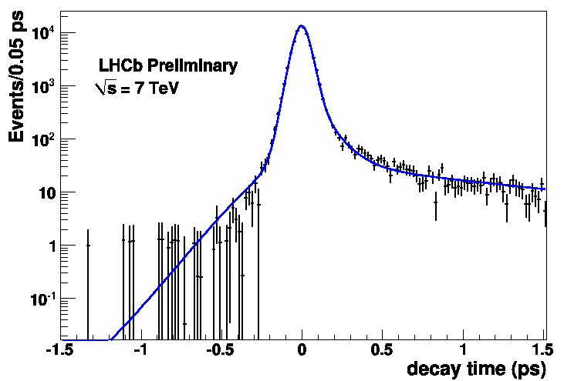
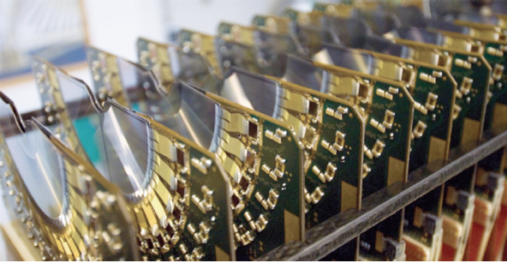
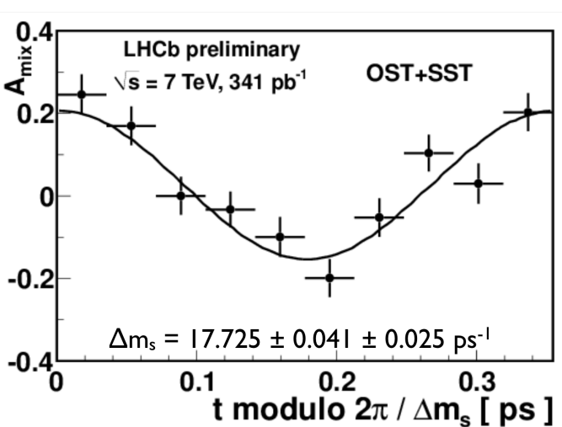
LHCb
ATLAS/CMS
Luminosity leveling → L ~ 3∙10³² cm⁻²s⁻¹
Experiment operates well (at 50ns) with μ ~ 1.5 beyond design of μ ~ 0.6
RICH works very well in complex events !
LHCb
Lumi Leveling by
displacing the beams
design
VELO: Proper-time resolution
[LHCb-CONF-2012-02]
Remarkable little running inefficiency 1.4% due to VELO closing/opening to beam
σ_{t} = 45 fs
B_{s}–B_{s} oscillations measured
[LHCb-CONF-2011-50]

Slide 15
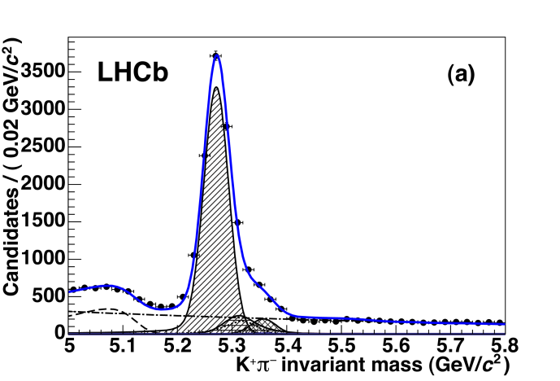
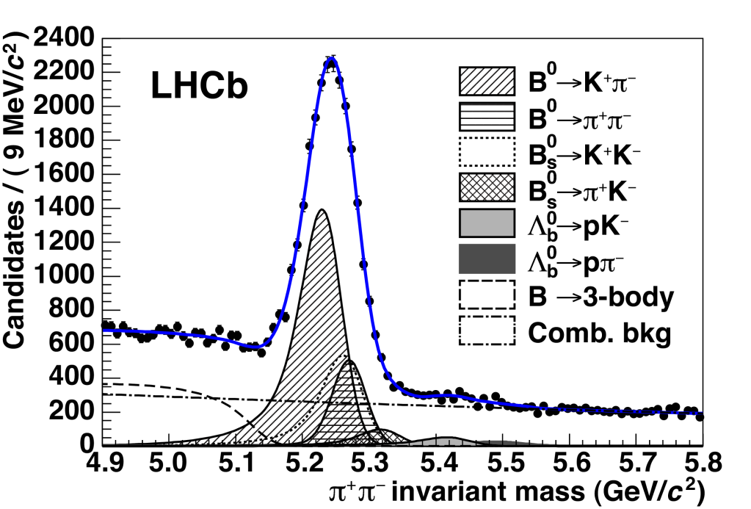
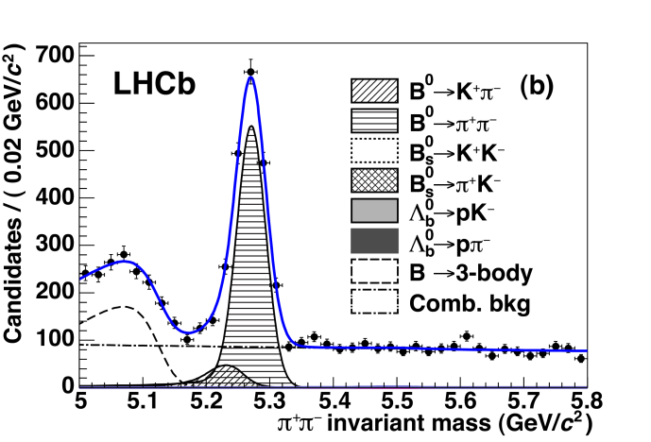
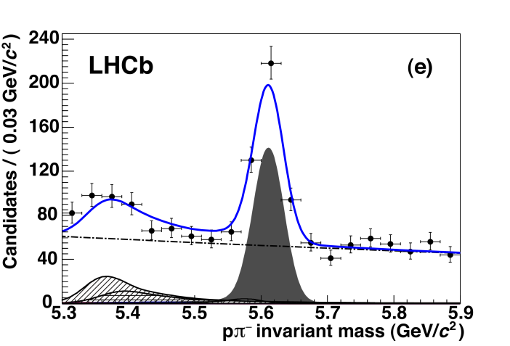
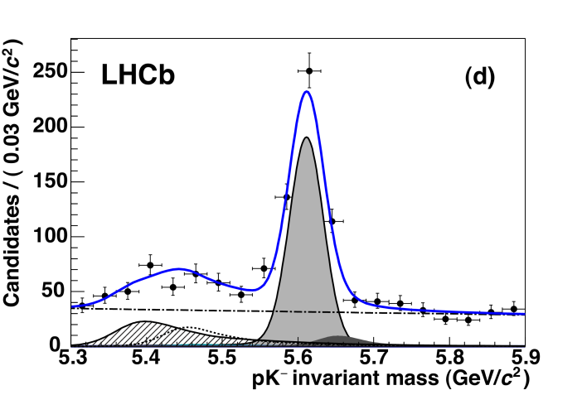
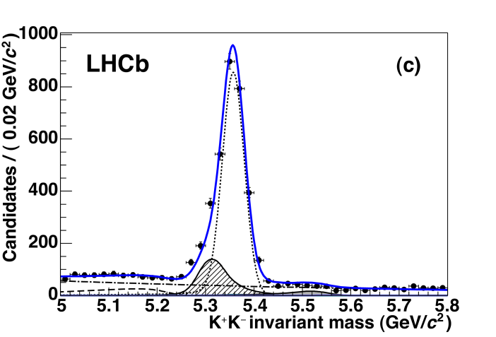
LHCb: Particle Identification Performance
[JHEP 10 (2012) 037]
Plot with ππ hypothesis - No RICH
B⁰ → Kπ
from talk of Pascal Perret , LPC Clermont
B⁰ → ππ
Λ_{b}→ pπ
Λ_{b}→ pK
B_{s} → KK

Slide 16
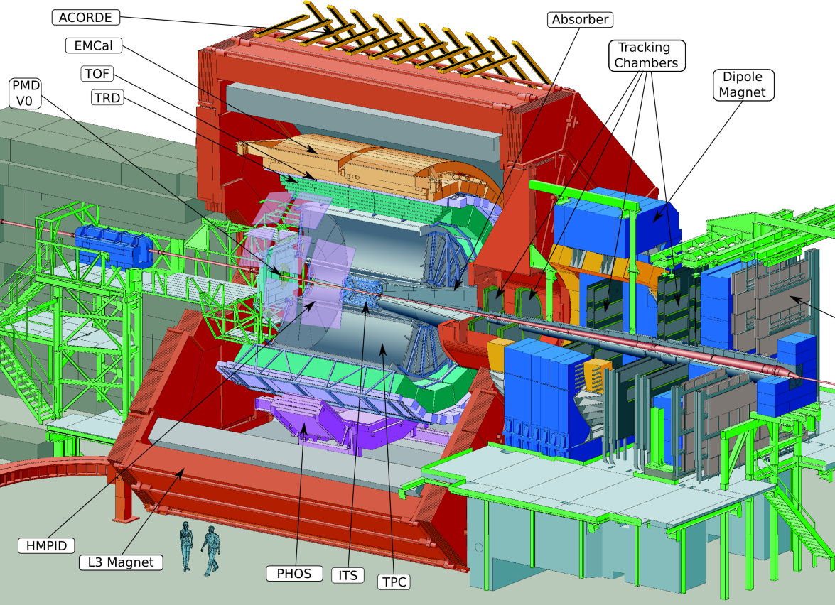
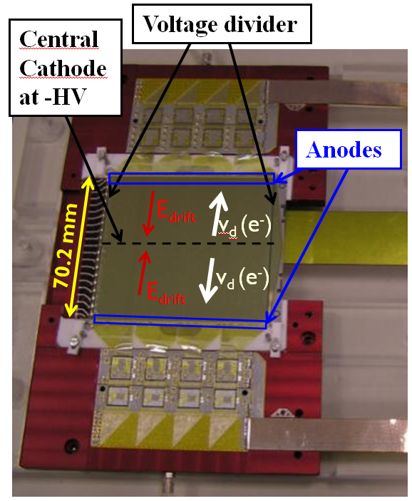
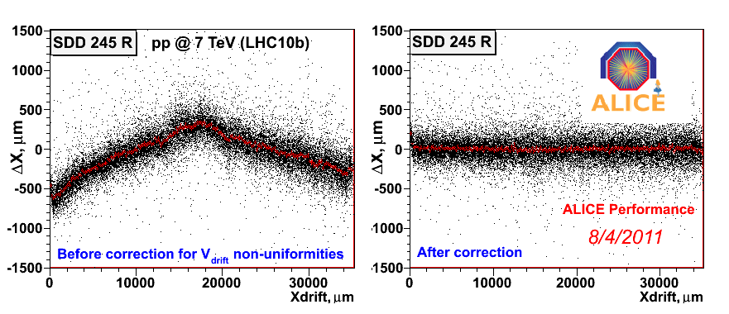
ALICE
Specialized on HI running but can do some things in pp
proves tracking at dN/dη ~6000
3 different silicon technologies
Silicon Drift Detector unique !
Calibration / Alignment of Silicon Drift Detectors
Impact parameter at 1GeV measured δ (rϕ) ~ 60μ !

Slide 17
Did LHC Detectors meet our Expectations?
Answer is clearly YES:
all LHC experiments producing beautiful results
experiments mastered to readout 80-90M channel at unprecedented data rates
different sub-systems having failure rates of few % only
observed performance very close to expected (planned) performance
running at significantly higher #int/crossing than foreseen (50nsec LHC bx, LHCb)
experiments dealt with unexpected back-ground conditions (CMS pixel PKAM-events)
please remember, that any of the LHC Detectors is a unique prototype
BUT
construction, commissioning and running did not go without problems
each case individual and no simple recipe for preventing in future (upgrade)
relatively small number of dedicated physicists keep experiments running
commissioning and calibration is never over, the battle goes on!
Worry: who will re-start the experiments in 2015 after LS1? training? career path?

Slide 18
Improvements and Upgrades
Data taking & physics analysis demonstrated eventual shortcomings of experiments
Upgrades due to:
- previous staging decisions (limited resources)
- different experimental conditions (LHC beyond design(>10³⁴) , 50nsec operation)
rather few due to poor decisions
Upgrades to experiments to be synchronized with LHC schedule
Upgrades divided into 3 Phases during Long Shutdowns (LS)
7/8TeV, L_{int} ~ 25 fb⁻¹
LS1 2013-14 : Phase 0 → ATLAS IBL (add 4th layer)
13/14 TeV, L_{int} ~ 100 fb⁻¹
LS2 2018-19: Phase 1 → CMS Pixel Upgrade (4 new layers) 2016/17
14TeV, L_{int} ~ 300 fb⁻¹
LS3 2022-? : Phase 2 → ATLAS & CMS replace complete tracker
14TeV, L_{int} ~ 3000 fb⁻¹
A few proposed upgrades are presented: (appology to all others)
ATLAS Insertable B-Layer (IBL)
CMS Pixel Upgrade
LHCb & VELO Upgrades
Resistive MicroMega for ATLAS μ-Chambers

Slide 19
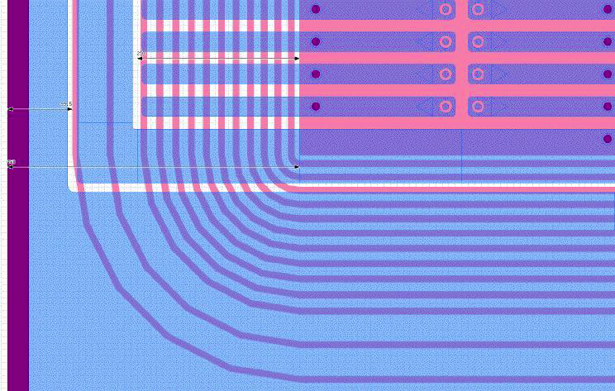
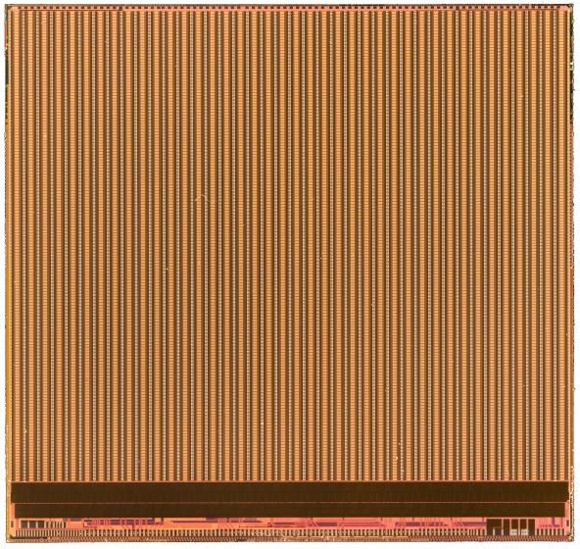
ATLAS IBL Upgrade
FE-I3 gets inefficient at HL-LHC
new FE-I4 ROC in 0.13μ CMOS
new pixel size 50μ x 250μ
chip shows excellent behavior
- low pixel threshold ~1600 e
- very rad. tolerant
- low power (22μW/pixel)
IBL installation in LS1 (2013-2014)
Sensor options: planar n-in-n and 3D
Remarkable: planar sensor with ~200μ pixel to edge
in-pixel storage
trigger
200µm
long pixel 500µm
pixel 250µm
“standard“
18.8mm
Trig’ed hits
storage
buffering
trigger
trigger
data out 160Mb/s

Slide 20
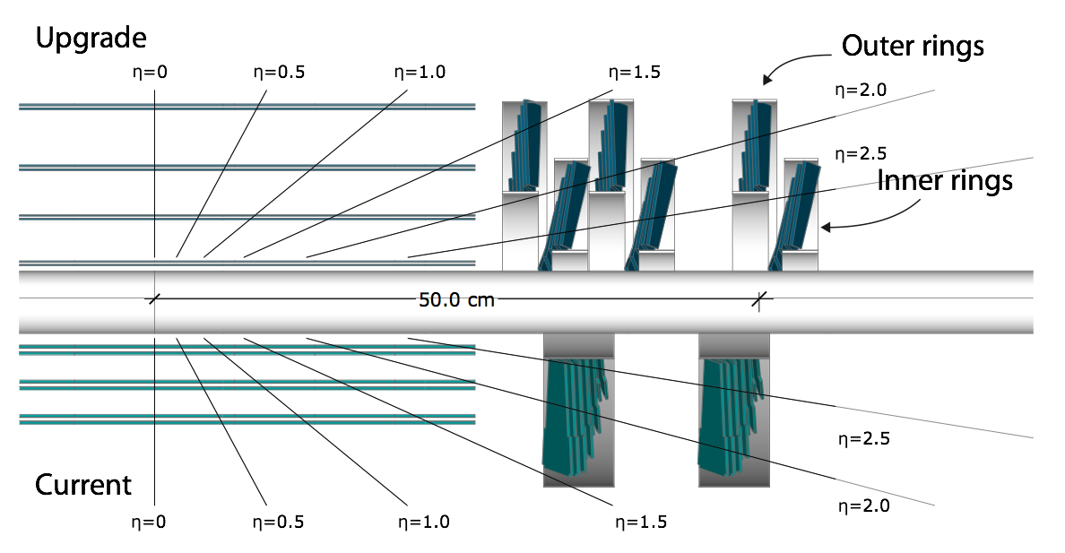
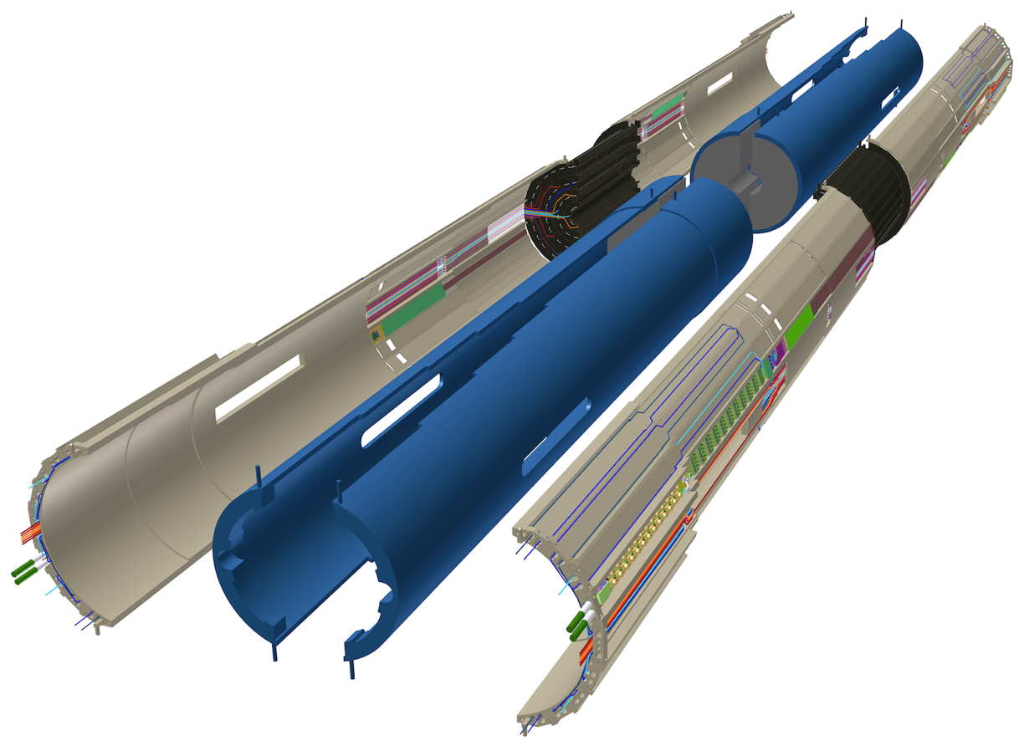
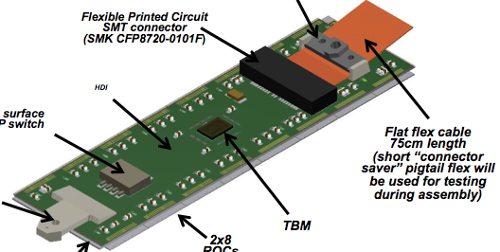
significant involvement by CH-consortium
CMS Pixel Upgrade
Minimal changes to system
Vertexing in large PU events
→ 3 layers to 4 layers !!
Shift material to high η , CO₂ cooling → reduced impact par. & γ conversion
Modify ROC for 2x10³⁴ operation
→ reduce data loss at r_{L1}=29.5mm
new beam pipe
Pixel ROC modified for 2x10³⁴
40MHz analog → 160MHz digital
0.25μ CMOS, 5Metals → 6Metals
increase depth of
- data buffer 32 → 80
- timestamps 12 → 24
add readout buffer (64)
add 8 bit ADC for pulse height
1600 e in-time pixel thresholds
PKAM events → DAQ resync
mass production Q3 2013
Pilot-system in LS1
Supply Tube & UL Mechanics
Install few Pilot-Modules in existing FPIX for DAQ running in 2015/16
Operate DC-DC converters with present strip tracker.
DC-DC converters
Opto-Link at 400Mb/s
CO₂ cooling
Uni. ZH

Slide 21
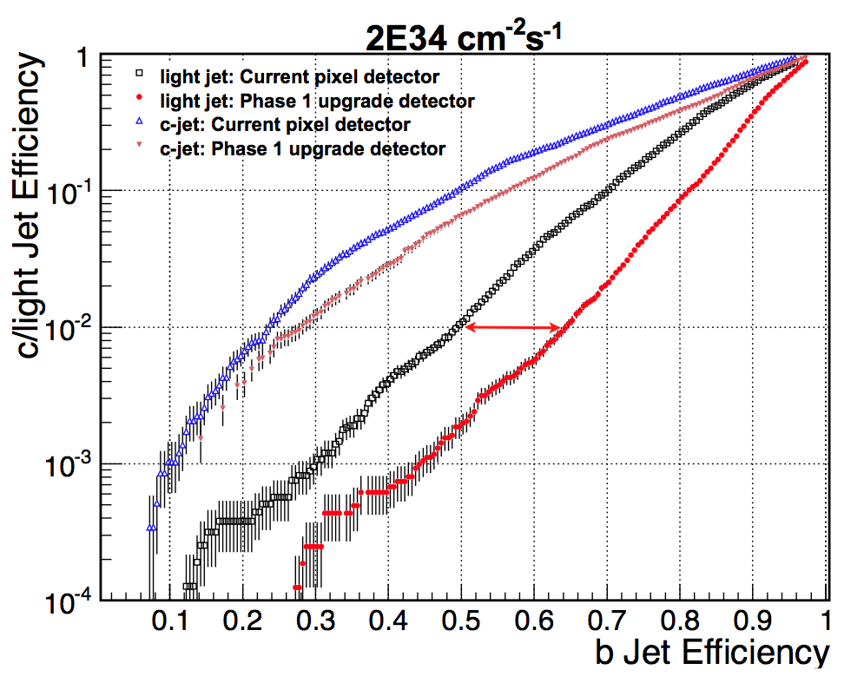
Performance in Vertexing & b-Tagging
H → ZZ*→ 4 l
signal efficiency gain: H→ 4μ +41%
H→ 2μ2e +48%
H→ 4e +51%
( ←→ 50 PU)
b-jet efficiency
~ 1.3x better
@ 10⁻² udg-rej.
2 b-jets → (1.3)² ~1.69
current
Primary vertex res-olution improved by factor ~1.5 - 2
upgrade
Upgrade detector much more robust to pile up than current one.
Upgrade @ 50 PU ~ Current @ 0 PU → maintain physics capability or better at large PU

Slide 22
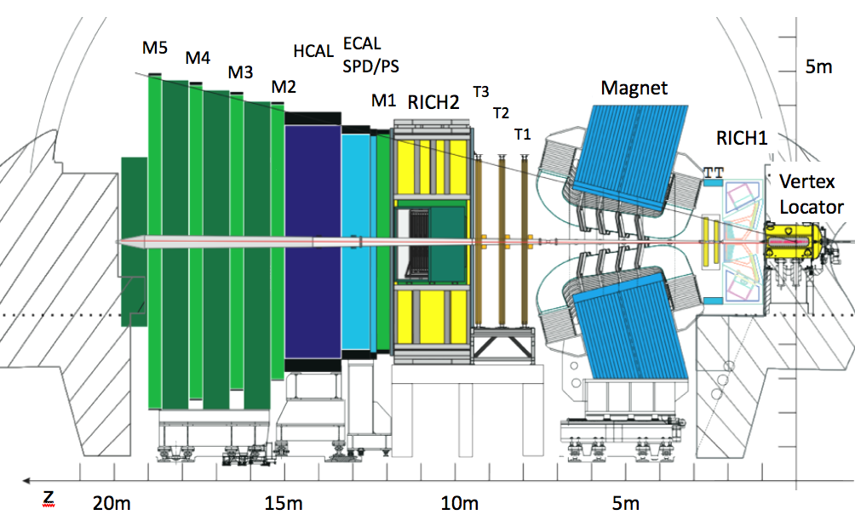
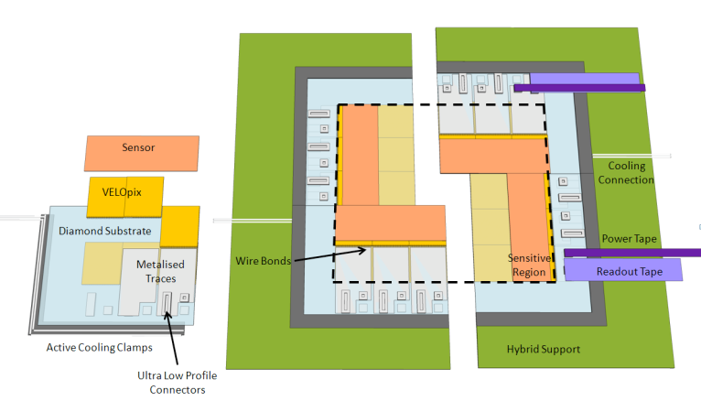
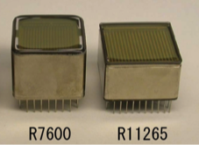
LHCb & Velo Upgrade
Calorimeters: replace R/O
New Silicon Tracker
New Vertex
Detector
5fb⁻¹ → 50fb⁻¹
open access allows simpler change
trigger limitations 1MHz → 40MHz
software trigger with 20KHz output
should deal with int. rate μ ~2.1
TORCH
RICH: change HPD’s to MAPMT’s
VELO Upgrade Options:
Strip detector: strip pitch 30μ
VELOPIX , Timepix based 55μx55μ
pixel ROC, large data rates output
PID Upgrade (keep RICH-1 & RICH-2)
HPD’s with 1MHz ROC → MAPMT’s 40MHz
Under development
@ Hamamatsu

Slide 23
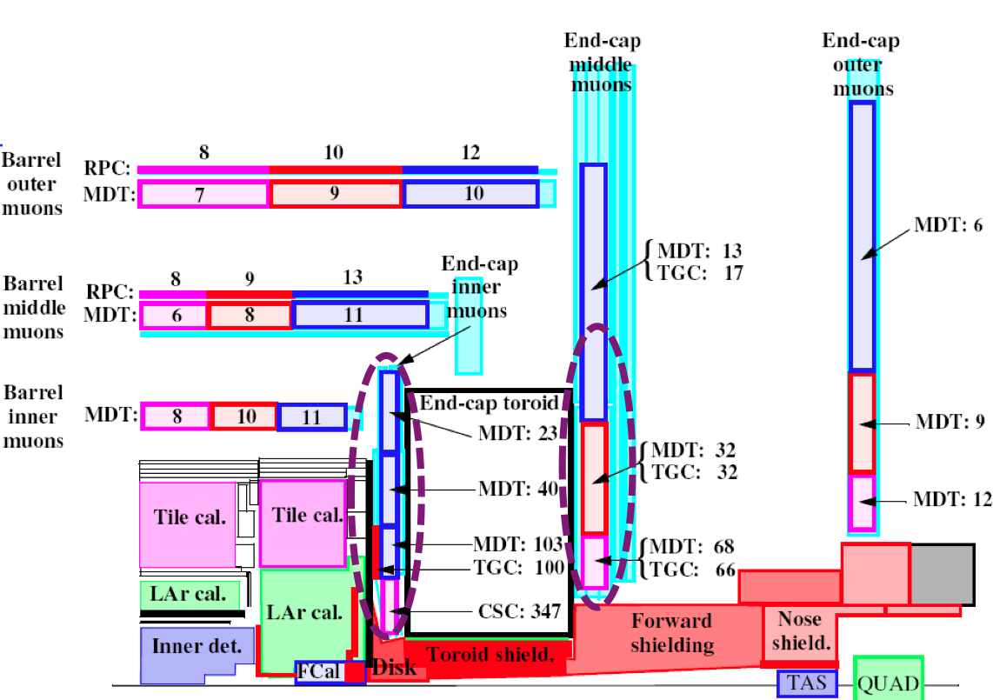
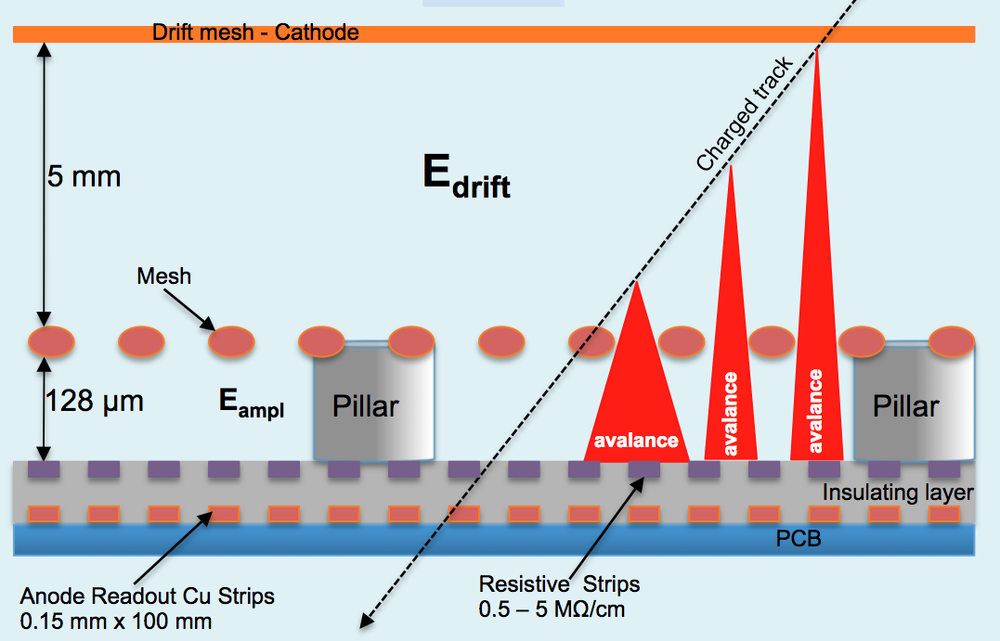
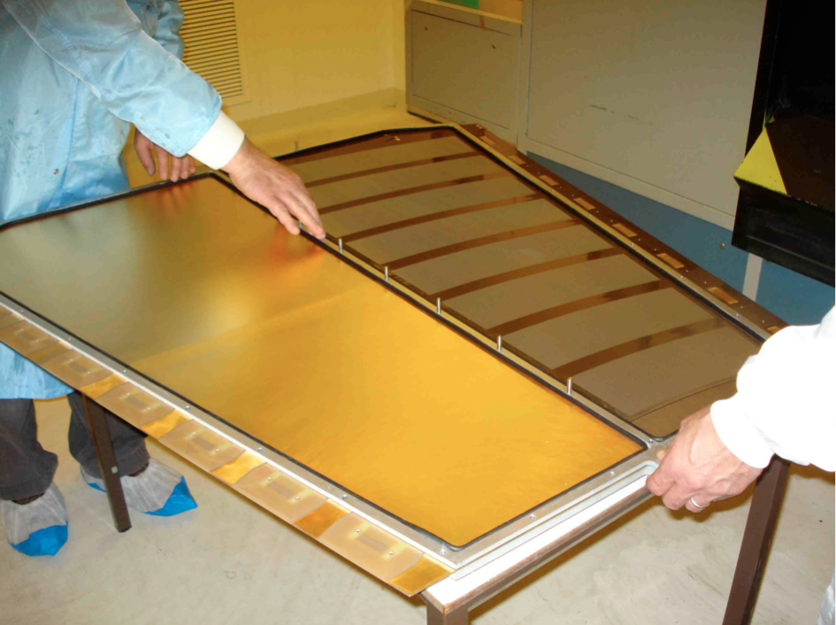
ATLAS μ-Chamber Upgrade
Reduce forward muon fake rate
several technologies considered, show here:
Resistive MicroMegas
designed for tolerating sparks
resistive strip parallel to readout strip
Technology is cheap → 200m²
1.2m x 0.6m resistive MM
Prototype (9cmx8cm) tested with neutrons ~10⁶/cm² . Shows no sparking compared to normal MM!

Slide 24
Challenges to Tackle
HL-LHC Performance Estimates
( min. β* =15cm , CRAB cavities )
Parameter | nominal | 25ns | 50ns
N | 1.15E+11 | 2.0E+11 | 3.3E+11
n_{b} | 2808 | 2808 | 1404
Peak Luminosity | 1 10³⁴ | 7.4 10³⁴ | 6.8 10³⁴
Events/crossing | 19 | 141 | 257
worry ! (lumi leveling?)
Physics analysis with many overlapping PU events is likely to suffer from
MET resolution
jet energy resolution
jet-jet separation
Triggering problems → fast readout links are useful

Slide 25
Missing Transverse Energy with CMS
In CMS different methods to calculate
Missing Transverse Energy (MET) :
Calorimeter MET
Track-corrected MET
Particle flow MET (pfMET) → best results
Missing Transverse Energy can be faked by
e.g. discharges or particle hits in photo-sensors !
Was dealt with careful algorithms !
F. Lacroix (U. Chicago / FNAL)
MET degradation .vs. # PU events
How about 257 PU ?
→ particle flow

Slide 26
High Granularity Particle Flow Calorimeters
M. Danilov, (ITEP), CALICE
Particle Flow Calorimeters have good chance to perform well even with many PU events.
Basic Particle Flow Algorithm:
Charged energy (65% in jet) – measure by tracking → separate multiple PU-events
Photon (25% in jet) – precisely measured in ECAL
neutrons / K_{L} (only 10% in jet) – measured in HCAL with moderate resolution
Have to subtract away the charged energy in observed HCAL showers
Confusion error in separation of showers is dominant
Need a highly segmented HCAL detector →
depth segmentation is crucial
CALICE AHCAL Prototype
calorimeter plane
90cm x 90cm
PF-Calos scaling like ΔE/E ~ 3%
38 layers with 2cm Fe (W since 2011)
Scint. tiles with SiPM readout

Slide 27
Insights, Technologies & “driving” Developments
Silicon sensors (basic material properties studies by RD50)
Irradiation in silicon sensors gives :
Surface damage from Ionizing Energy Loss (IEL) → surface charges (SiO₂)
Crystal damage from Non-Ionizing Energy Loss (NIEL) → energy levels in bandgap
the latter leading to leakage current, trapping centers and doping effects.
Type Inversion (doping)
Normalize dose Φ_{eq} to
damage of 1-MeV-neutrons

Slide 28
Observe the generation of universal, device doping independent
leakage currents
charge trapping times
Signal charge trapping is dominant effect of irradiation at 10¹⁵n_{eq} and above !
charge collection distance

Slide 29
Effective doping concentration N_{eff} depends on radiation activated defects:
Epitaxial silicon diodes irradiated with:
23 GeV protons
reactor neutrons
Depending an radii, HL-LHC experiments will expose their silicon sensors more to charged hadrons or neutrons → pixels (more hadrons) & strips (more neutrons)

Slide 30
Charge Collection in 3D Detectors
short charge collection distance
insensitive regions for tracks passing through electrode pillars. e.g. 90⁰ tracks
interleaved electrode pillars → capacitance !
3D sensors show avalanche charge multiplication after irradiation. (seen also in planar)
→ non gaussian sensor noise in read out
3D-silicon sensors planned in ATLAS ILB pixel upgrade

Slide 31
Diamond Sensors
(RD42, ETHZ)
Diamond pixel sensor can be operated at 300⁰K
Excellent thermal conductor → heat removal
Particle detectors from Chemical Vapor Deposited (CVD) Diamond are trapping defect dominated.
Mono-crystalline diamonds show much better charge collection distances !
Mono- / Poly-crystalline Comparison
Poly-crystalline material shifted by ≈ 3.8 × 10¹⁵ p/cm² to mono-crystalline material
Running construction projects:
- ATLAS Beam Conditions Monitor
- CMS Pixel Luminosity Telescope
- ATLAS Diamond Beam Monitor

Slide 32
Summary & Conclusions
LHC detectors have produced marvelous results and performed very well
Appologize for all the superbe sub-detector results not mentioned here
Remarkable physics performance of both GP LHC experiments, with rather different design choices
Each experiment is a unique prototype with its very unique problems
Not everything went perfect at all times, but ingenuity and dedication of people allowed to cope with problems, even beyond design boundary conditions
Commissioning & calibration continues → algorithmic performance upgrade
Role of micro-electronics is crucial
- reduce costs of highly segmented systems
- reduce power of digitisation/wave form sampling & read-out
- fast timing in highly segmented systems (very forward E/HCAL 20-30psec possibel )
- flexible detector specific digital data manipulations (FPGA)
High speed data read-out links will play a crucial role in upgrade of LHC detectors

Slide 33
Relatively low mass of the Higgs-like particle implies fairly soft pT spectrum
→ must use relatively low threshold triggers under challenging pile-up conditions
→ high speed data readout links (opto-links) could evtl. save us!
HL-LHC with many Pile-Up events will challenge calorimeter based physics analysis
Tracker crucial in this task → particle flow → combined tracker-calorimeter design
Tracker needs to be designed for particle flow task → e.g. re-seeding at outer radii
However:
Feed back mechanism from physics to improved hardware not so clear established
Segregation of physics analysis community to detector builders is serious problem.
Hopes:
High eta region (2.5-4.5) detectors could be pioneered and could pionieer new very high performance technologies (pixels 1-2μm resolution , highly segmented calorimeter) → design cycle possibility for young LHC physicists.

Slide 34
Thank you for your attention !

