Slide 1
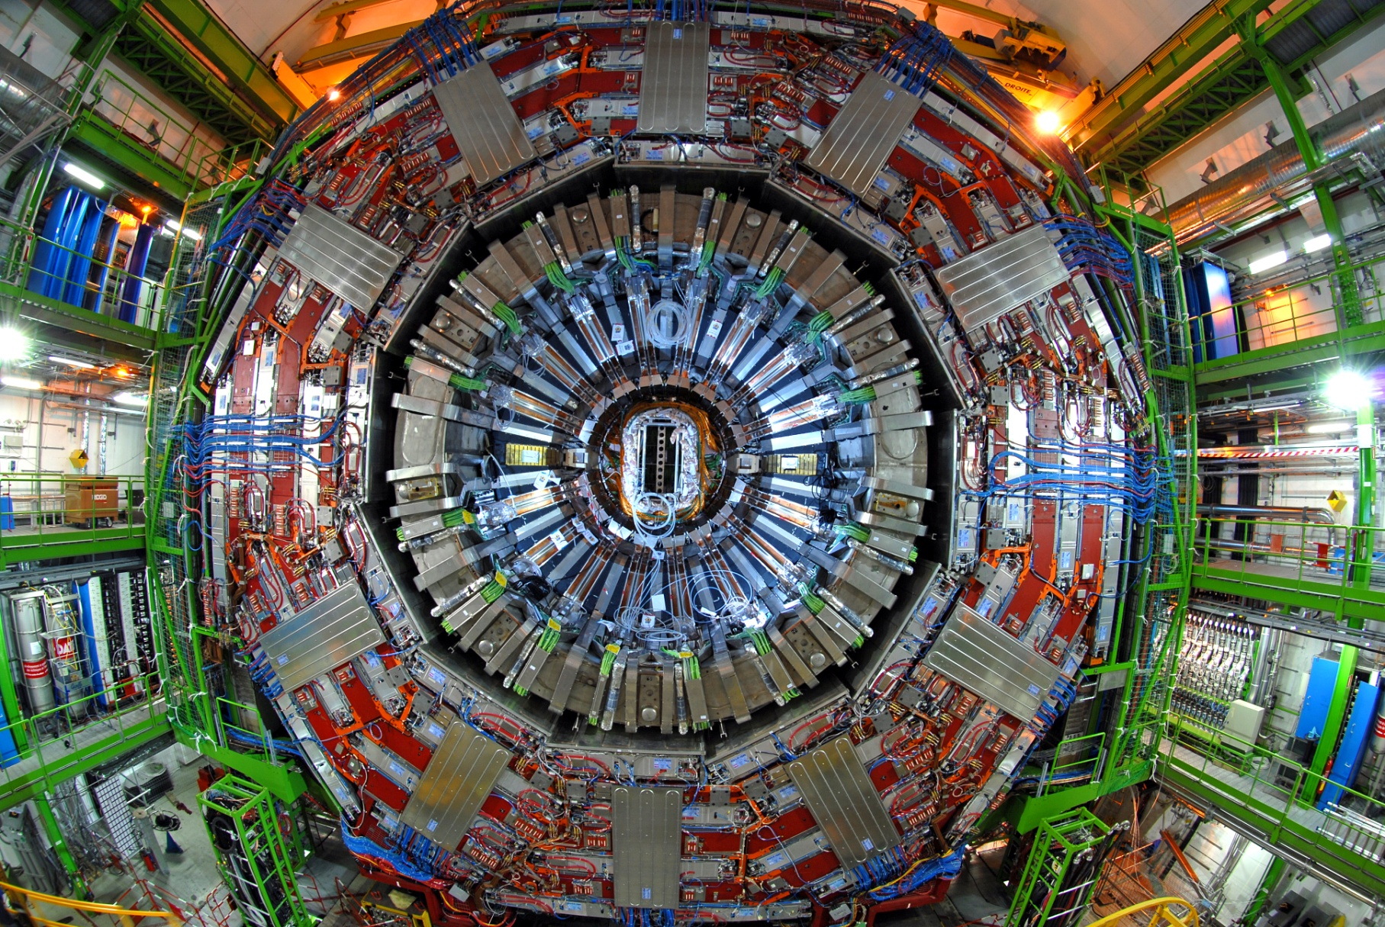
The CMS Particle Flow algorithm in CMS
Boris Mangano (ETH Zürich)
on behalf of the CMS collaboration

Slide 2
Tracker
Reconstruct & identify all stable particles in the event in a optimal way
ECAL
HCAL
Magnet
Muon

Slide 3
μ
neutral hadron
photon
charged hadrons

Slide 4
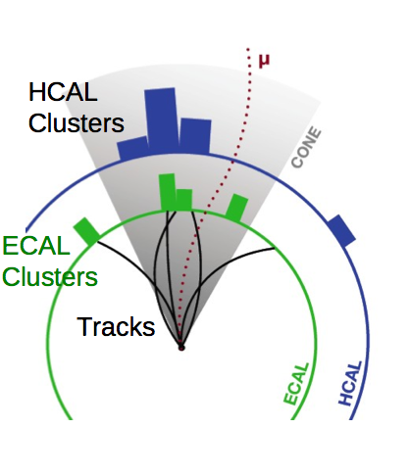
From particles to PF particles
“True” or generated particles
Detector measurements
μ
neutral hadron
Particle Interaction & Detection
photon
charged hadrons
Analysis
as if it is done on generator level particles
PF particles
μ
neutral hadron
Particle Flow reconstruction
photon
charged hadrons

Slide 5
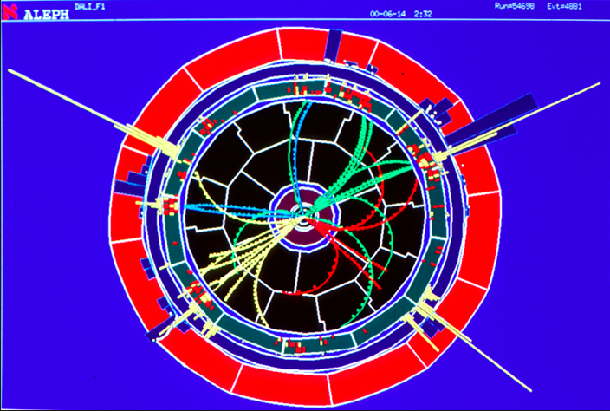
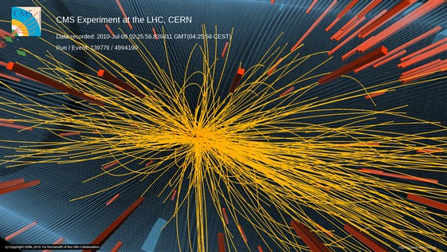
Particle flow past and present

Slide 6
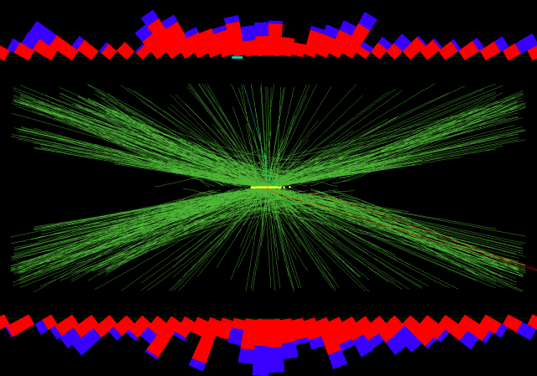
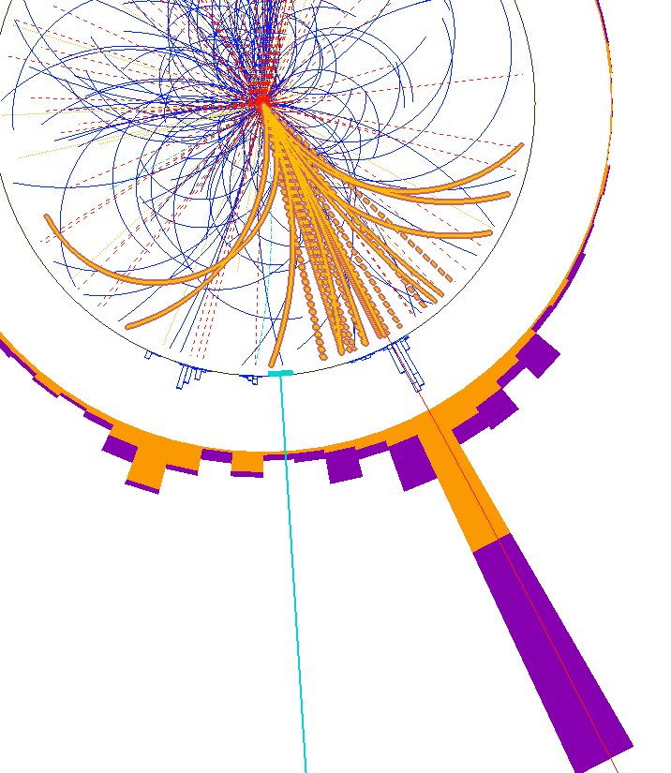
Particle flow and jets
Transverse view (x-y plane)

Slide 7
Calorimeter resolution:
Can Tracker help Calorimeter also in this?
Calorimeter (E_{ecal} + E_{had}) resolution to hadrons:
For CMS,
stochastic term a ≈ 110-120%
Why is it so large and how can be reduced?
Let’s consider for a moment a toy model for a calorimeter
Calorimeter response R is:
R=1 for E=20 GeV
R<1 for E<20 GeV
R>1 for E>20 GeV

Slide 8
Calorimeter resolution & response: fragmentation
measured energy
45 GeV
55 GeV
40 GeV
calorimeter
35 GeV
20 GeV
20 GeV
5 GeV
20 GeV
30 GeV
fragmentation/hadronization
20 GeV
20 GeV
20 GeV
10 GeV
50 GeV parton
50 GeV parton
“true” energy
50 GeV parton

Slide 9
Calorimeter resolution & response: fragmentation
measured energy
45 GeV
calorimeter
20 GeV
5 GeV
20 GeV
Measured jet energy depends on how the parton fragment
fragmentation/hadronization
20 GeV
20 GeV
10 GeV
50 GeV parton
“true” energy

Slide 10
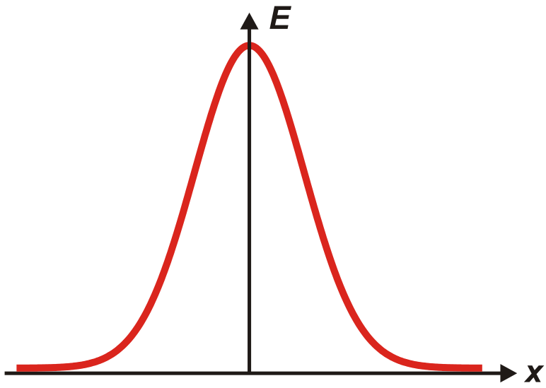
Calorimeter resolution: intrinsic fluctuations
20 GeV
20 GeV
21 GeV
19 GeV
calorimeter
single particle
20 GeV hadron
20 GeV
20 GeV
20 GeV
Single particle energy measurement depends on intrinsic fluctuations of:
calorimeter sampling
showering
....

Slide 11
Tracker+Calorimeter: JetPlusTrack
Option 1:
subtract from calorimeter measurements the expected average energy deposit caused by the pointing tracks
calorimeter clusters
20 GeV
5 GeV
20 GeV
20 GeV
reduces effect of parton fragmentation
measurement is still sensitive to intrinsic calorimeter resolution
reconstructed tracks
20 GeV
10 GeV
“JetPlusTrack” or EnergyFlow approach

Slide 12
Tracker+Calorimeter: ParticleFlow
Option 2:
replace observed calorimeter cluster energy with the energy of the pointing/matched tracks
calorimeter clusters
20 GeV
5 GeV
20 GeV
20 GeV
reduce effect of parton fragmentation
effectively replace calorimeter energy resolution with tracker momentum resolution for charged hadrons
neutral hadrons reconstruction still dominated by calorimeter resolution
reconstructed tracks
20 GeV
10 GeV
reconstructed particle
50 GeV parton
Particle Flow approach

Slide 13
A real case: CMS detector
Calorimeter jet:
  E = E_{HCAL} + E_{ECAL}
  σ(E) ~ calo resolution
  to hadron energy:
  120 % / √E
  direction biased (B = 3.8 T)
Particle flow jet:
  charged hadrons
    σ(pT)/pT ~ 1%
    direction measured at vertex
  photons/electrons
    σ(E)/E ~ 1% / √E
    good direction resolution
  neutral hadrons
    σ(E)/E ~ 120 % / √E
Still poor resolution, but neutral hadrons are the smallest component of the jet/event particles:
70% charged hadrons
20% photons
less than 10% neutral hadrons

Slide 14
Jet energy resolution
Particle Flow converges to a calorimetric measurement at high p_{T} when:
calorimetric clusters corresponding to different particles cannot be separated
calorimetric resolution is comparable or better than tracker one

Slide 15
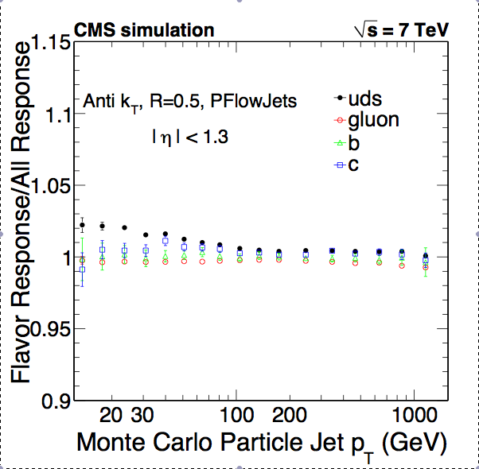
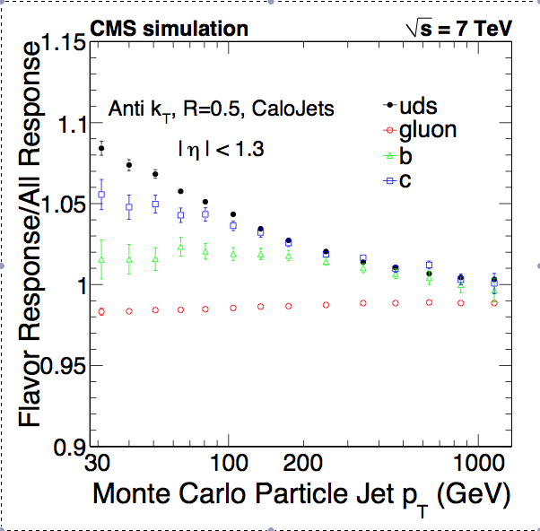
Jet energy response
Calo Jets
PF Jets
PF jet response almost independent from the flavour of the jet-initiating parton

Slide 16
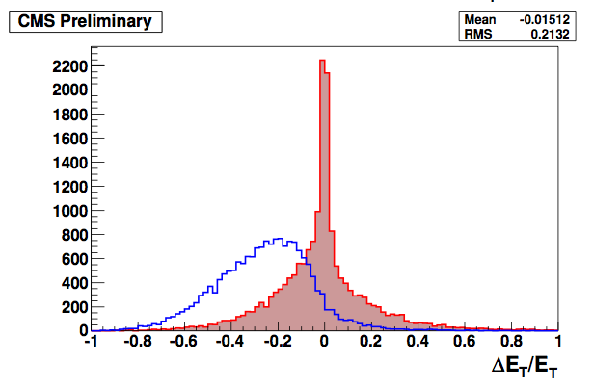
Tau reconstruction
SIMULATION
π⁺
π⁰
π⁻
π⁺
Barrel
particle flow
calorimeter-based
τ
Particle flow is at its best in the reconstruction of taus: neutral hadron component (the component that is worst measured) is minimal

Slide 17
MET resolution
Z p_{T} > 100 GeV

Slide 18
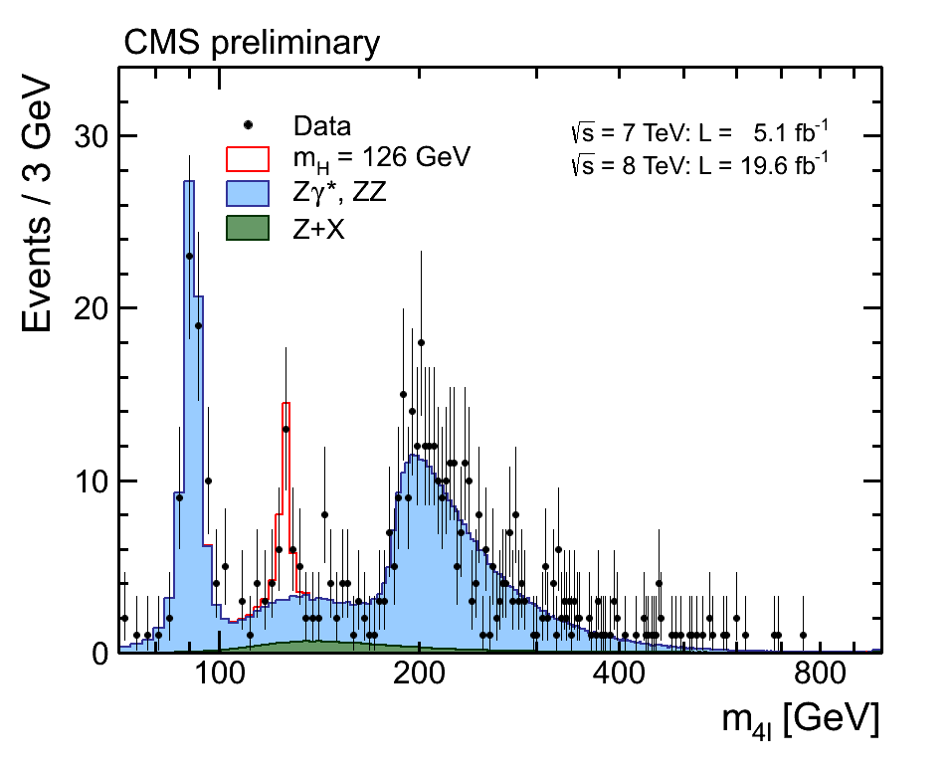
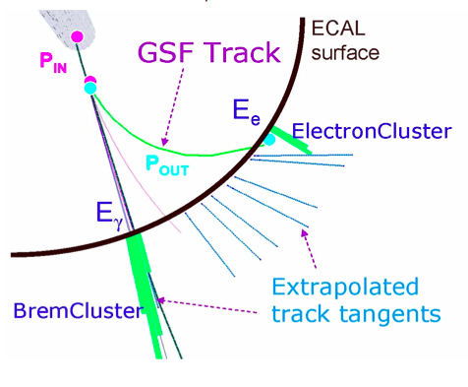
Electron reconstruction and Isolation

Slide 19
CONCLUSION
The CMS Particle Flow:
  Improves the reconstruction of basically all physics objects (resolution improvement up to a factor 2X for Jets and MET)
  Makes analysis of data as if it is done on generator level particles
  Performs in data as expected from simulation
  Most analyses in CMS are now using Particle Flow

Slide 20

Why particle flow ?
The whole is greater than the sum of its parts (Aristotle)

Slide 21
Backup slides

Slide 22
Backup slides on cluster-track linking

Slide 23
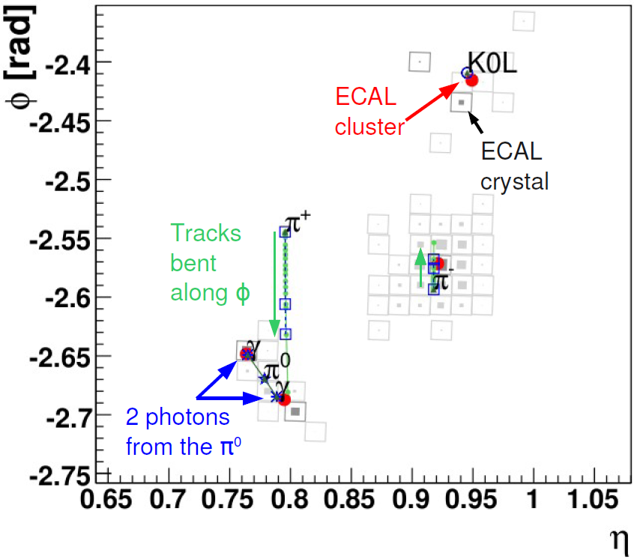
Linking – ECAL view
Track impact within cluster boundaries
→ track & cluster linked

Slide 24
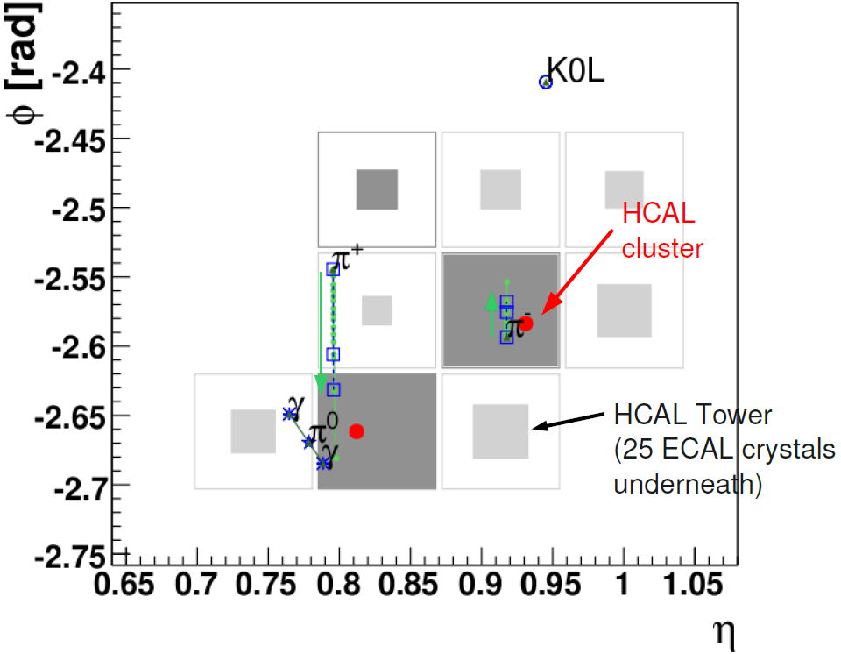
Linking – HCAL view
Track impact within cluster boundaries
→ track & cluster
linked
Clusters overlapping
→ clusters linked

Slide 25
Links and blocks
Links:
  Track-ECAL
  Track-HCAL
  ECAL-HCAL
  Track-track
  ECAL-preshower
The block building rule:
  2 linked PF elements are put in the same blocks
HCAL
ECAL
ECAL
3 typical blocks
Track
Track

Slide 26
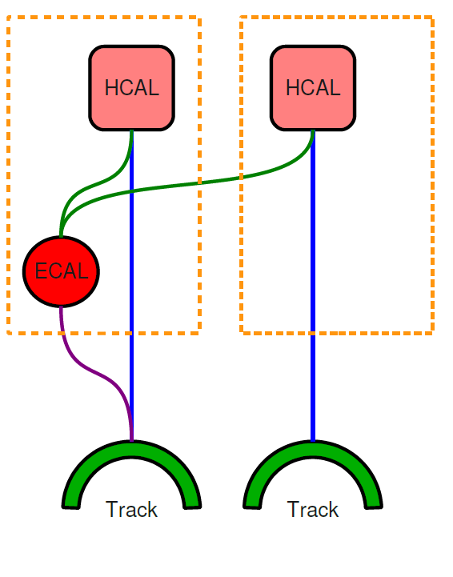
Charged hadrons, overlapping neutrals
For each HCAL cluster, compare:
  Sum of track momenta p
  Calorimeter energy E
    Linked to the tracks
    Calibrated for hadrons
E and p compatible
  Charged hadrons
E > p + 120% √p
  Charged hadrons +
  Photon / neutral hadron
E<<p
  Need attention …
  Rare: muon, fake track

Slide 27
Charged+neutrals: E ≈ p
Charged hadron energy from a fit of p_{i} and E
  i = 1, .. , Ntracks
  Calorimeter and track resolution accounted for
Makes the best use of the tracker and calorimeters
  Tracker measurement
  at low pT
  Converges to calorimeter measurement at high E

Slide 28
Charged+neutrals: E > p
Significant excess of energy in the calorimeters:
E > p + 120% √E
Charged hadrons [ p_{i} ]
Neutrals:
  E from ECAL or HCAL only:
    HCAL → h⁰ [ E – p ]
    ECAL → γ [ E_{ECAL} – p/b ]
  E from ECAL and HCAL:
    E-p > E_{ECAL} ?
      γ [ E_{ECAL} ]
      h⁰ with the rest
    Else:
      γ [ (E – p) / b ]
Always give precedence to photons

Slide 29
Backup slides on tracker/tracking

Slide 30
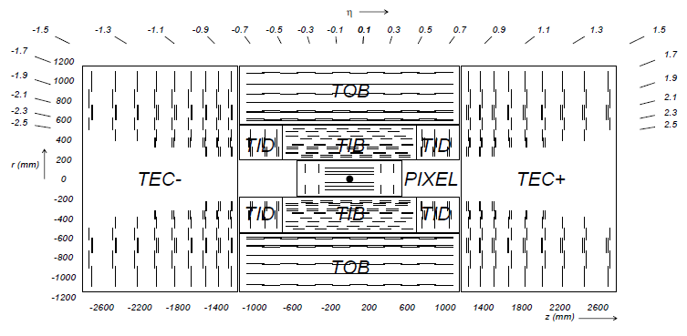
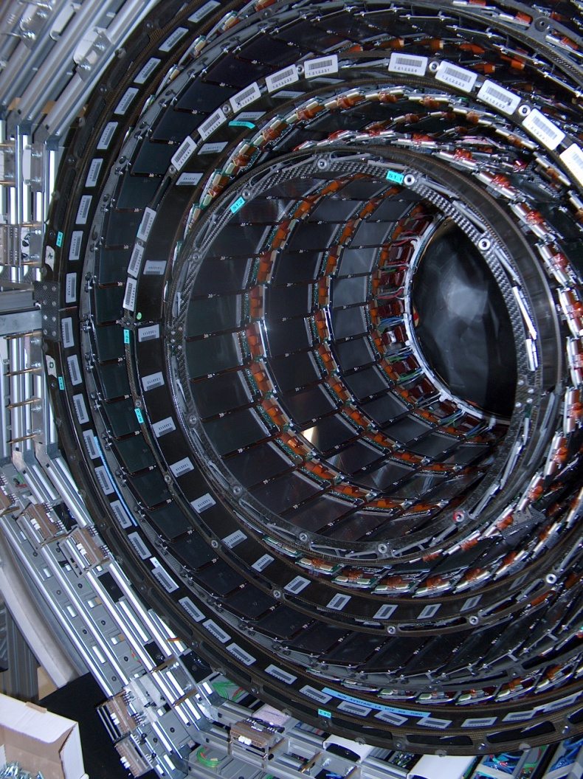
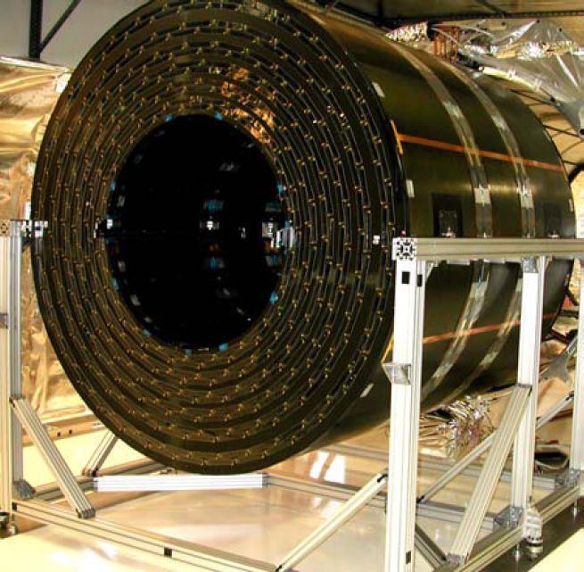
Tracking system
Huge silicon tracker
Hermetic
Highly efficient
TOB
TIB

Slide 31
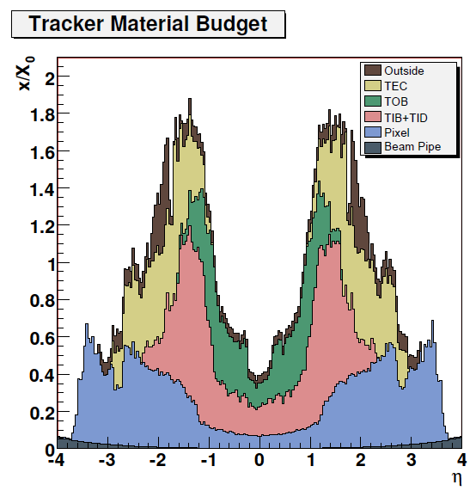
Tracking system
Huge silicon tracker
Hermetic
Highly efficient
But up to 1.8 X0
  Nuclear interactions
  γ conversions
  e- brems

Slide 32
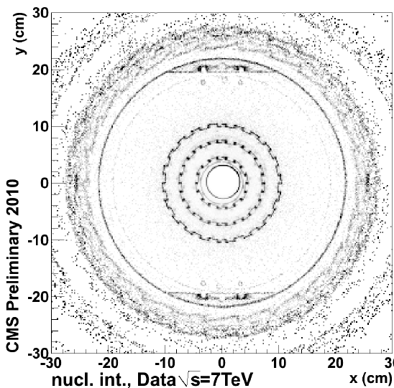
Tracking
Efficient also for secondary tracks
Secondary tracks
used in PF:
  Charged hadrons from nuclear interactions
    No double-counting of the primary track momentum
  Conversion electrons
    Converted brems
    from electrons
Nuclear interaction vertices
Displaced beam pipe!

Slide 33
Backup slides on
PF clustering

Slide 34
PF Clustering
Used in:
  ECAL, HCAL, preshower
Iterative,
energy sharing
  Gaussian shower profile with fixed σ
Seed thresholds
  ECAL : E > 0.23 GeV
  HCAL : E > 0.8 GeV

Slide 35
PF Clustering
Used in:
  ECAL, HCAL, preshower
Iterative,
energy sharing
  Gaussian shower profile with fixed σ
Seed thresholds
  ECAL : E > 0.23 GeV
  HCAL : E > 0.8 GeV

Slide 36
Other Backup slides

Slide 37
MET response

Slide 38
Jet energy resolution (MC)
Factor 2 improvement at low pT
Particle Flow converges to a calorimetric measurement at high pT when calorimetric clusters corresponding to different particles cannot be separated

Slide 39
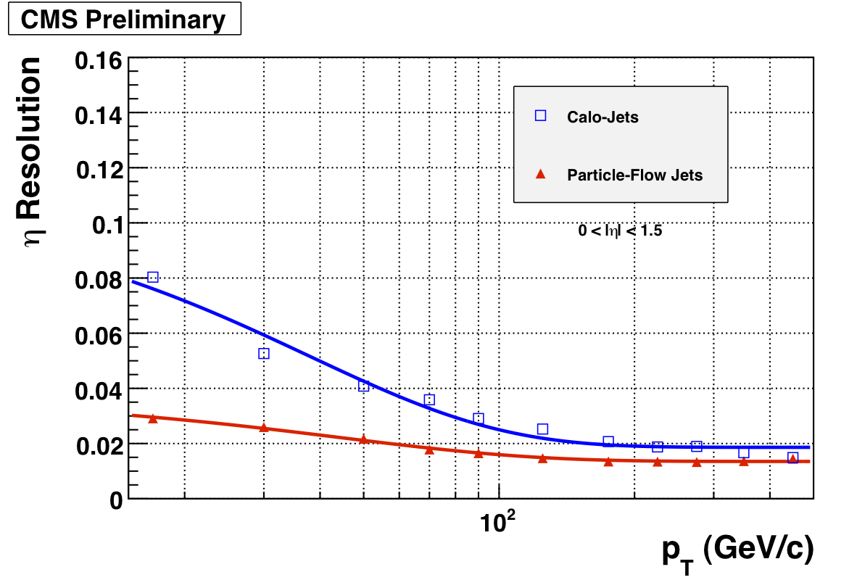
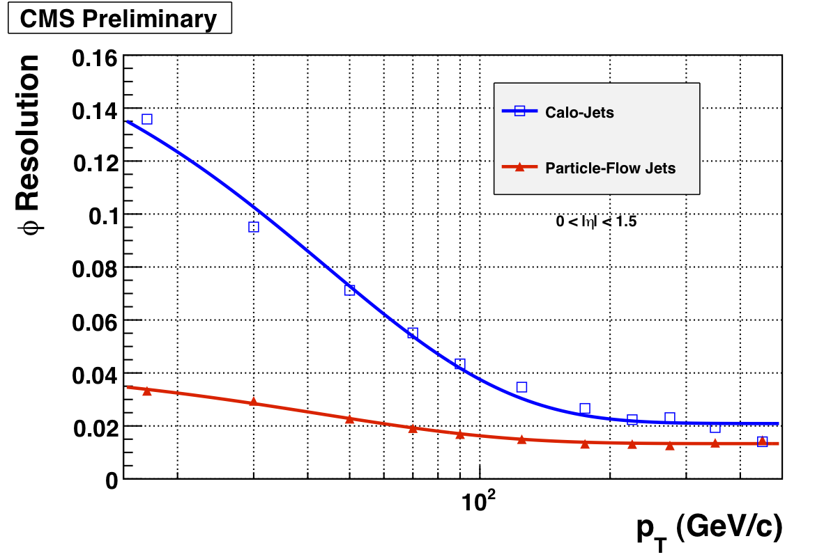
Jets : η and ϕ Resolution
η
ϕ
1 HCAL tower

Slide 40
Recipe for a good particle flow
Separate neutrals
from charged hadrons
  Field integral (BxR)
  Calorimeter granularity
Efficient tracking
Minimize material before calorimeters
Clever algorithm to compensate for detector imperfections
PF Jet,
pT = 140 GeV/c
Data

Slide 41
Recipe for a good particle flow
Strong magnetic field:
3.8 T
ECAL radius 1.29 m
BxR = 4.9 T.m
  ALEPH: 1.5x1.8 = 2.7 T.m
  ATLAS: 2.0x1.2 = 2.4 T.m
  CDF: 1.5x1.5 = 2.25 T.m
  DO: 2.0x0.8 = 1.6 T.m
PF Jet,
pT = 140 GeV/c
Data

Slide 42
Neutral/charged separation (1)
ECAL granularity
A typical jet
  pT = 50 GeV/c
Cell size:
  0.017x0.017
Good!

Slide 43
Neutral/charged separation (2)
HCAL granularity
A typical jet
  pT = 50 GeV/c
Cell size:
  0.085x0.085
  5 ECAL crystals
Bad…

