Slide 1

String Theory & the Future of Particle Physics

Slide 2
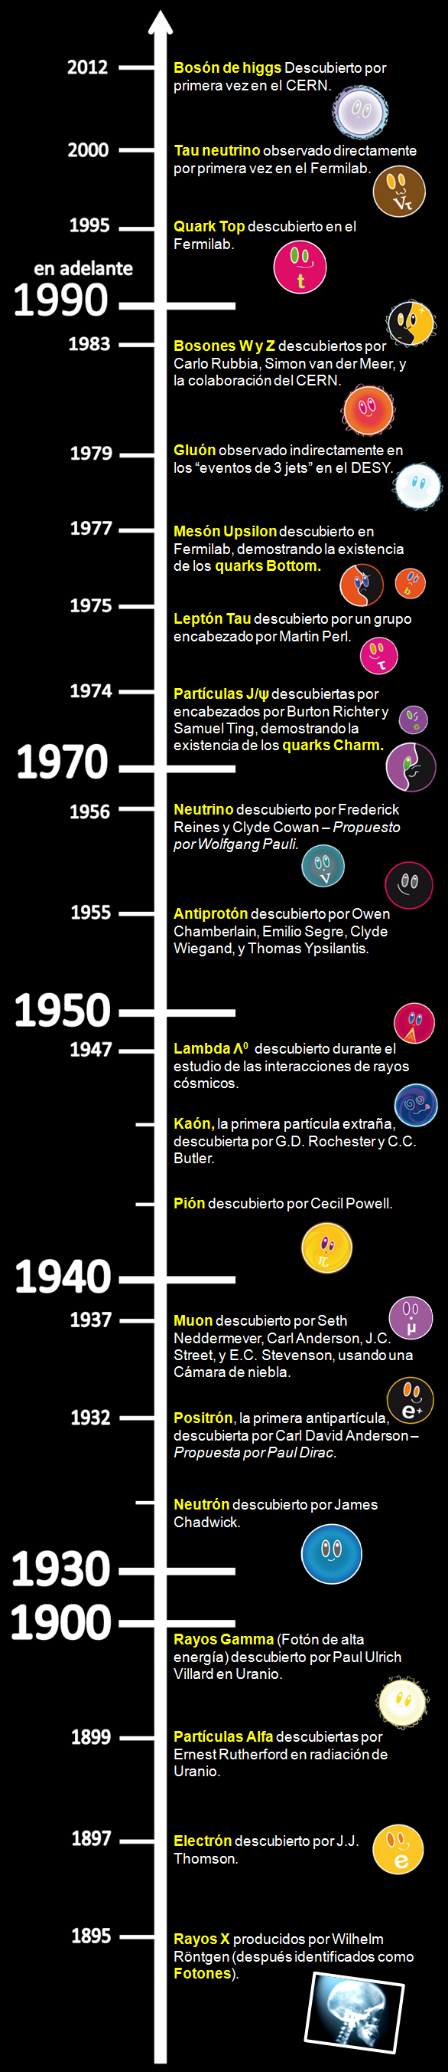

Slide 3

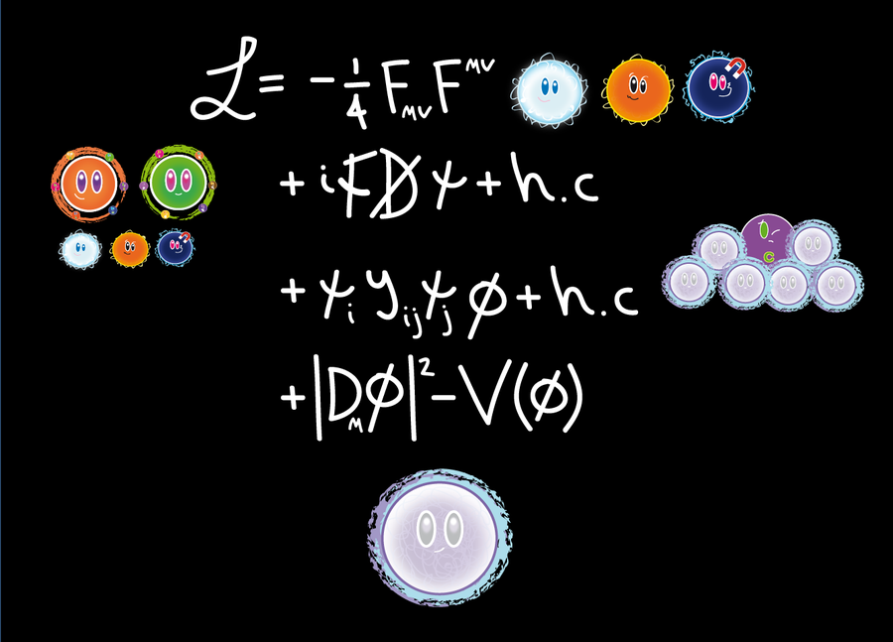
The Standard Model works…
…too good almost.

Slide 4
.
The Standard Model is an Effective Quantum Field Theory.
It has a cut-off, and eventually has to be derived from an underlying theory.
Hints: naturalness, hierarchy problem (?), DARK MATTER!
Ideas: supersymmetry, unification,…
Can be described via Effective QFT.
Why do we need string theory?
Inclusion of gravity, uv-completeness (Planck scale),
cosmological constant problem (?).

Slide 5
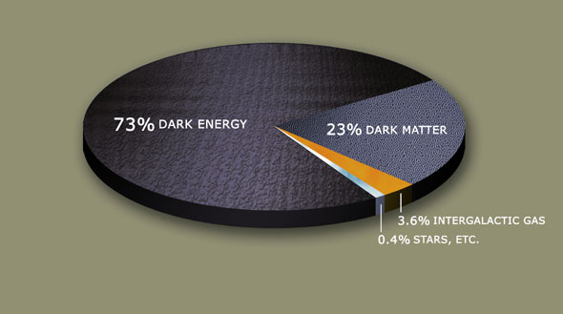


Slide 6
Effective Quantum Field Theory
is based on the idea that one can integrate out
high energy degrees of freedom (massive particles).
It relies on a separation of time and energy scales.
Warning: this does not always work!
Anomalies.
String theory: extended objects, induced gravity.
Condensed matter: emergence of particles/forces.
Glassy systems.

Slide 7
String Theory is an extension of the
framework of QFT. It has a higher degree
of self-consistency:
anomaly cancelations + finiteness
incorporates gravity, black holes…
non-perturbative dualities
Is it UV-complete? Formally, probably yes, but:
String theory is also an effective frameworks.

Slide 8
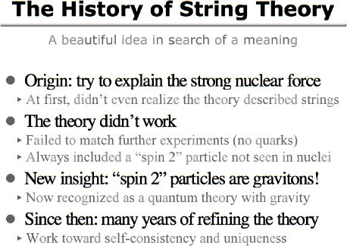

Slide 9

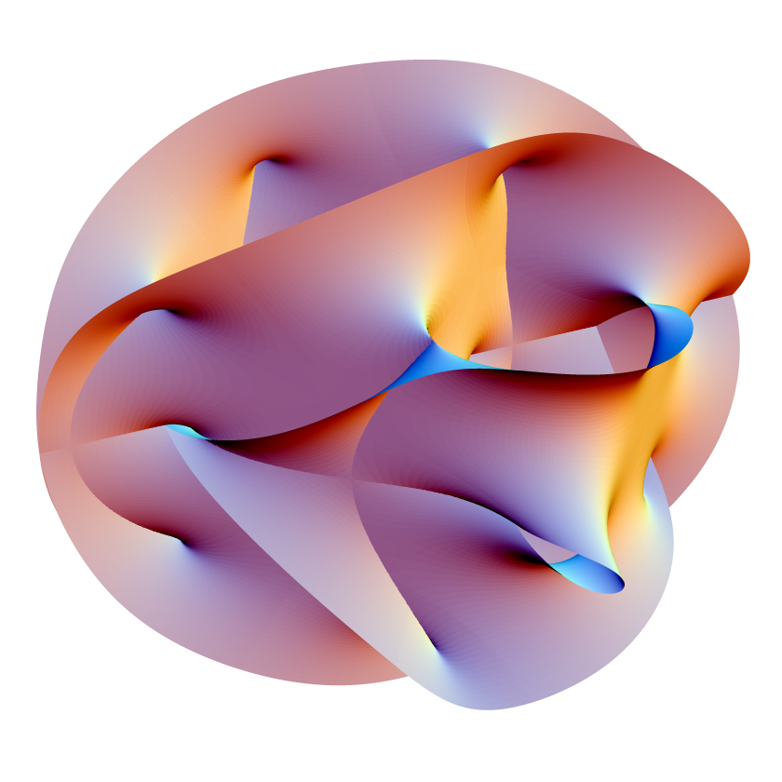
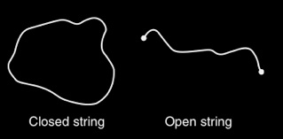
String Theory: “the old view.”
String Theory postulates that particles are represented by vibrating strings that live in 10 dimensions
=> need to compactify.
Consistency of the theory will tell us about beyond SM physics and possibly constrain the parameters of the SM.
It can only be tested by ultra HE experiments.

Slide 10
The (Supersymmetric) Standard Model can be embedded in string theory in more than one way.
Flux compactifications of F-theory.
D-brane constructions.
…
Issues: moduli stabilization
Susy breaking
Cosmological constant

Slide 11
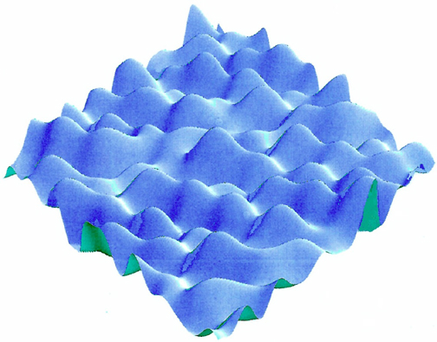
The String Theory Landscape
The Standard
Model

Slide 12
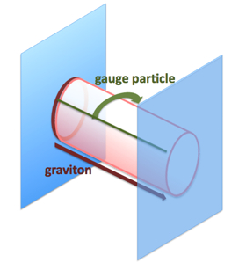
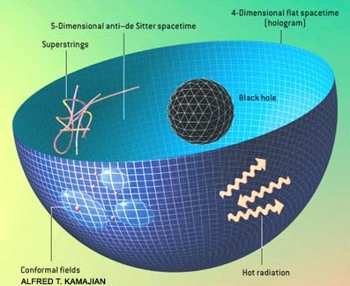
String Theory: “the present view.”
String Theory is a framework that has
succeeded in combining gravity and gauge theory and in some limits is
equivalent to it.
String theory incorporates the holographic principle, describes
black holes, connects the renormalization group to gravity,
and gives hints about the emergence
of space dimensions.

Slide 13
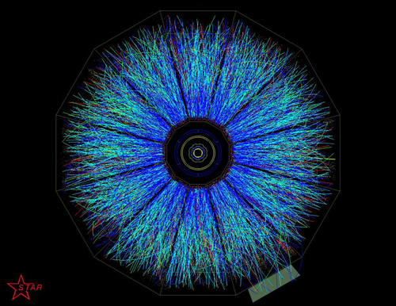
AdS/CFT correspondence.
Open/closed string or
gauge theory/gravity duality
Powerful tool to study strongly
coupled dynamics: quark-gluon plasma
High-Tc- superconductivity.
ONE SPACE DIMENSION EMERGES CORRESPONDING TO THE “SCALE” OF THE BOUNDARY THEORY. RADIAL EVOLUTION IS LIKE RENORMALIZATION GROUP FLOW.

Slide 14
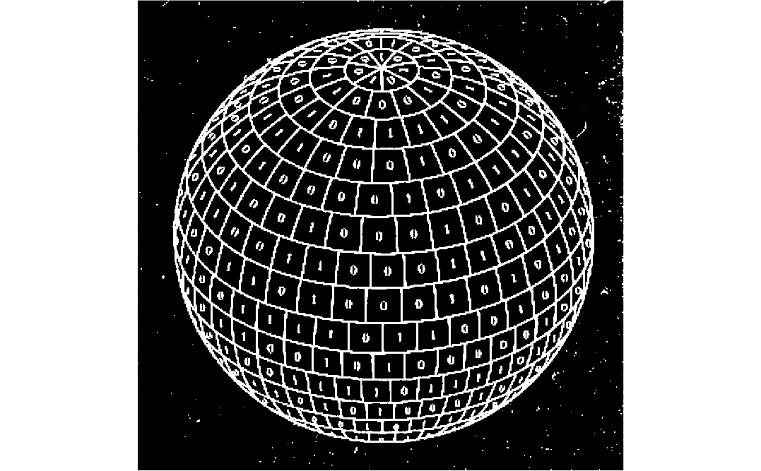

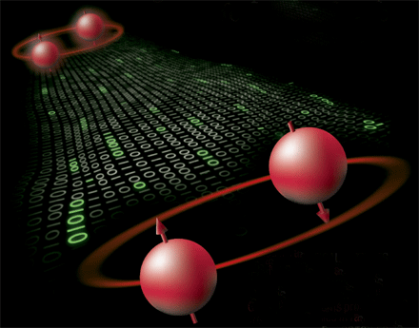
String Theory: “the future view.”
String Theory (or whatever we call it) is a universal framework that starts from basic principles (includes QM).
It tells us how space time, matter and forces emerge together from an underlying microscopic description.
Gravity and the holographic principle
are not assumed but a logical consequence

Slide 15
What about Dark Energy and Dark Matter?
These are emergent too!
Dark Energy and Dark Matter are a logical consequence of the emergent nature of space-time and of gravity.
Eventually, this leads to a new theory of gravity that reproduces Einstein’s General Relativity at short time and distance scales.
But extends it (not modifies it) at large scales by including Dark Matter and Dark Energy in a natural way.

Slide 16
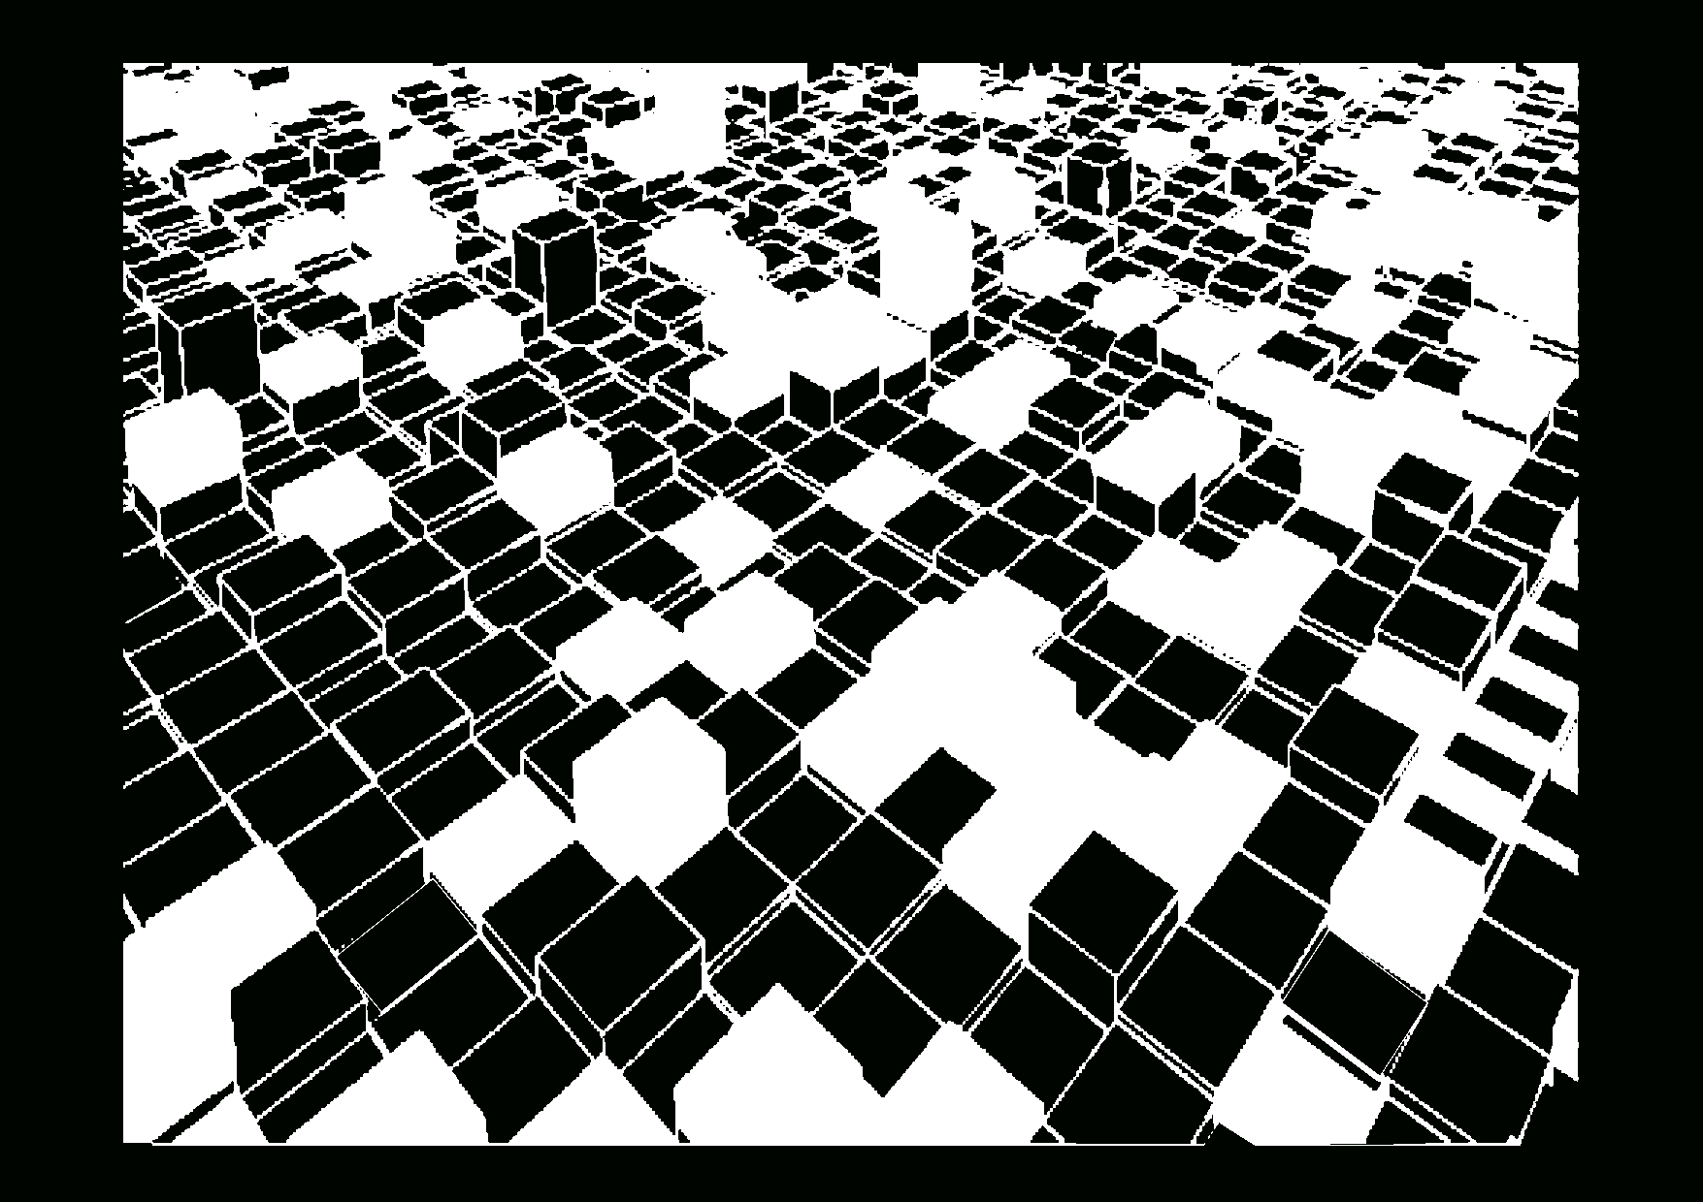
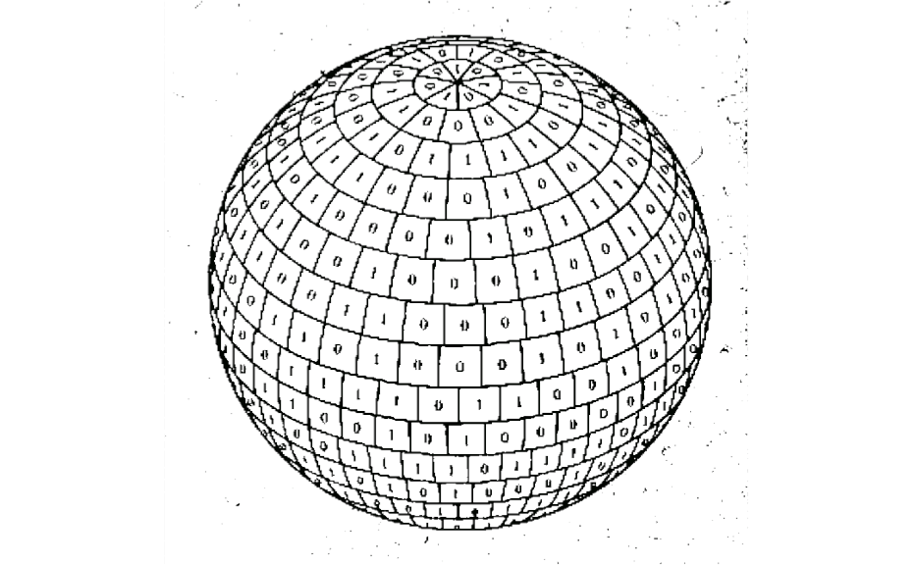
What would be see if we start colliding matter at the highest possible energy?
What are the most fundamental constituents?

Slide 17
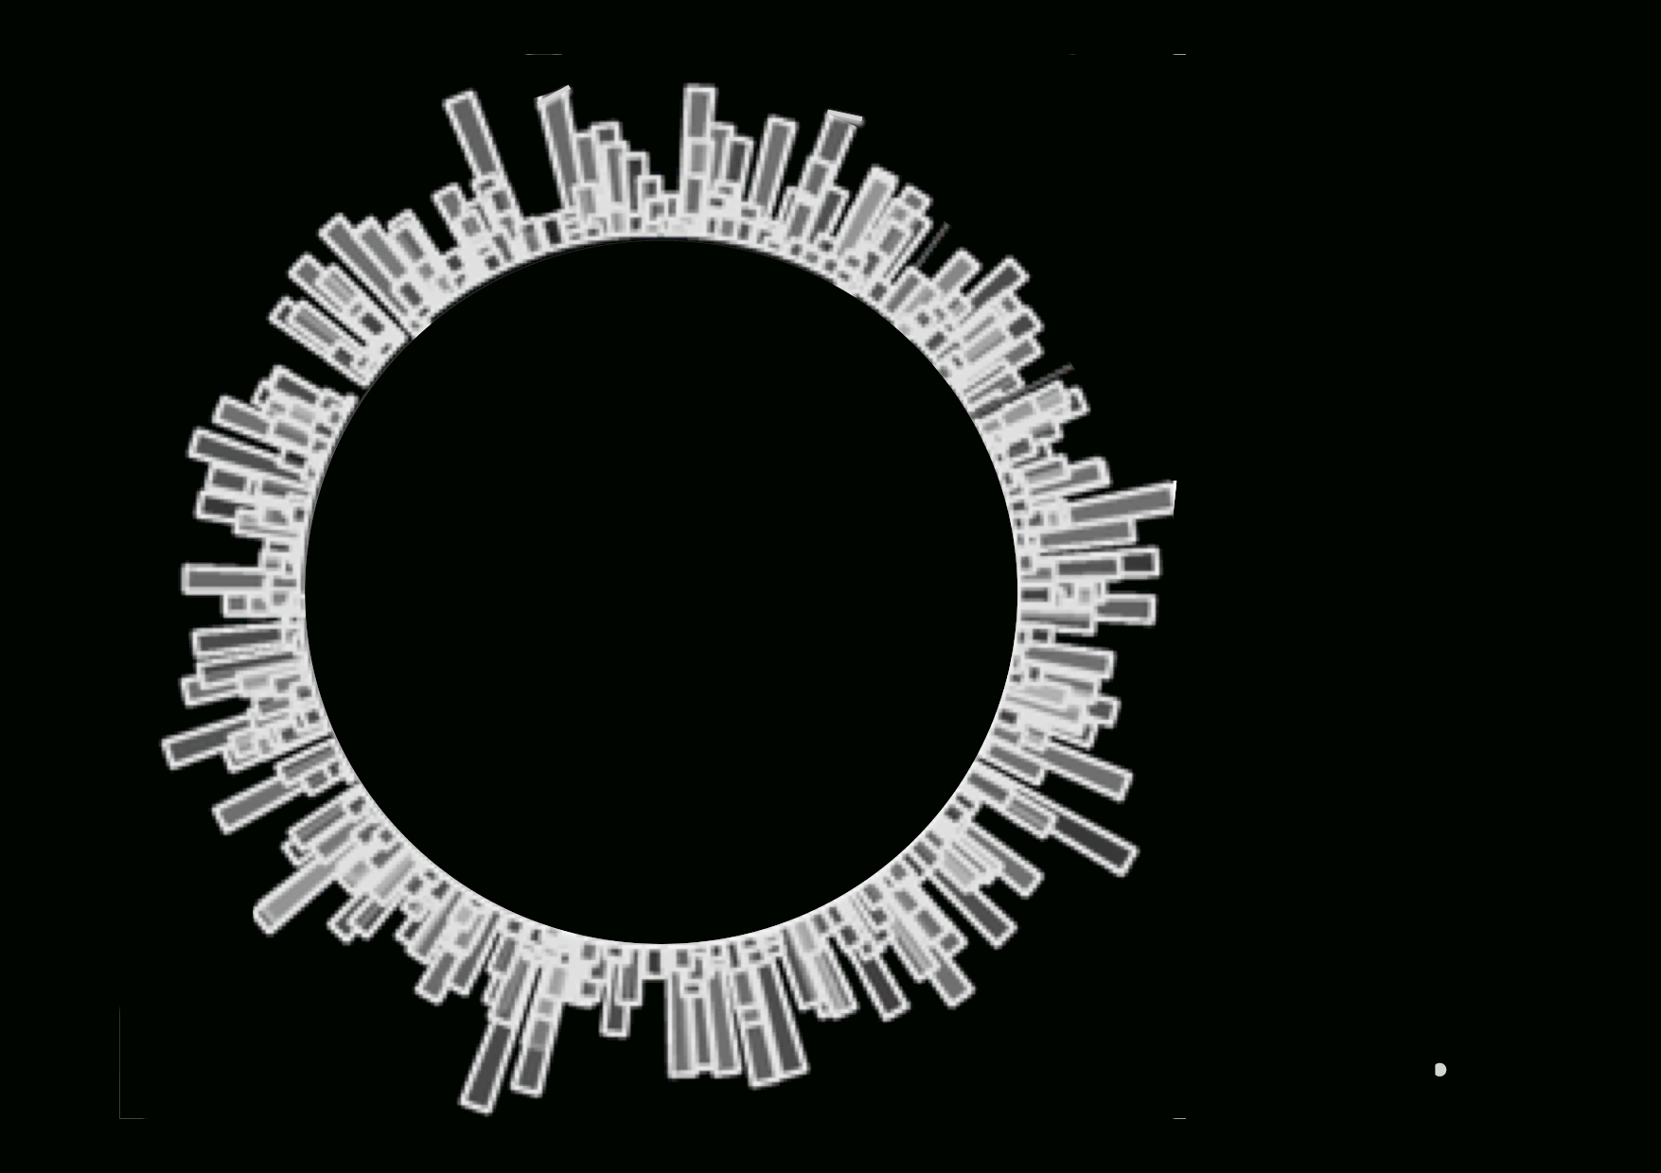
The microscopic phase space is described by the ways in which the N energy quanta with
are distributed over the `calorimetric’ boundary cells.

Slide 18
Statistics operation: why not continuous?

Slide 19
Positions get ambiguous
Coordinates turn
into matrices

Slide 23
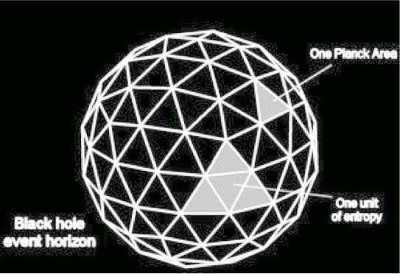
The Bekenstein-Hawking Entropy
Puts a fundamental bound
on the amount of quantum
information ass

Slide 24
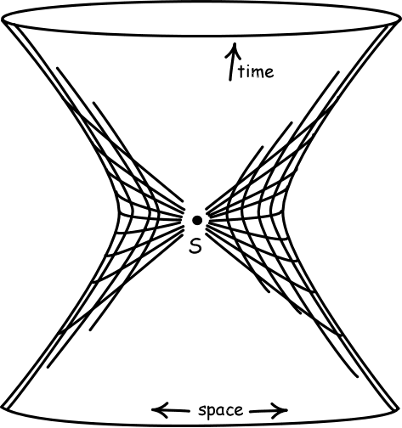
Acceleration
at the Horizon
Cosmological
Horizon
De Sitter
Space

Slide 26
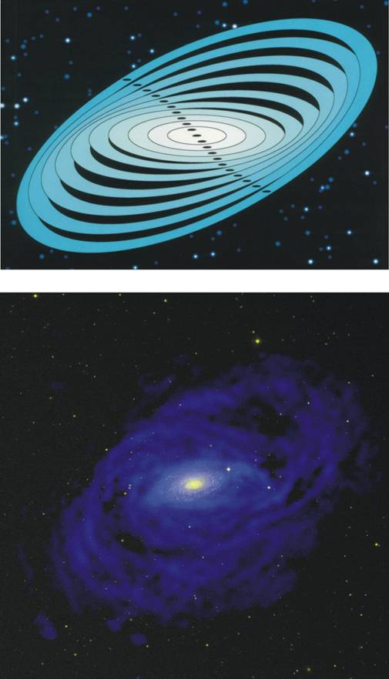
Dark Matter
in Galaxies

Slide 27
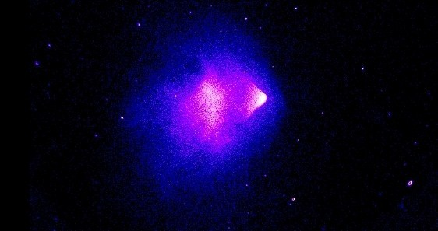

Dark Matter
In Clusters
Bullet
Cluster

Slide 28
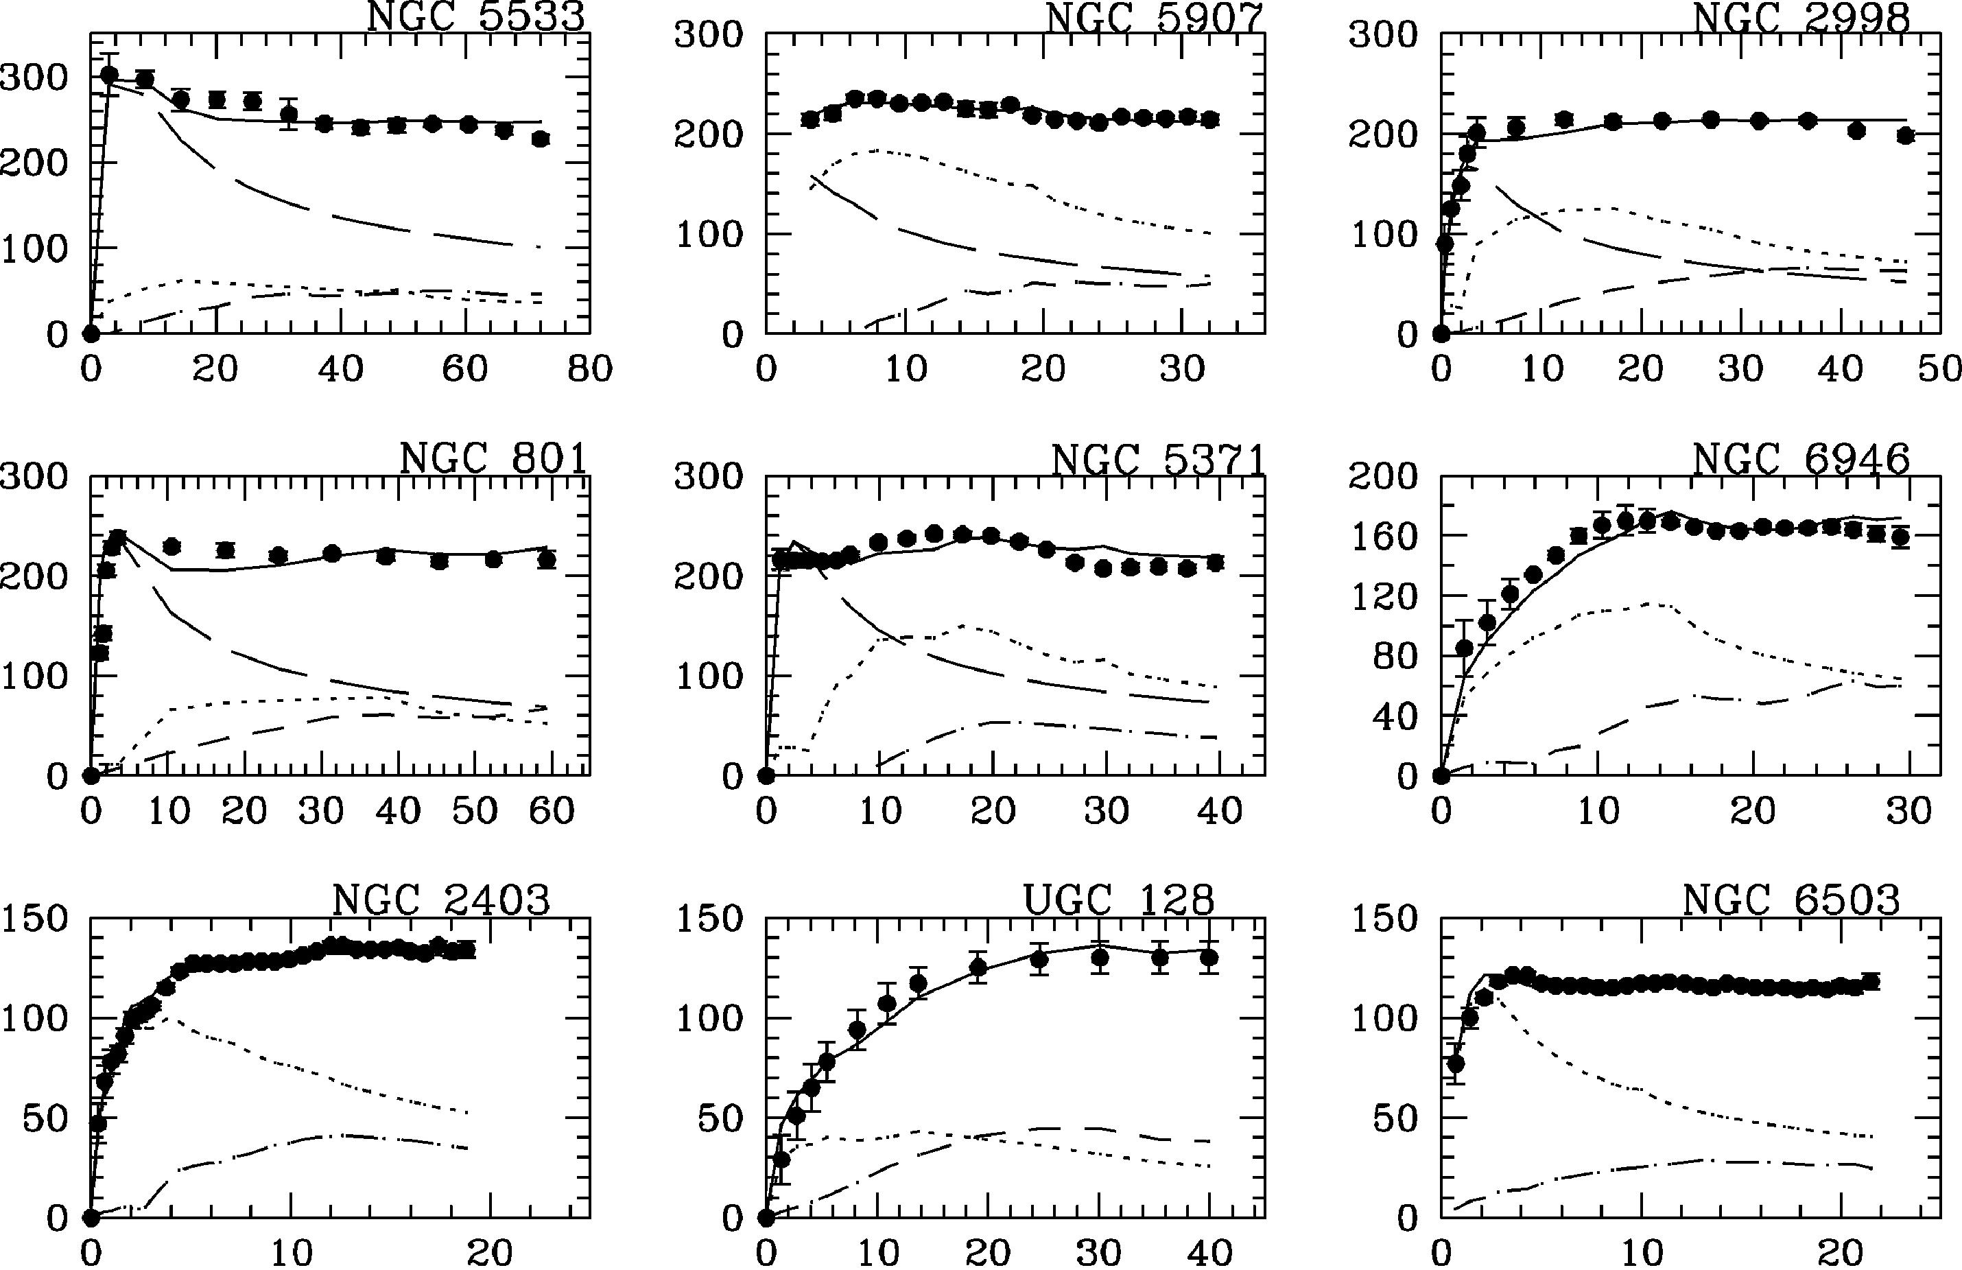

Slide 29
Baryonic Tully-Fisher relation
McCaugh
Why?

Slide 31
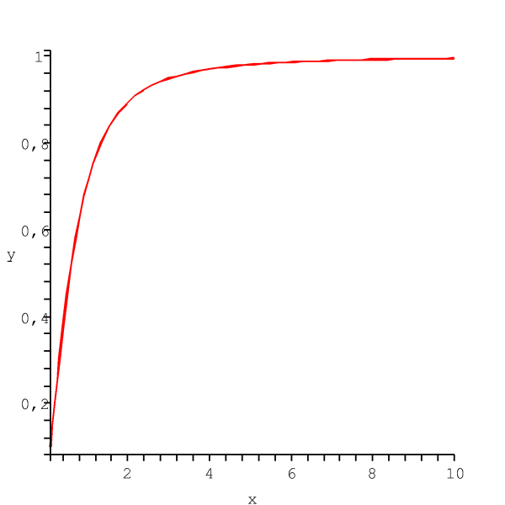

Slide 32
Phenomenological fit: MOND

Slide 33
Typical mass distribution in clusters
M_{dyn}
M_{m}
M_{g}
M*

Slide 34
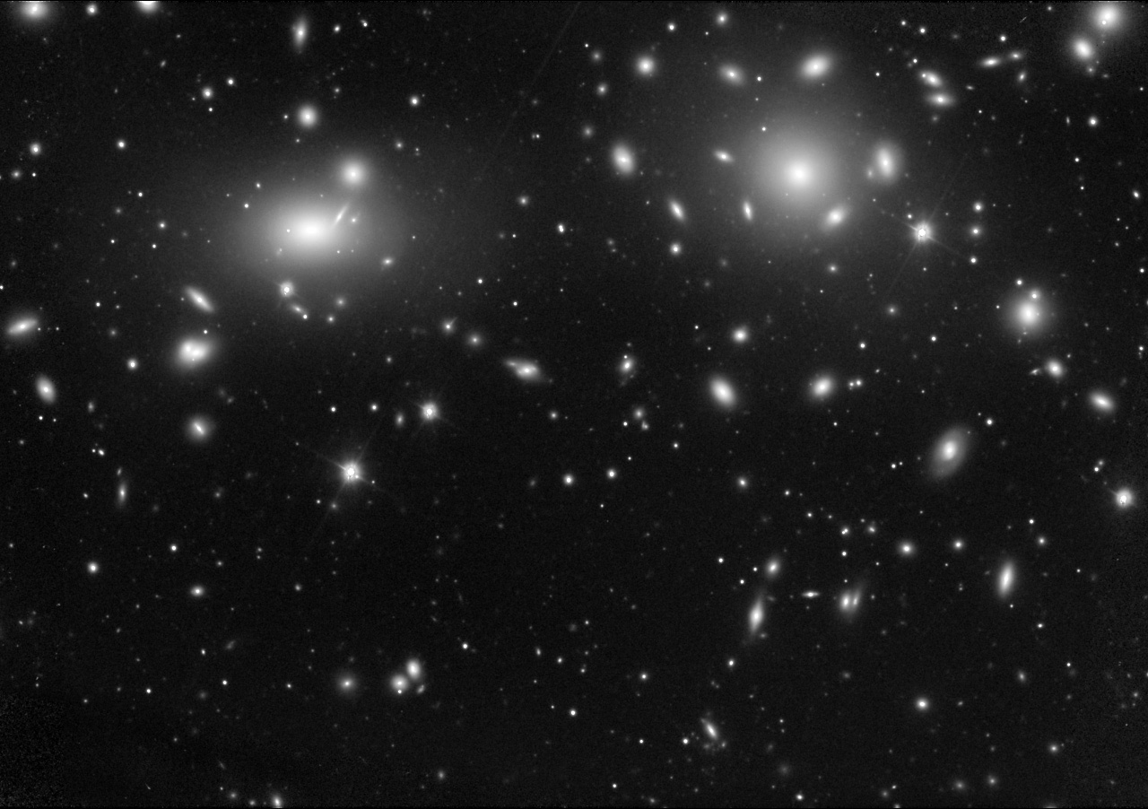
Coma Cluster
(Zwicky 1937,Sanders 2003)
M_{m}
M_{N}
M_{gas}

Slide 35
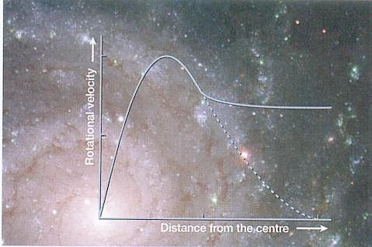
The quantity
can be predicted

Slide 36
Dark Matter appears to be associated with a
slow relaxation process whose size is determined by
“Thermal” fluctuations of the underlying dynamics.
where Newton’s potential has only N modes

Slide 37
A Universal Dark Matter Formula
Or equivalently

Slide 38
Express the masses in terms of average densities
and differentiate with
respect to R

Slide 39
Universal DM formula for average mass densities as a function of R: applies to all cosmic structures
This leads to the following prediction:
Even to the Universe:
4% Baryons =>
22.5% Dark Matter !!

Slide 40
The DM formula gives a precise theoretical
relation between the values of Ω_{c} and Ω_{b} .
Ω_{c}
Ω_{b}

Slide 41
The same relation expressed in terms of directly
measured quantities is affected by the
uncertainty in the measured value of h.
Ω_{c}h²
Ω_{b}h² [in units of h²]

Slide 42
Comparison with the values of Ω_{c}h² and Ω_{b}h² obtained from the
1st year WMAP data.
Ω_{c}h²
Ω_{b}h² [in units of h²]

Slide 43
Measured values of
Ω_{c}h² and Ω_{b}h² from
9 year WMAP data.
Ω_{c}h²
Ω_{b}h² [in units of h²]

Slide 44
Measured values of
Ω_{c}h² and Ω_{b}h² from
Planck (2013) data.
Ω_{c}h²
Ω_{b}h² [in units of h²]

Slide 45
Measured values of Ω_{c}h² and Ω_{b}h² from combined
weighted average of WMAP+ Planck data.
Ω_{c}h²
Ω_{b}h² [in units of h²]

Slide 46


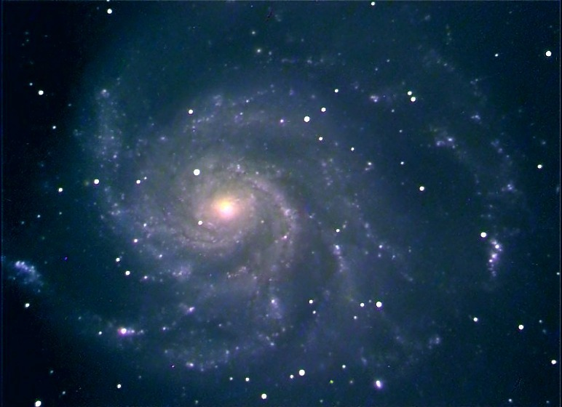
EMERGENT
FORCES
SPACETIME
MATTER
DARK
MATTER
DARK
ENERGY

Slide 47
The Bekenstein-Hawking Entropy
Puts a fundamental bound
on the amount of quantum
information ass

Slide 49
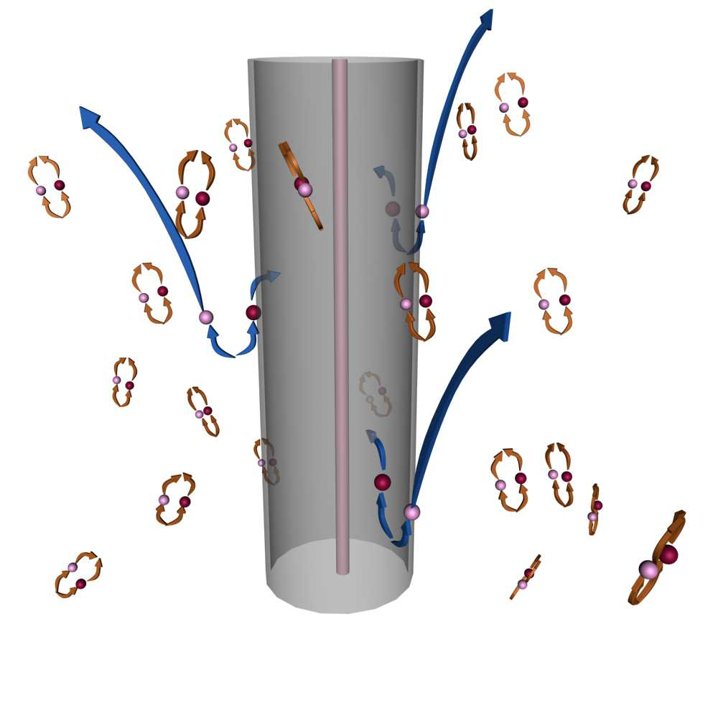
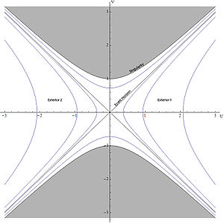
Hawking Temperature

Slide 50
Acceleration
at the Horizon
Cosmological
Horizon
De Sitter
Space

Slide 51
Acceleration
at the Horizon
Cosmological
Horizon
De Sitter
Space

Slide 53
Hongsheng
Zhao

Slide 55
Why do we need String Theory?
Old idea:
Hints about beyond SM physics.
Explanation of SM parameters.

Slide 58
The microscopic phase space is described by the ways in which the N energy quanta with
are distributed over the `calorimetric’ boundary cells.

Slide 59
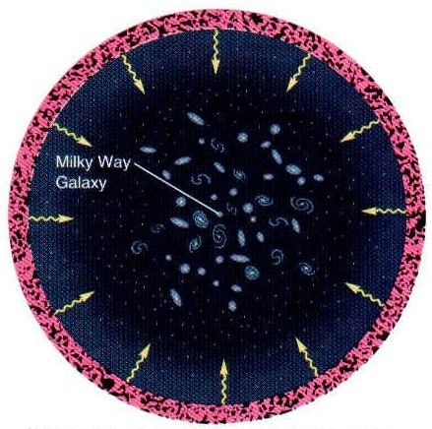

Slide 60
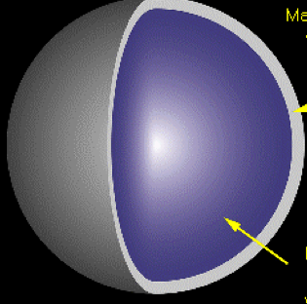
NEUTRON STAR
Degenerate
Fermions
GRAVITATIONAL COLLAPSE:
What happens to the phase space occupied by the fermions?
What about the fermi statistics?

Slide 61
Statistics operation: discrete

Slide 62
Statistics operation: why not continuous?

Slide 63
NEUTRON STAR
Degenerate
Fermions
GRAVITATIONAL COLLAPSE:
What happens to the phase space occupied by the fermions?
What about the fermi statistics?

Slide 64
Positions get ambiguous
Coordinates turn
into matrices

Slide 65
At horizons space and time dissappear.
At horizons the separation of
time scales between the eigenvalues and the “off diagonal modes”
breaks down and the coordinates
become non commuting matrices.

Slide 66
NEUTRON STAR
Degenerate
Fermions
GRAVITATIONAL COLLAPSE:
What happens to the phase space occupied by the fermions?
What about the fermi statistics?

Slide 67
FD/BE statistics => “D-brane” statistics

Slide 68
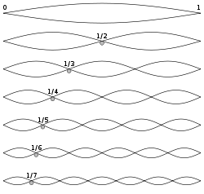


STRING THEORY

Slide 69
Statistics operation: discrete

Slide 70
Statistics operation: discrete

Slide 71
Statistics operation: why not continuous?

Slide 72
Positions get ambiguous
Coordinates turn
into matrices

Slide 73
At horizons space and time dissappear.
At horizons the separation of
time scales between the eigenvalues and the “off diagonal modes”
breaks down and the coordinates
become non commuting matrices.

Slide 75
EMERGENT
FORCES
SPACETIME
MATTER
DARK
MATTER
DARK
ENERGY

Slide 76
String Theory
D-branes

Slide 77
SNAARTHEORIE
WAT ZIJN DE PRINCIPES?

